Slide 1
Who we are and what we do for RedHatters?

Slide 2
What is BEC?
Brnopolis NGO and Brno City Hall
A service office catering to the needs of skilled foreign professionals who are living or working in Brno
BEC is your key partner when settling down in Brno area

Slide 3
What we do ?
formalities and paperwork
daily living issues
networking
enjoying life in Brno
We help to make your life easier

Slide 4
What services?
individual consultation and advice
assisting and interpreting with authorities
organizing networking events
sharing knowledge and contacts online
Flexible to meet your individual needs

Slide 5
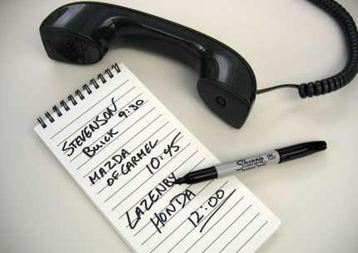
Consulting
in person at our office
via e-mail, on phone
at your work – once a month
We listen to your individual problem and come up with the best solution

Slide 6
Assisting
BEC representative
prepares necessary documents in advance
accompanies clients to authorities to interpret
Smooths out cultural misunderstandings
Keeps track of the process

Slide 7
What is our expertise?
Visas, residence permits
Housing rental and property purchase
Health insurance, medical services
Driving licence, vehicle registration
Trade licensing
Income tax, accounting
Business consulting
Banking and loans
Education, schools and kindergarten
Language courses
Translating and interpreting
Arts and culture
Family and children’s activities
Leisure, sports and hobbies
Everything ☺

Slide 8
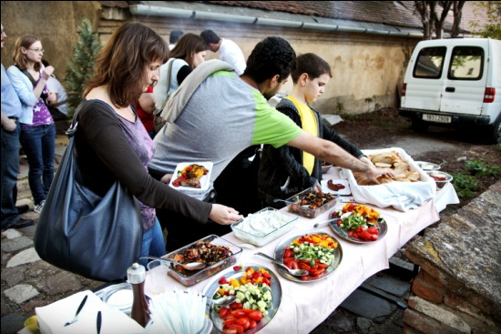

Slide 9
What kind of events?
Expert seminars:
Managing international teams
Work permits
Family life and facilities for parents with children
Sports and leisure opportunities Seminar
Housing (tba)
Health care (tba)

Slide 10
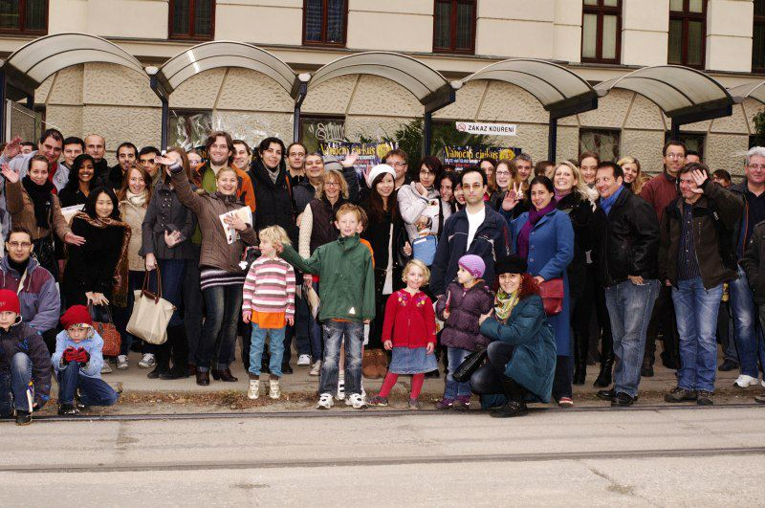
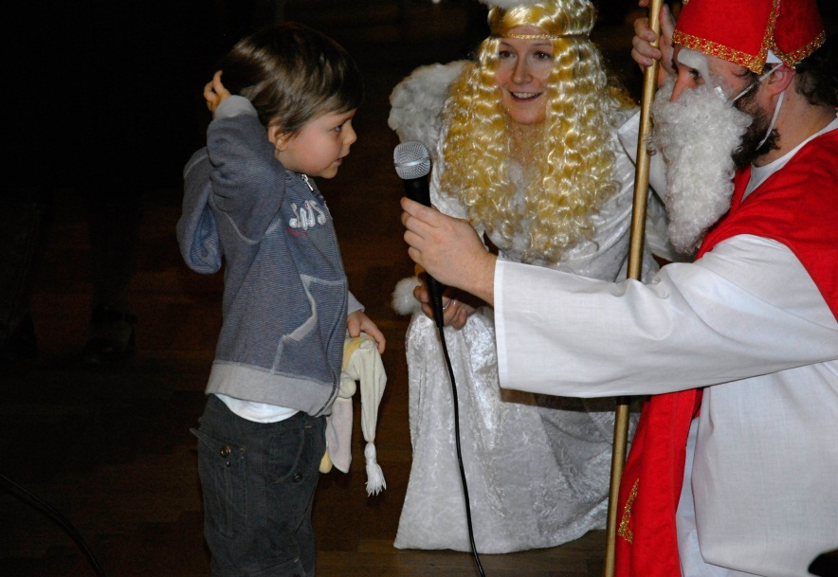
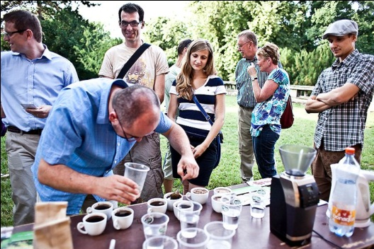
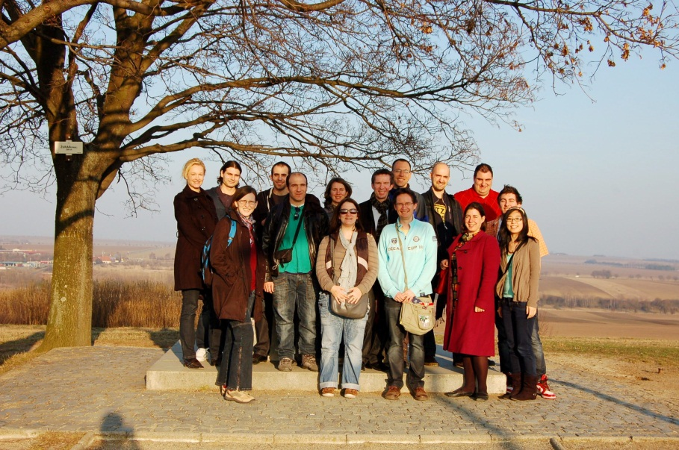

Slide 11
What kind of events?
Fun events:
Brno Tram Joyride
St. Nicholas Eve
Leisure activities
Wine Tastings
Monthly Meetings
Trips

Slide 12
Where can I find out more?
www.BrnoExpatCentre.EU
Whats New
Topic Overview (Working, Housing, Health, Getting about, Education etc.)
Event Calendar
What Expats Say
Forum
Register for Monthly Newsletter

Slide 13
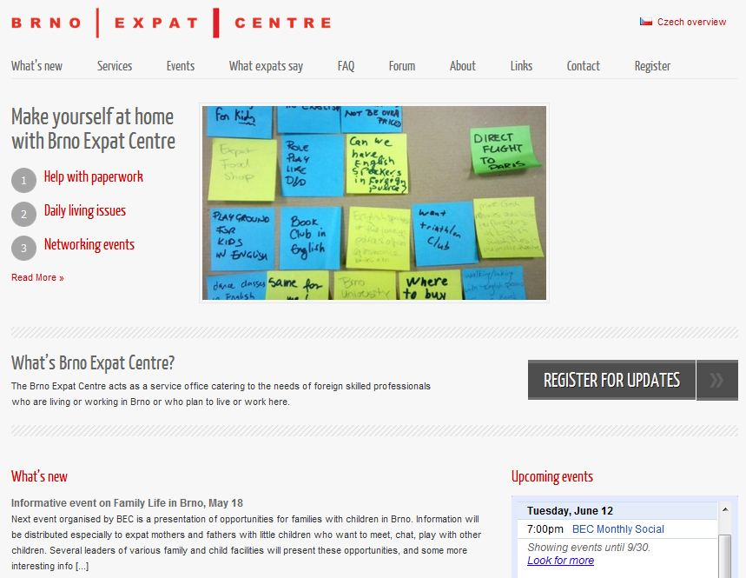

Slide 14
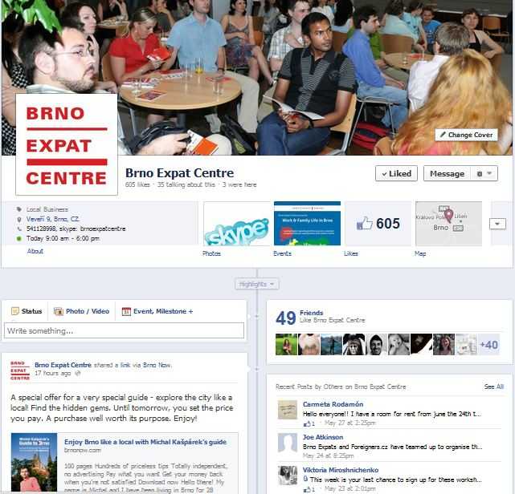
What are your social networks?
Facebook
LinkedIn

Slide 15
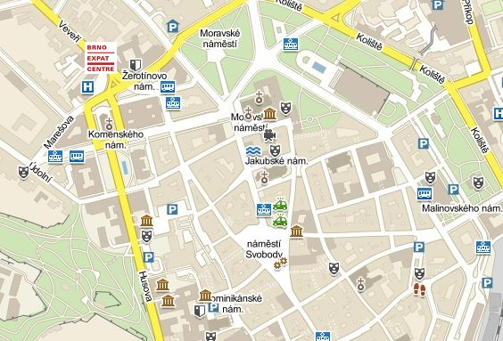
How to contact?
Brno Expat Centre Veveří 9
(tram stop Česká)
info@brnoexpatcentre.eu
Skype: brnoexpatcentre

Slide 16
Our mission is to create an environment in Brno where newcomers feel welcome and easily make a connection to the city and its citizens.

