Slide 1
Making bar chart
The two following figures were created by embedding Excel objects in a PowerPowerpoint presentation.
When imported into Impress, the colors turn to black & white.
This is ironic because it is taken from a lecture about the choice of color in creating graphs.
Last two pictures are embedded PDFs and do not exhibit the problem.

Slide 2
Bar Chart 1

Slide 3
Bar Chart 2

Slide 4
Potential Issues
MS Excel® graphs are designed to look pretty rather than convey information
3D effect on bars
Okay, as long as it doesn’t get in the way of interpretation
Color choices
Red–Green color blindness is very common
Colors are roughly same intensity, so will show up the same on B & W copies
Solution: Look at colors on HSV scale and pick colors that differ on S dimension

Slide 5
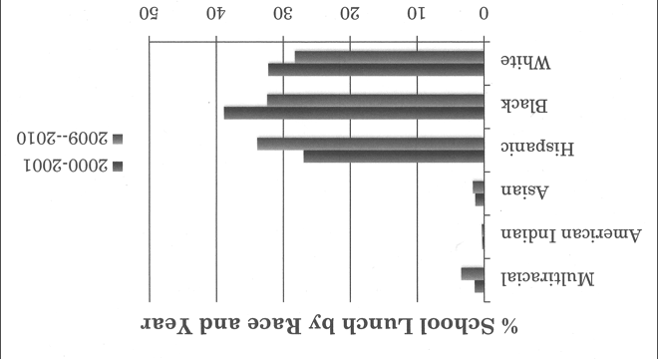
Bar Chart 2 B & W

Slide 6
Bar Chart 2 Improved

