Slide 1
Education program
on preventing upper limbs lymphoedema in patients who are at risk of developing lymphoedema after breast cancer treatment.

Slide 2
Content
Background
Aim
Objective
What is lymphoedema?
  Lymphatic system
  Lymphoedema
  Diagnosis, symptoms and staging of lymphoedema
  Etiology
content of the education topics
  Patient education on lymphoedema and life style changes
  Exercise
  Monitoring and early intervention

Slide 3
Content (continue)
Methods of conducting education program
  Project design
  Patient selection
  Education tool
  assessment via questionnaire
  Measurement of lymphoedema
  Plan of implementation
Evaluation
Conclusion
Group members

Slide 4
Background
Breast cancer is the most common cancer in women (~23% of female cancers)
↑breast cancer survivors → ↑ possible side effects of breast cancer treatment
treatment side effects…
  impair activity function
  quality of life
prevention and management of treatment side effects is importance!!!

Slide 5

Breast cancer related lymphoedema (BCRL)

Slide 6
importance of conducting education programme
Early stage of lymphedema → reversible
SO…
prevention, monitoring and early detection is important!!!

Slide 7
health belief model
most commonly use
Including 6 main
  Perceived seriousness
  Perceived susceptibility
  Perceived benefits
  Perceived barriers
  Cue to action
  Self efficacy
???????

Slide 8

As a nurse…
introduce the pathophysiology,
possible side effect of lymphedema
How common is lymphoedema
↑perceived severity
Goal of program achieved!
↑ Perceived susceptibility
Promote effectiveness of recommended actions of preventing lymphedema
↑ perceived benefit
Providing information
follow up section
↓Perceived barriers
↑ Cue to action
↑ Self efficacy

Slide 9
Aim
develop an education program on preventing upper limbs lymphoedema patients who are at risk of developing lymphoedema after breast cancer treatment

Slide 10
Objective
To enhance knowledge and reinforce their behavior on awareness of preventing lymphoedema among post breast cancer treatment patient
To decrease the incidence rate of lymphoedema

Slide 11
What is lymphoedema?
Lymphatic system
-produce cells and antibodies, destruct red cells and lymph circulation
-made up of the network of collecting vessels as the transport throughout the body, and, the lymph nodes which interposing along the lymphatic vessel and filtering the lymph
-higher hydrostatic pressure in blood vessel→ pushes the fluid out of the veins into the interstitial space→ enter the lymphatic capillaries (Production of lymph )→ moves along capillaries and finally drain back into the venous system

Slide 12
What is lymphoedema?
2 Type of lymphedema
  Primary
    Congenital or Hereditary
  Secondary
    Due to acquired causes
Quantitative problem between the lymphatic load and the lymphatic transport capacity.
Lymphedema will arise as a result of local accumulation of body fluid in body tissue but cannot be drained efficiently.
If left it untreated, progressively, a chronic condition with extremity deformity
Notes:
<number>

Slide 13
Diagnosis method for lymphoedema
Up to now, no International standard criteria
Two most common criteria
  Comparing the affected limb and the unaffected limb
  Comparing the affected limb periodically
Notes:
<number>

Slide 14
Diagnosis method for lymphoedema
3 method to could be use for measurement
  Circumferential limb measurement
  Water displacement
  Perometry
Notes:
<number>

Slide 15
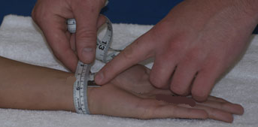
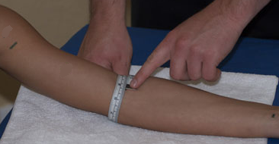
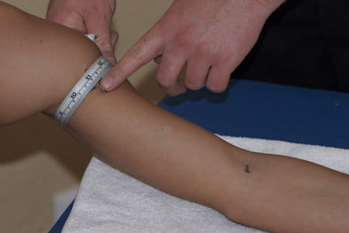
Circumferential limb measurement
Notes:
<number>

Slide 16
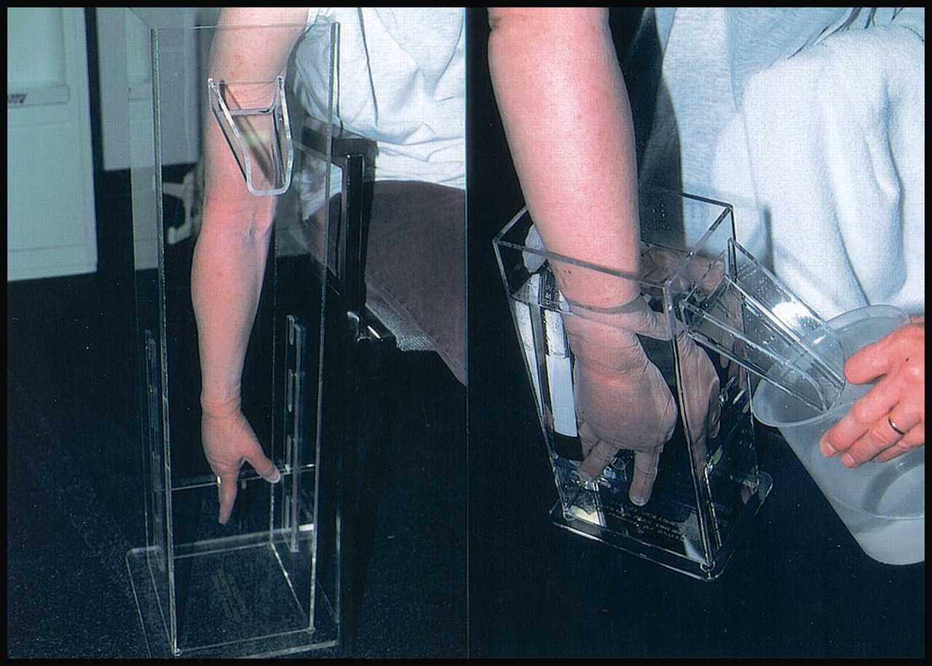
Water displacement
Notes:
<number>

Slide 17
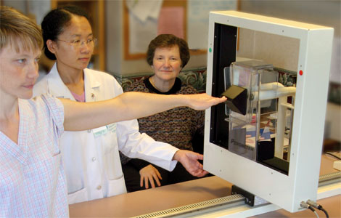
Perometry
Works similar to CT but used infrared light instead of X ray.
Notes:
<number>

Slide 18
Diagnosis method for lymphoedema
 | Cost | Easy to use | Time involved | Pros | Cons
Circumferential limb measurement | Very low | Very easy | Long | Can do it every where | Consistency of each measurement
Water displacement | Very low | Ok | Medium | Sensitive and accurate | Not suitable with wounds and lesion
Perometry | Very high | Very easy | Low | Volume changes calculated in seconds. | The cost of this diagnostic methods is high.
Notes:
<number>

Slide 19
Symptoms for lymphoedema
Feelings of swelling, tightness, heaviness, pain, burning
Numbness in the affected arm, shoulder girdle or thoracic region
Limited mobility in the affected hand, wrist, elbow and shoulder.
Notes:
<number>

Slide 20
Symptoms for lymphoedema
Such symptoms might indicate sub-clinical lymphoedema
They are warning signs
  Early intervention is needed.
Notes:
<number>

Slide 21
Different staging of lymphoedema
Latency stage
  Transport capacity decrease
  No visible edema
  Nil complaint
Notes:
<number>

Slide 22
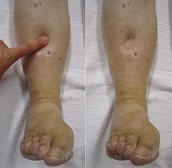
Different staging of lymphoedema
Stage I – Reversible Stage
  Accumulation of protein rich edema fluid
  Pitting edema
  Decrease with elevation
Notes:
<number>

Slide 23
Different staging of lymphoedema
Stage II - Spontaneously irreversible
  Accumulation of protein rich edema fluid
  Pitting becomes progressively more difficult
  Connective tissue proliferation
Notes:
<number>

Slide 24
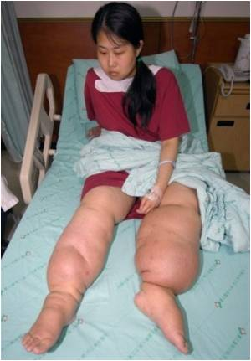
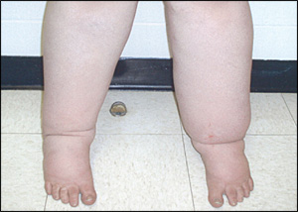
Different staging of lymphoedema
Stage III - Elephantiasis
  Accumulation of protein rich edema fluid
  Non-Pitting
  Fibrosis and
sclerosis
  Skin changes
(papillomas, hyperkeratosis)
Notes:
<number>

Slide 25
Etiology
1. The extent of surgery to the breast has been shown to influence rate of BCRL
Mastectomy and axillary lymph nodes dissection decreases the transport capacity of the entire lymph vascular system.
-32% after radical mastectomy
-20-30% incidence after modified radical mastectomy
-17-27% after ALND
-If only partial mastectomy and no ALND was done, the incidence would greatly reduced to 5%.

Slide 26
Etiology
2. Adjuvant radiotherapy to axillary
RT increase risk of tissue fibrosis, causing constriction of lymphatic channels.
Delays growth of new lymphatics into tissue healing after surgery and inhabits the normal lymphatic response to inflammatory site.
The incidence rate of BCRL after axillary RT was 14%.

Slide 27
Other related factor
Staging at diagnosis is another factor for developing lymphoedema.
Infection
Old age
Obesity
Lack of exercise
Operation in dominant hand
Trauma to the operated arms
Excessive limb use
Local application of heat and generalized hrating such as immersion in hot tub baths

Slide 28
content of the education topics
-Patient education on lymphoedema and life style changes
  Cause and risk factor of lymphoedema
  life style advice
  early detection of lymphoedema
-Exercise
-Monitoring and early intervention
  regular follow-up appointments

Slide 29
Method

Slide 30
Project design
Questionnaire
  Pre-test and post-test
  To evaluate the knowledge on preventive strategies on lymphoedema
Measurement
  Arm circumference
When follow up
  Symptoms of lymphoedema?
  Compliance to preventive strategies

Slide 31
Patient selection
Include
  Chinese women
  New case in PYNEH
  Undergo MRM for breast cancer
  with or without axillary lymph node dissection
  Undergo axillary RT for breast cancer

Slide 32
Patient selection
Exclude
  impaired cognitive function
  coexisting arm morbidities due to previous fracture or surgery
  already diagnosed with lymphoedema
Selection period
  Half year

Slide 33
Education tool
Education video
  life style changes, exercise, monitoring and early intervention
Well accepted by the mean age group (51.2) of breast cancer
No extra work to health care providers

Slide 34
Education tool
When talking about…
  precautions
  Educate and empower
  Not restriction
  Knowledge of pathophysiology
  Easily understood
  Exercise
  Demonstration
  E.g. video

Slide 35
Questionnaire and checklists

Slide 36
Questionnaire
About knowledge of preventiing lymphoedema
  To test their knowledge
  To be done after the video
included 10 multiple choice questions
covered with
  Pathrophysiology
  risk factors
  signs and symptoms of lymphoedema
  prevention strategies of developing lymphoedema
Opinions will be obtained by three experts in oncology department

Slide 37
Checklists
checklists on lymphedema symptoms
  a tool to assess participants symptoms on lymphedema, include
  swelling
  Heaviness
  breast swelling
  Firmness
  Numbness
  Tenderness
  Aching
  Stiffness
  impaired limb mobility
  arm weakness
  respond with “yes” or “no” regarding whether a symptom is currently present

Slide 38
Checklists
Checklist on lymphedema risk reduction behavior
  a tool to assess survivors’ practice of risk education behaviors
  included with four behavior domains as
  skin care
  Lifestyle
  avoid limb constriction
  prevent extremes of temperature

Slide 39
Lymphedema measurement
To examine arm circumference of participants
  Circumferential limb measurement

Slide 40
Plan of implementation
Potential lymphedema cases were identified
  by a researcher in outpatient clinics
  by screening patients during new case consultation
Selection period
  Half year

Slide 41
Plan of implementation
Potential cases
  invited to join the education programme
  baseline assessment on bilateral arms circumference would be obtained
  explanation were given
  invited to join the breast cancer case manager activities
  originally set up in out-patient clinic
  Being held every month

Slide 42
Plan of implementation
After each breast cancer case manager activities completed
  the new participants would be…
  asked to stay
  To complete the Questionnaire about knowledge of preventing lymphoedema.
  To watch a video
  To complete the Questionnaire again.

Slide 43
Plan of implementation
Duration of following each case
  One year
When follow up in OPD
  measured bilateral arms circumference
  lymphoedema symptoms
  risk reduction behavior
  to detect early signs of lymphoedema
  by completing the checklists
  reinforce the compliance

Slide 44
Plan of implementation
If 2 cm or greater difference in limb girth measured from the bilateral arms
  referred to physician
  for the diagnosis of lymphedema.
If symptoms of lymphedema noted,
  referred to physician
  for early treatment of lymphedema.

Slide 45
Evaluation plan
At the end of the programme
  the difference of the average marks of pre-test and post –test results would be calculated
  if the average marks of the test after attending the video talk increased
  the participants’ knowledge on lymphedema would be increased after the talk.

Slide 46
Evaluation plan
incidence rate of lymphedema
  The number of diagnosis of lymphedema last year
  The number of diagnosis after one year of breast cancer
  obtained by reviewing the computerized patient records
  before the start of the programme..

Slide 47
Evaluation plan
Incidence rate of lymphedema
  If the incidence rate decreased after the programme
  indicate the effectiveness of the programme

Slide 48
Conclusion
Living with lymphedema would greatly affect breast cancer survivor on daily living and also psychosocial aspects. Prevention and early detection of BCRL was valuable.
With the use of educational programme, breast cancer survivors could identified the consequence and risk factor of BCRL and so to carryout preventive measures and monitor her condition time to time.

