Slide 1
Operating Systems:
Storage: Disks & File Systems
INF1060:
Introduction to Operating Systems and Data Communication
Pål Halvorsen
Wednesday, October 12, 2011

Slide 2
Overview
(Mechanical) Disks
Disk scheduling
Memory/buffer caching
File systems

Slide 3

Disks
tertiary storage
(tapes)
Disks ...
  are used to have a persistent system
  are cheaper compared to main memory
  have more capacity
  are orders of magnitude slower
Two resources of importance
  storage space
  I/O bandwidth
We must look closer on how to manage disks, because...
  ...there is a large speed mismatch (ms vs. ns) compared to main
  memory (this gap still increases)
  ...disk I/O is often the main performance bottleneck
secondary storage
(disks)
main memory
cache(s)

Slide 4
Mechanics of Disks
Spindle
of which the platters
rotate around
Tracks
concentric circles on a
single platter
Platters
circular platters covered with
magnetic material to provide
nonvolatile storage of bits
Disk heads
read or alter the magnetism (bits) passing under it. The heads are attached to an arm enabling it to move across the platter surface
Sectors
segment of the track circle –
usually each contains 512 bytes –
separated by non-magnetic gaps.
The gaps are often used to identify
beginning of a sector
Cylinders
corresponding tracks on the different
platters are said to form a cylinder

Slide 5
Disk Capacity
The size (storage space) of the disk is dependent on
  the number of platters
  whether the platters use one or both sides
  number of tracks per surface
  (average) number of sectors per track
  number of bytes per sector
Example (Cheetah X15.1):
  4 platters using both sides: 8 surfaces
  18497 tracks per surface
  617 sectors per track (average)
  512 bytes per sector
  Total capacity = 8 x 18497 x 617 x 512 ≈ 4.6 x 10¹⁰ = 42.8 GB
  Formatted capacity = 36.7 GB
Note:
there is a difference between formatted and total capacity. Some of the capacity is used for storing checksums, spare tracks, gaps, etc.

Slide 6
Disk Access Time
How do we retrieve data from disk?
  position head over the cylinder (track) on which the block (consisting of one or more sectors) are located
  read or write the data block as the sectors are moved under the head when the platters rotate
The time between the moment issuing a disk request and the time the block is resident in memory is called disk latency or disk access time

Slide 7
Disk Access Time
I want
block X
block x
in memory
Disk platter
Disk access time =
Disk head
Seek time
+ Rotational delay
+ Transfer time
Disk arm
+ Other delays

Slide 8
Disk Access Time: Seek Time
Seek time is the time to position the head
  the heads require a minimum amount of time to start and stop moving the head
  some time is used for actually moving the head –
  roughly proportional to the number of cylinders traveled
  Time to move head:
number of tracks
seek time constant
fixed overhead
Time
“Typical” average:
10 ms → 40 ms (old)
7.4 ms (Barracuda 180)
5.7 ms (Cheetah 36)
3.6 ms (Cheetah X15)
~ 10x - 20x
x
Cylinders Traveled
1
N

Slide 9
Disk Access Time: Rotational Delay
Time for the disk platters to rotate so the first of the required sectors are under the disk head
head here
Average delay is 1/2 revolution
“Typical” average:
8.33 ms (3.600 RPM)
5.56 ms (5.400 RPM)
4.17 ms (7.200 RPM)
3.00 ms (10.000 RPM)
2.00 ms (15.000 RPM)
block I want

Slide 10
Disk Access Time: Transfer Time
Time for data to be read by the disk head, i.e., time it takes the sectors of the requested block to rotate under the head
Transfer time is dependent on data density and rotation speed
Transfer rate =
Transfer time = amount of data to read / transfer rate
Transfer rate example
  Barracuda 180:
  406 KB per track x 7.200 RPM ≈ 47.58 MB/s
  Cheetah X15:
  306 KB per track x 15.000 RPM ≈ 77.15 MB/s
If we have to change track, time must also be added for moving the head
amount of data per track
time per rotation
Note:
one might achieve these transfer rates reading continuously on disk, but time must be added for seeks, etc.

Slide 11
Disk Access Time: Other Delays
There are several other factors which might introduce additional delays:
  CPU time to issue and process I/O
  contention for controller
  contention for bus
  contention for memory
  verifying block correctness with checksums (retransmissions)
  waiting in scheduling queue
  ...
Typical values: “0”
(maybe except from waiting in the queue)

Slide 12
Disk Specifications
Note 1:
disk manufacturers usually
denote GB as 10⁹ whereas
computer quantities often are
powers of 2, i.e., GB is 2³⁰
Some existing (Seagate) disks:
 | Barracuda 180 | Cheetah 36 | Cheetah X15.3
Capacity (GB) | 181.6 | 36.4 | 73.4
Spindle speed (RPM) | 7200 | 10.000 | 15.000
#cylinders | 24.247 | 9.772 | 18.479
average seek time (ms) | 7.4 | 5.7 | 3.6
min (track-to-track) seek (ms) | 0.8 | 0.6 | 0.2
max (full stroke) seek (ms) | 16 | 12 | 7
average latency (ms) | 4.17 | 3 | 2
internal transfer rate (Mbps) | 282 – 508 | 520 – 682 | 609 – 891
disk buffer cache | 16 MB | 4 MB | 8 MB
Note 2:
there is a difference between internal and formatted transfer rate. Internal is only between platter. Formatted is after the signals interfere with the electronics (cabling loss, interference, retransmissions, checksums, etc.)
Note 3:
there is usually a trade off between speed and capacity

Slide 13
Writing and Modifying Blocks
A write operation is analogous to read operations
  must potentially add time for block allocation
  a complication occurs if the write operation has to be verified –
  must usually wait another rotation and then read the block to see if it is the block we wanted to write
  Total write time ≈ read time (+ time for one rotation)
A modification operation is similar to read and write operations
  cannot modify a block directly:
    read block into main memory
    modify the block
    write new content back to disk
    (verify the write operation)
  Total modify time ≈ read time (+ time to modify) + write time

Slide 14
Disk Controllers
To manage the different parts of the disk, we use a disk controller, which is a small processor capable of:
  controlling the actuator moving the head to the desired track
  selecting which head (platter and surface) to use
  knowing when the right sector is under the head
  transferring data between main memory and disk

Slide 15
Efficient Secondary Storage Usage
Must take into account the use of secondary storage
  there are large gaps in access times between disks and memory, i.e.,
  a disk access will probably dominate the total execution time
  there may be huge performance improvements if we reduce the number of disk accesses
  a “slow” algorithm with few disk accesses will probably outperform a “fast” algorithm with many disk accesses
Several ways to optimize .....
  block size - 4 KB
  file management / data placement - various
  disk scheduling - SCAN derivate
  multiple disks - a specific RAID level
  prefetching - read-ahead
  memory caching / replacement algorithms - LRU variant
  …

Slide 16
Disk Scheduling

Slide 17
Disk Scheduling
Seek time is the dominant factor of the total disk I/O time
Let operating system or disk controller choose which request
to serve next depending on the head’s current position and
requested block’s position on disk (disk scheduling)
Note that disk scheduling ≠ CPU scheduling
  a mechanical device – hard to determine (accurate) access times
  disk accesses can/should not be preempted – run until they finish
  disk I/O often the main performance bottleneck
General goals
  short response time
  high overall throughput
  fairness (equal probability for all blocks to be accessed in the same time)
Tradeoff: seek and rotational delay vs. maximum response time

Slide 18
Disk Scheduling
Several traditional algorithms
  First-Come-First-Serve (FCFS)
  Shortest Seek Time First (SSTF)
  SCAN (and variations)
  Look (and variations)
  …
A LOT of different algorithms exist depending on expected access pattern

Slide 19
First–Come–First–Serve (FCFS)
FCFS serves the first arriving request first:
Long seeks
“Short” response time for all
incoming requests (in order of arrival, denoted by cylinder number):
12
14
2
7
21
8
24
cylinder number
scheduling
queue
1
5
10
15
20
25
12
14
2
7
21
8
24
time

Slide 20
Shortest Seek Time First (SSTF)
SSTF serves closest request first:
short seek times
longer maximum response times – may even lead to starvation
incoming requests (in order of arrival):
12
14
2
7
21
8
24
12
14
2
7
21
8
24
cylinder number
1
5
10
15
20
25
scheduling
queue
time

Slide 21
SCAN
SCAN (elevator) moves head edge to edge and serves requests on the way:
bi-directional
compromise between response time and seek time optimizations
several optimizations: C-SCAN, LOOK, C-LOOK, …
incoming requests (in order of arrival):
12
14
2
7
21
8
24
12
14
2
7
21
8
24
cylinder number
1
5
10
15
20
25
scheduling
queue
time

Slide 22
SCAN vs. FCFS
incoming requests (in order of arrival):
12
14
2
7
21
8
24
Disk scheduling makes a difference!
In this case, we see that SCAN requires much less head movement compared to FCFS
  here 37 vs. 75 tracks
  imagine having
  20.000++ cylinders
cylinder number
1
5
10
15
20
25
FCFS
time
SCAN
time

Slide 23
Modern Disk Scheduling
Disk used to be simple devices and disk scheduling used to be performed by OS (file system or device driver) only…
… but, new disks are more complex
  hide their true layout, e.g.,
    only logical block numbers
    different number of surfaces, cylinders, sectors, etc.
OS view
real view

Slide 24

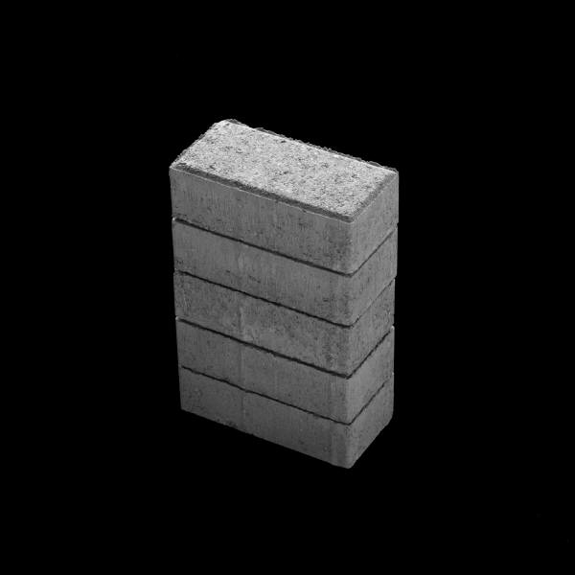

Modern Disk Scheduling
Disk used to be simple devices and disk scheduling used to be performed by OS (file system or device driver) only…
… but, new disks are more complex
  hide their true layout
  transparently move blocks to spare cylinders
    e.g., due to bad disk blocks
OS view
real view

Slide 25
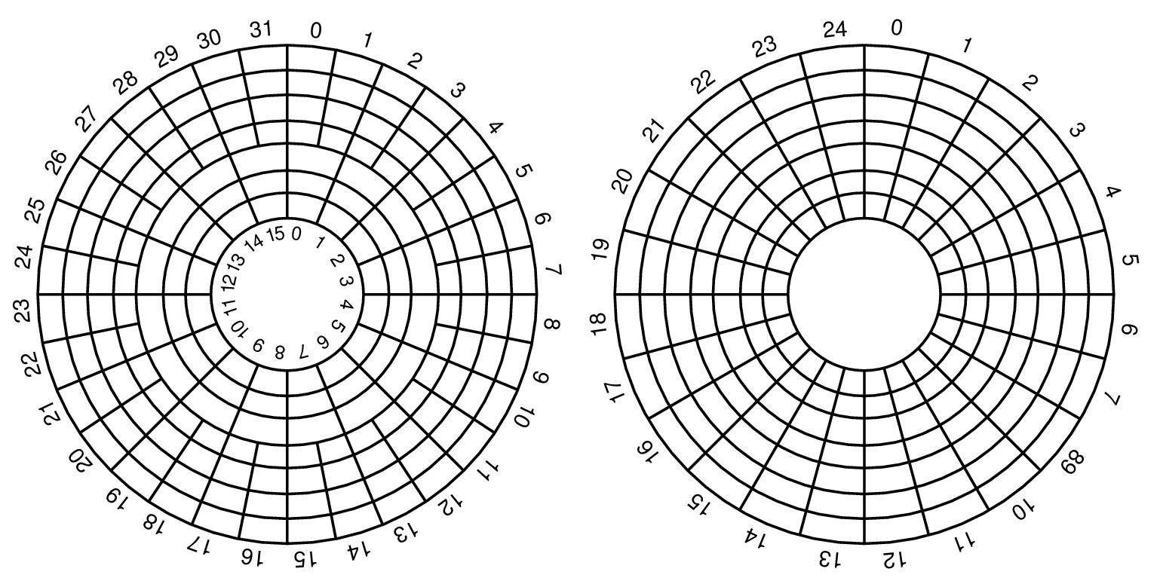
Modern Disk Scheduling
Seagate X15.3:
Zone | Cylinders per Zone | Sectors per Track | Zone Transfer Rate (MBps) | Sectors per Zone | Efficiency | Formatted Capacity (MB)
1 | 3544 | 672 | 890,98 | 19014912 | 77,2% | 9735,635
2 | 3382 | 652 | 878,43 | 17604000 | 76,0% | 9013,248
3 | 3079 | 624 | 835,76 | 15340416 | 76,5% | 7854,293
4 | 2939 | 595 | 801,88 | 13961080 | 76,0% | 7148,073
5 | 2805 | 576 | 755,29 | 12897792 | 78,1% | 6603,669
6 | 2676 | 537 | 728,47 | 11474616 | 75,5% | 5875,003
7 | 2554 | 512 | 687,05 | 10440704 | 76,3% | 5345,641
8 | 2437 | 480 | 649,41 | 9338880 | 75,7% | 4781,506
9 | 2325 | 466 | 632,47 | 8648960 | 75,5% | 4428,268
10 | 2342 | 438 | 596,07 | 8188848 | 75,3% | 4192,690
Disk used to be simple devices and disk scheduling used to be performed by OS (file system or device driver) only…
… but, new disks are more complex
  hide their true layout
  transparently move blocks to spare cylinders
  have different zones
OS view
real view
Constant angular velocity (CAV) disks
  constant rotation speed
  equal amount of data in each track
  thus, constant
  transfer time
Zoned CAV disks
  constant rotation speed
  zones are ranges of tracks
  typical few zones
  the different zones have different amount of data, i.e., more better on outer tracks
  thus, variable transfer time

Slide 26
Modern Disk Scheduling
Disk used to be simple devices and disk scheduling used to be performed by OS (file system or device driver) only…
… but, new disks are more complex
  hide their true layout
  transparently move blocks to spare cylinders
  have different zones
  head accelerates – most algorithms assume linear movement overhead
Time
~ 10x - 20x
x
Cylinders Traveled
1
N

Slide 27
Modern Disk Scheduling
Disk used to be simple devices and disk scheduling used to be performed by OS (file system or device driver) only…
… but, new disks are more complex
  hide their true layout
  transparently move blocks to spare cylinders
  have different zones
  head accelerates – most algorithms assume linear movement overhead
  on device buffer caches may use read-ahead prefetching
disk
buffer
disk

Slide 28
Modern Disk Scheduling
Disk used to be simple devices and disk scheduling used to be performed by OS (file system or device driver) only…
… but, new disks are more complex
  hide their true layout
  transparently move blocks to spare cylinders
  have different zones
  head accelerates – most algorithms assume linear movement overhead
  on device buffer caches may use read-ahead prefetching
  “smart” with build in low-level scheduler (usually SCAN-derivate)
  we cannot fully control the device (black box)
OS could (should?) focus on high level scheduling only!??

Slide 29
Schedulers today (Linux)?
NOOP
  FCFS with request merging
Deadline I/O
  C-SCAN based
  4 queues: elevator/deadline for read/write
Anticipatory
  same queues as in Deadline I/O
  delays decisions to be able to merge more requests
  (e.g., a streaming scenario)
Completely Fair Queuing (CFQ)
  1 queue per process (periodic access, but period length depends on load)
  gives time slices and ordering according to priority level
  (real-time, best-effort, idle)
  work-conserving

Slide 30

Cooperative user-kernel space scheduling
Some times the kernel does not have enough information to make an efficient schedule
File tree traversals
  processing one file after another
  tar, zip, …
  recursive copy (cp -r)
  search (find)
  …
Only application knows
access pattern
  use ioctl FIEMAP (FIBMAP)
  to retrieve extent locations
  sort in user space
  send I/O request according to
  sorted list
GNU/BSD Tar vs. QTAR

Slide 31
Cooperative user-kernel space scheduling
Some times the kernel does not have enough information to make an efficient schedule
File tree traversals
  processing one file after another
  tar, zip, …
  recursive copy (cp -r)
  search (find)
  …
Only application knows
access pattern
  use ioctl FIEMAP (FIBMAP)
  to retrieve extent locations
  sort in user space
  send I/O request according to
  sorted list
GNU/BSD Tar vs. QTAR
So, schedule your disk
requests wisely….!
→ it does matter

Slide 32
Memory Caching

Slide 33
Data Path (Intel Hub Architecture)
application
Pentium 4
Processor
file system
communication
system
registers
disk
network card
cache(s)
RDRAM
file system
memory
controller
hub
RDRAM
RDRAM
application
RDRAM
I/O
controller
hub
PCI slots
PCI slots
PCI slots
disk

Slide 34
Buffer Caching
How do we manage a cache?
how much memory to use?
how much data to prefetch?
which data item to replace?
how do lookups quickly?
…
application
caching possible
cache
file system
communication
system
expensive
disk
network card

Slide 35
Buffer Caching: Windows XP
An I/O manager performs caching
  centralized facility to all components (not only file data)
I/O requests processing:
process
  I/O request from process
  I/O manager forwards to cache manager
in cache:
  cache manager locates and copies data
  to process buffer via VMM
  VMM notifies process
on disk:
  cache manager generates a page fault
  VMM makes a non-cached service request
  I/O manager makes request to file system
  file system forwards to disk
  disk finds data
  reads into cache
  cache manager copies data to process buffer via VMM
  virtual memory manager notifies process
I/O
manager
virtual memory
manager (VMM)
file system
cache
drivers
manager
disk
drivers
Kernel

Slide 36
Buffer Caching: Linux / Unix
A file system performs caching
  caches disk data (blocks) only
  may hint on caching decisions
  prefetching
I/O requests processing:
Process
Kernel
  I/O request from process
  virtual file system forwards to local file system
  local file system finds requested block number
  requests block from buffer cache
  data located…
    … in cache:
      return buffer memory address
    … on disk:
      make request to disk driver
      data is found on disk and transferred to buffer
      return buffer memory address
  file system copies data to process buffer
  process is notified
virtual file
system
FAT32
Linux ext2fs
HFS
(Windows)
(Macintosh)
buffers
disk
drivers

Slide 37
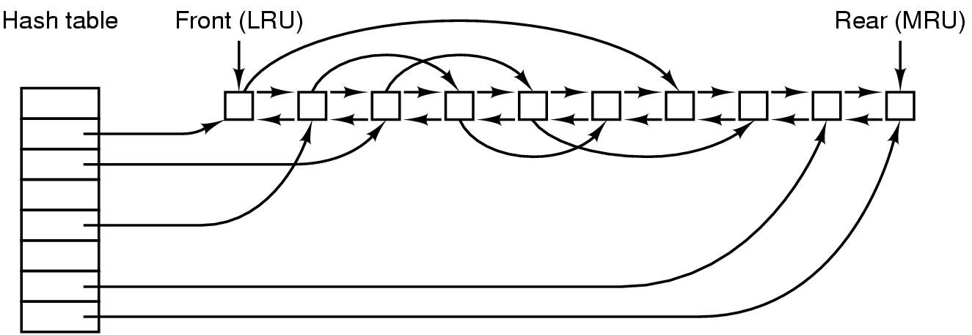
Buffer Caching Structure

Slide 38
File Systems

Slide 39
Files??
A file is a collection of data – often for a specific purpose
  unstructured files, e.g., Unix and Windows
  structured files, e.g., MacOS (to some extent) and MVS
In this course, we consider unstructured files
  for the operating system, a file is only a sequence of bytes
  it is up to the application/user to interpret the meaning of the bytes
  simpler file systems

Slide 40
File Systems
File systems organize data in files and manage access regardless of device type, e.g.:
  storage management – allocating space for files on secondary storage
  file management – providing mechanisms for files to be stored, referenced, shared, secured, …
    file integrity mechanisms – ensuring that information is not corrupted, intended content only
    access methods – provide methods to access stored data

Slide 41
Organizing Files - Directories
A system usually has a large number of different files
To organize and quickly locate files, file systems use directories
  contain no data itself
  file containing name and locations of other files
  several types
    single-level (flat) directory structure
    hierarchical directory structure

Slide 42
Single-level Directory Systems
Root directory
Four files
CP/M
  Microcomputers
  Single user system
VM
  Host computers
  “Minidisks”: one partition per user

Slide 43
Hierarchical Directory Systems
Tree structure
  nodes = directories
  root node = root directory
  leaves = files
Directories
  stored on disk
  attributes just like files
To access a file
  must (often) test all directories in path for
    existence
    being a directory
    permissions
  similar tests on the file itself
/
/

Slide 44
Hierarchical Directory Systems
Windows: one tree per partition or device
Device C
Device D
\
\
WINNT
EXPLORER.EXE
Complete filename example:
C:\WinNT\EXPLORER.EXE

Slide 45
Hierarchical Directory Systems
Unix: single acyclic graph
spanning several devices
/
cdrom
/
doc
Howto
Complete filename example:
/cdrom/doc/Howto

Slide 46
Start here

Slide 47
File & Directory Operations
File:
  create
  delete
  open
  close
  read
  write
  append
  seek
  get/set attributes
  rename
  link
  unlink
  …
Directory:
  create
  delete
  opendir
  closedir
  readdir
  rename
  link
  unlink
  …

Slide 48
Example: open(), read() and close()
#include <stdio.h>
#include <stdlib.h>
int main(void)
{
int fd, n;
char buffer[BUFSIZE];
char *buf = buffer;
if ((fd = open( “my.file” , O_RDONLY , 0 )) == -1) {
printf(“Cannot open my.file!\n”);
exit(1); /* EXIT_FAILURE */
}
while ((n = read(fd, buf, BUFSIZE) > 0) {
<<USE DATA IN BUFFER>>
}
close(fd);
exit(0); /* EXIT_SUCCESS */
}

Slide 49

Open
BSD example
open(name,mode,perm)
system call handling as described earlier
Operating System
sys_open() → vn_open():
  Check if valid call
  Allocate file descriptor
  If file exists, open for read.
  Must get directory inode. May require disk I/O.
  Set access rights, flags and pointer to vnode
  Return index to file descriptor table
fd
fd
user
kernel
control block
control block

Slide 50
Example: open(), read() and close()
#include <stdio.h>
#include <stdlib.h>
int main(void)
{
int fd, n;
char buffer[BUFSIZE];
char *buf = buffer;
if ((fd = open( “my.file” , O_RDONLY , 0 )) == -1) {
printf(“Cannot open my.file!\n”);
exit(1); /* EXIT_FAILURE */
}
while ((n = read(fd, buf, BUFSIZE) > 0) {
<<USE DATA IN BUFFER>>
}
close(fd);
exit(0); /* EXIT_SUCCESS */
}

Slide 51
Read
BSD example
buffer
read(fd, *buf, len)
system call handling as described earlier
Operating System
sys_read() → dofileread() → (*fp_read==vn_read)():
  Check if valid call and mark file as used
  Use file descriptor as index in file table
  to find corresponding file pointer
  Use data pointer in file structure to find vnode
  Find current offset in file
  Call local file system
VOP_READ(vp,len,offset,..)

Slide 52
Read
VOP_READ(...) is a pointer to a read function in the
corresponding file system, e.g., Fast File System (FFS)
READ():
  Find corresponding inode
  Check if valid call - file size ≥ len + offset
  Loop and find corresponding blocks
    find logical blocks from inode, offset, length
    do block I/O, fill buffer structure
    e.g., bread(...) → bio_doread(...) → getblk()
    return and copy block to user
Operating System
VOP_READ(vp,len,offset,..)
getblk(vp,blkno,size,...)

Slide 53
Read
A | B | C | D | E | F | G | H | I | J | K | L
Operating System
getblk(vp,blkno,size,...)
M
Search for block in buffer cache, return if found
(hash vp and blkno and follow linked hash list)
Get a new buffer (LRU, age)
Call disk driver - sleep or do something else
Reorganize LRU chain and return buffer
VOP_STRATEGY(bp)

Slide 54
Read
Operating System
VOP_STRATEGY(...) is a pointer to the corresponding
driver depending on the hardware,
e.g., SCSI - sdstrategy(...) → sdstart(...)
Check buffer parameters, size, blocks, etc.
Convert to raw block numbers
Sort requests according to SCAN - disksort_blkno(...)
Start device and send request
VOP_STRATEGY(bp)

Slide 55
Read
file attributes
...
data pointer
data pointer
data pointer
data pointer
data pointer
...
...
Operating System
M

Slide 56

Read
Interrupt to notify end of disk IO
Kernel may awaken sleeping process
A | B | C | D | E | F | G | H | I | J | K | L
M
Operating System
Search for block in buffer cache, return if found
(hash vp and blkno and follow linked hash list)
Get a new buffer (LRU, age)
Call disk driver - sleep or do something else
Reorganize LRU chain (not shown) and return buffer
M

Slide 57
Read
buffer
READ():
  Find corresponding inode
  Check if valid call - file size vs. len + offset
  Loop and find corresponding blocks
    find logical blocks from inode, offset, length
    do block I/O,
    e.g., bread(...) → bio_doread(...) → getblk()
    return and copy block to user
Operating System
M

Slide 58
Example: open(), read() and close()
#include <stdio.h>
#include <stdlib.h>
int main(void)
{
int fd, n;
char buffer[BUFSIZE];
char *buf = buffer;
if ((fd = open( “my.file” , O_RDONLY , 0 )) == -1) {
printf(“Cannot open my.file!\n”);
exit(1); /* EXIT_FAILURE */
}
while ((n = read(fd, buf, BUFSIZE) > 0) {
<<USE DATA IN BUFFER>>
}
close(fd);
exit(0); /* EXIT_SUCCESS */
}

Slide 59
Management of File Blocks
file attributes
...
data pointer
data pointer
data pointer
data pointer
data pointer
...
...

Slide 60
Management of File Blocks
Many files consist of several blocks
  relate blocks to files
  how to locate a given block
  maintain order of blocks
Approaches
  chaining in the media
  chaining in a map
  table of pointers
  extent-based allocation

Slide 61
Chaining in the Media
Metadata
File blocks
Metadata points to chain of used file blocks
Free blocks may also be chained
nice if you only read sequentially from the start
expensive to search (random access)
must read block by block

Slide 62
Chaining in a Map
Metadata
Map
File blocks

Slide 63
FAT Example
FAT: File Allocation Table
Versions FAT12, FAT16, FAT32
  number indicates number of bits used to identify blocks in partition (2¹²,2¹⁶,2³²)
  FAT12: Block sizes 512 bytes – 8 KB: max 32 MB partition size
  FAT16: Block sizes 512 bytes – 64 KB: max 4 GB partition size
  FAT32: Block sizes 512 bytes – 64 KB: max 2 TB partition size
Boot
sector
FAT1
FAT2
(backup)
Root
directory
Other directories and files
0000
…
0001
0000
empty
File1
File1
File1
File2
File2
0002
0003
0003
0004
0004
FFFF
File3
File2
empty
empty
empty
empty
0005
0006
0006
0008
0007
FFFF
0008
FFFF
empty
empty
empty
empty
empty
empty
0009
0000
…
Notes:
FAT32, with cluster values held in a 32-bit field, of which 28 bits are used to hold the cluster number, for a maximum of approximately 268 million (228) clusters. This allows for drive sizes of up to 8 terabytes with 32KB clusters, but the boot sector uses a 32-bit field for the sector count, limiting volume size to 2 TB on a hard disk with 512 byte sectors.

Slide 64
Table of Pointers
Metadata
Table of pointers
File blocks
good random and sequential access
main structure small, extra blocks if needed
uses one indirect block regardless of size
can be too small

Slide 65
Unix/Linux Example: FFS, UFS, …
inode
Flexible block size
e.g. 4KB
mode
Data block
Data block
owner
…
Data block
Direct block 0
Data block
Direct block 1
ca. 1000 entries
per index block
…
Direct block 10
Data block
Data block
Direct block 11
Single indirect
index
Double indirect
Data block
Triple indirect
Data block
Data block
index
index
Data block
index
Data block
Data block
index
index
index
index
index
Data block
Data block

Slide 66
Extent-based Allocation
Observation:
indirect block reads introduce disk I/O and breaks access locality
Metadata
List of extents
File blocks
1
3
2
faster block allocation (many at a time)
higher performance reading large data elements
less file system meta data
reduce number of lookups reading a file

Slide 67
Linux Example: XFS, JFS, EXT4…
Count-augmented address indexing in the extent sections
Introduce a new inode structure
  add counter field to original direct
  entries
    direct points to a disk block
    count indicated how many other
    blocks is following the first block
    (contiguously)
inode
attributes
direct 0
count 0
3
data
data
data
direct 1
count 1
direct 2
count 2
…
…
direct 10
count 10
direct 11
count 11
single indirect
double indirect
triple indirect

Slide 68
ext4_inode
struct ext4_inode {
__le16 i_mode; /* File mode */
__le16 i_uid; /* Low 16 bits of Owner Uid */
__le32 i_size; /* Size in bytes */
__le32 i_atime; /* Access time */
__le32 i_ctime; /* Inode Change time */
__le32 i_mtime; /* Modification time */
__le32 i_dtime; /* Deletion Time */
__le16 i_gid; /* Low 16 bits of Group Id */
__le16 i_links_count; /* Links count */
__le32 i_blocks; /* Blocks count */
__le32 i_flags; /* File flags */
...
__le32 i_block[EXT4_N_BLOCKS];/* Pointers to blocks */
__le32 i_generation; /* File version (for NFS) */
__le32 i_file_acl; /* File ACL */
__le32 i_dir_acl; /* Directory ACL */
__le32 i_faddr; /* Fragment address */
...
__le32 i_ctime_extra; /* extra Change time (nsec << 2 | epoch) */
__le32 i_mtime_extra; /* extra Modification */
__le32 i_atime_extra; /* extra Access time */
__le32 i_crtime; /* File Creation time */
__le32 i_crtime_extra; /* extra */
};
i_block [NUM]
inode
attributes
direct 0
count 0
3
data
data
data
direct 1
count 1
direct 2
count 2
…
…
direct 10
count 10
direct 11
count 11

Slide 69
ext4_inode
...
__le16 eh_depth;
...
Tree of extents organized
using an HTREE
ext4_extent_header
ext4_extent
ext4_extent
ext4_extent
ext4_extent
i_block [NUM]
struct ext4_extent {
__le32 ee_block; /* first logical block extent covers */
__le16 ee_len; /* number of blocks covered by extent */
__le16 ee_start_hi; /* high 16 bits of physical block */
__le32 ee_start; /* low 32 bits of physical block */
};
4
Max size of
4 x 128 MB = 512 MB??
AND what about fragmented disks??
Theoretically, each extent can have 2¹⁵ continuous blocks, i.e., 128 MB data using a 4KB block size
Notes:
ext4_inode has i_block array (60 bytes total).
The first 12 bytes store ext4_extent_header;
the remainder stores an array of 4 of ext4_extent.
#define EXT4_N_BLOCKS 12 +1+1+1 = 15 (60 bytes)
An HTREE is a specialized tree data structure for directory indexing, similar to a B-tree. They are constant depth of either one or two levels, have a high fanout factor, use a hash table of the filename, and do not require balancing.
Htree indexes are used in the ext3 and ext4 Linux filesystems

Slide 70
ext4_inode
ext4_extent_header
ext4_extent_idx
ext4_extent_idx
ext4_extent_idx
ext4_extent_idx
i_block [NUM]
struct ext4_extent_idx {
__le32 ei_block; /* index covers logical blocks from 'block' */
__le32 ei_leaf; /* pointer to the physical block of the next * * level. leaf or next index could be there */
__le16 ei_leaf_hi; /* high 16 bits of physical block */
__u16 ei_unused;
};
...
__le16 ee_len;
__le16 ee_start_hi;
__le32 ee_start;
 one 4 KB can hold 340 ext4_extents(_idx)
 first level can hold 170 GB
 second level can hold 56 TB (limed to 16 TB, 32 bit pointer)
4

Slide 71
Windows Example: NTFS
Each partition contains a master file table (MFT)
  a linear sequence of 1 KB records
  each record describes a directory or a file (attributes and disk addresses)
info about data blocks
record header
standard info
data header
file name
1st extension
run 1
run 2
2nd extension
run 3
run 1
run k
MFT 26
…data…
20
4
30
MFT 27
2
74
10
7
2
run 2, run 3, …, run k-1
78
3
unused
27 - second extension record
26 - first extension record
24 - base record
A file can be …
stored within the record (immediate file, < few 100 B)
represented by disk block addresses (which hold data):
runs of consecutive blocks (<addr, no>, like extents)
use several records if more runs are needed
first 16 reserved for
NTFS metadata

Slide 72
Recovery & Journaling
When data is written to a file, both metadata and data must be updated
  metadata is written asynchronously, data may be written earlier
  if a system crashes, the file system may be corrupted and data is lost
Journaling file systems provide improved consistency and recoverability
  makes a log to keep track of changes
  the log can be used to undo partially completed operations
  e.g., ReiserFS, JFS, XFS and Ext3 (all Linux)
  NTFS (Windows) provide journaling properties where all changes to MFT and file system structure are logged

Slide 73
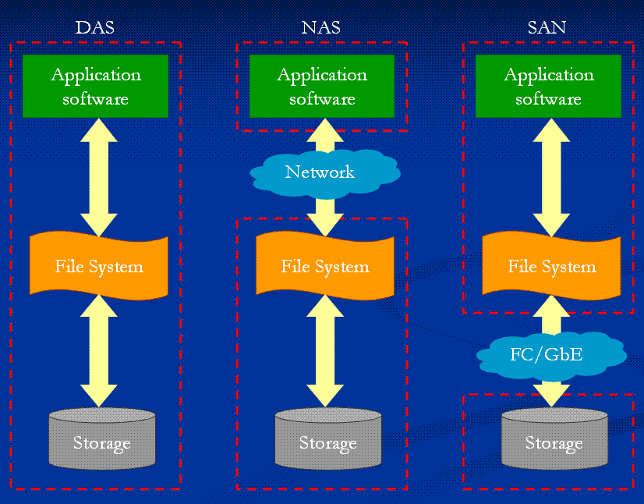
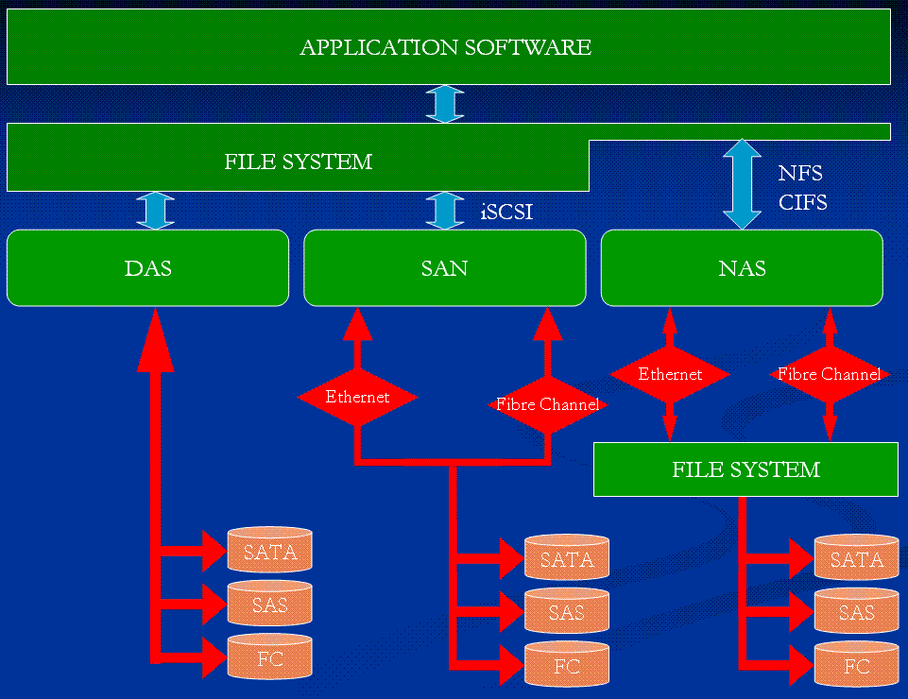
DAS vs. NAS vs. SAN??
How will the introduction of network
attached disks influence storage?
Direct attached storage
Network attached storage
  uses some kind of file-based protocol to attach remote devices non-transparently
  NFS, SMB, CIFS
Storage area network
  transparently attach remote storage devices
  iSCSI (SCSI over TCP/IP), iFCP (SCSI over Fibre Channel), HyperSCSI (SCSI over Ethernet), ATA over Ethernet

Slide 74
Mechanical Disks vs. Solid State Disks???
How will the introduction of SSDs influence storage?
 | Storage capasity (GB) | Average seek time / latency (ms) | Sustained transfer rate (MBps) | Interface (Gbps)
Seagate Cheetah X15.6 (3.5 inch) | 450 | 3.4 (track to track 0.2) | 110 - 171 | SAS (3) FC (4)
Seagate Savvio 15K (2.5 inch) | 73 | 2.9 (track to track 0.2) | 29 - 112 | SAS (3)
OCM Flash Media Core Series V2 | 250 | < .2 - .3 | up to 170 | SATA (3)
Intel X25-E (extreme) | 64 | 0.075 | 250 | SATA (3)
Intel X25-M (mainstream) | 160 | 0.085 | 250 | SATA (3)
Mtron SSD Pro 7500 series | 128 | 0.100 | 130 | SATA (1.5)
Gigabyte GC-Ramdisk | 4 | 0.000xxx | GBps | SATA (1.5)
Notes:
FC = fibre channel
SAS = serial attached SCSI

Slide 75
The End:
Summary

Slide 76
Summary
Disks are the main persistent secondary storage device
The main bottleneck is often disk I/O performance due to disk mechanics:
seek time and rotational delays
Much work has been performed to optimize disks performance
  scheduling algorithms try to minimize seek overhead (most systems use SCAN derivates)
  memory caching can save disk I/Os
  additionally, many other ways (e.g., block sizes, placement, prefetching, striping, …)
  world today more complicated (both different access patterns, unknown disk characteristics, …)
  → new disks are “smart”, we cannot fully control the device
File systems provide
  file management – store, share, access, …
  storage management – of physical storage
  access methods – functions to read, write, seek, …
  …

