Slide 1
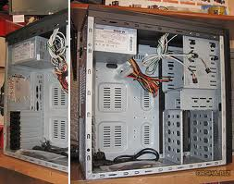
qwerqerq
Qwerqewrqerqreqweqerqerqerqr
Wqerqwerqewrqerwqerwqerw
qwerqewrqerqerqerqwr

Slide 2
asdfadfsadsasdfasdf
asdfasdfadsfasdfasdfsdfa
asdfadsfadsfadsfafd
Asdfadsfadsfadsfadsfasdf
asdfasdfafadf

