Slide 1
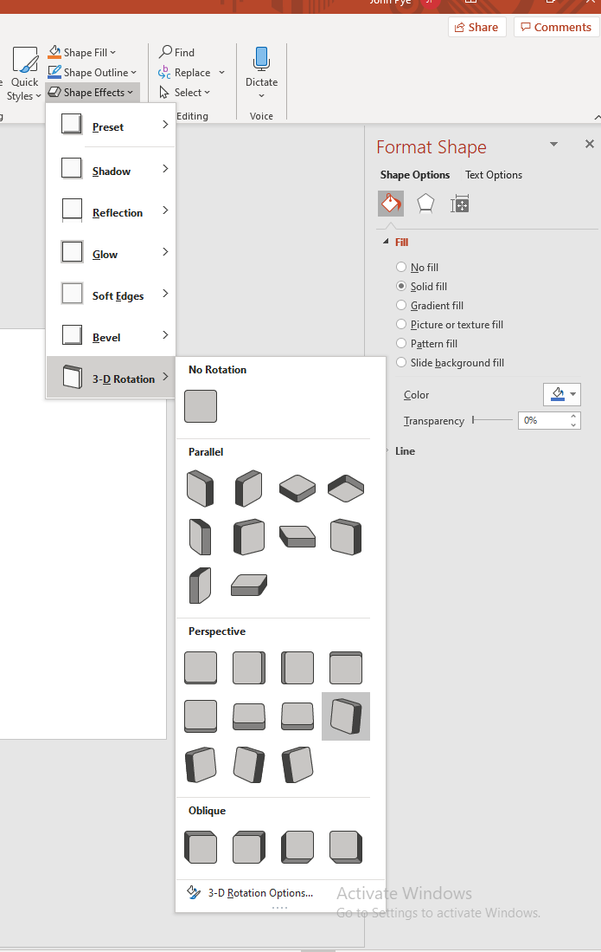
Skewed arrow (vector shape)
Skewed arrow (bitmaps – should match)
Using ‘Shape Effects’ → 3-D Rotation → Parallel (bottom) and Perspective (top)

