Slide 1
When Transparency is 100 % in ‘Text Option’->’Text Contour’, then text in it is not shown in Libreoffice
TEST
Not display
TEST
display

Slide 2
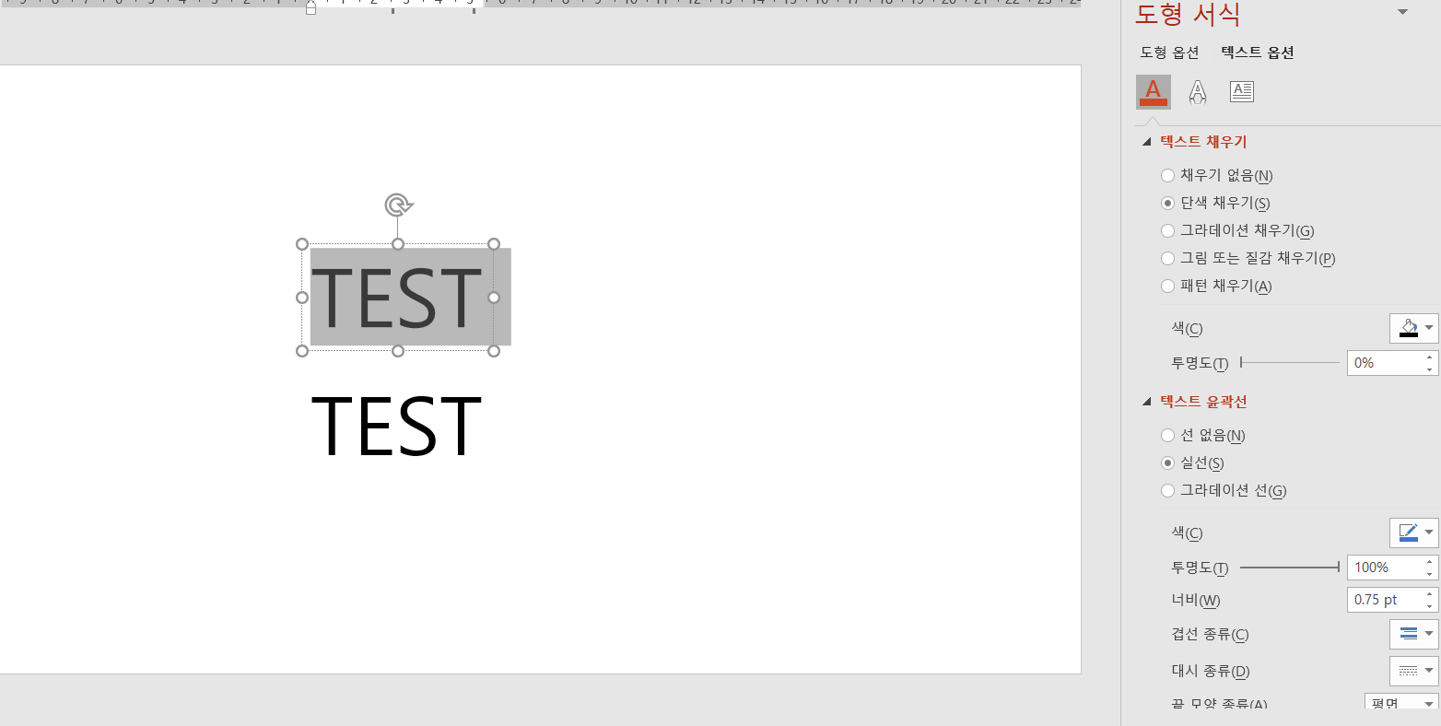
TEST Option -> Text Contour -> Transparency : 100 %

