Slide 1
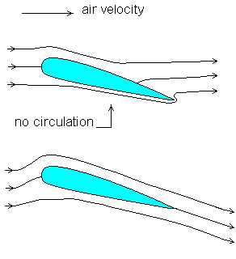
The Kutta Condition
Suppose that the air flow streaming around the wing has no circulation. In such case the stagnation point lies on the upper trailing edge of the wing. Due to this a reverse gradient in pressure is generated, that drives the flow from the trailing edge to the stagnation point.
The Kutta condition states that a body with a sharp trailing edge gener­ates a circulation of just sufficient strength that the flow smoothly leaves the trailing edge.

Slide 2
Stall
A stall is what happens to a wing when it produces less lift with an increase in the angle of attack.
As the AOA increases, the air flow eventually will break away from the surface of the wing and become turbulent, the low pressure area diminishes and the wing is stalled.

Slide 3
Lift and Lift Coefficient

