Slide 1
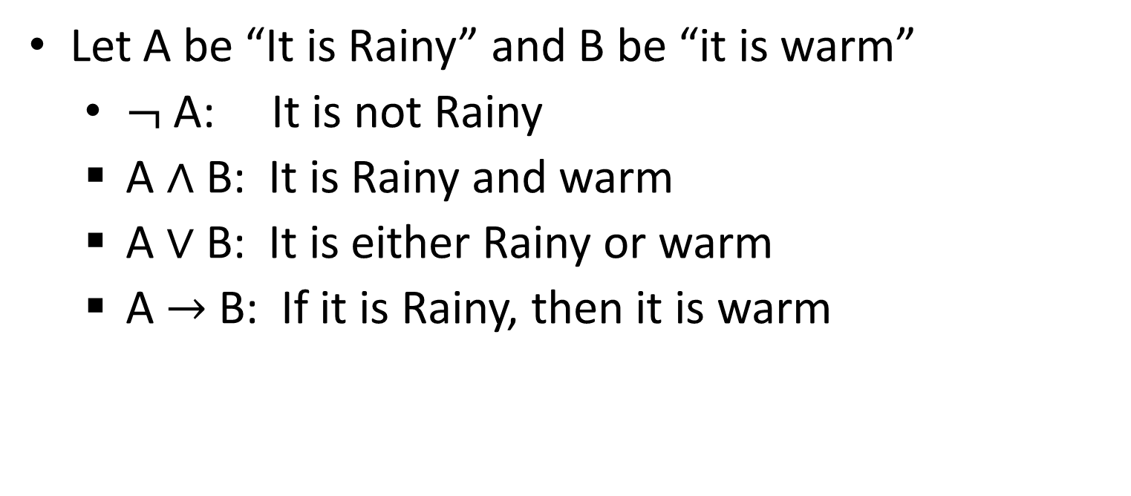
Let A be “It is Rainy” and B be “it is warm”
$¬$A: It is not Rainy
A $∧$ B: It is Rainy and warm
A $∨$ B: It is either Rainy or warm
A $→$ B: If it is Rainy, then it is warm

