Slide 1
Envision Flow of Execution

Slide 2
ENVISION – Triad of Relationships
Goals
Policies
Actors
Intentions
Values
Economic Services
Ecosystem Services
Socio-cultural Services
Provide a common frame of reference
for actors, policies and landscape productions
Landscapes
Metrics of Production

Slide 3
Policy Definition
Landscape policies are decisions or plans of action for accomplishing desired outcomes.
from:
Lackey, R.T. 2006. Axioms of ecological policy. Fisheries. 31(6): 286-290.

Slide 4
Policies in ENVISION
Policies define decisions actors can make. They translate into “outcomes” – changes to the underlying IDU representation, when an actor choses to “adopt” a policy
Policies are the primary way to represent anthropogenic decision-making processes as a driver of landscape change.
Primary Characteristics:
Applicable Site Attributes/Constraints (Spatial Query)
Effectiveness of the Policy (determined by evaluative models)
Outcomes (possible multiple) associated with the selection and application of the Policy
Example: [Purchase conservations easement to allow revegetation of degraded riparian areas] in [areas with no built structures and high channel migration capacity] when [native fish habitat becomes scarce]

Slide 5
Policies consist of:
Some Basic Attributes Name, is it mandatory, persistent, exclusive…
Site Constraints - Spatial Queries that specify where policies can be applied.
Resource Constraints - Sets of statements limiting global policy use
Outcomes –what happens when a policy is adopted, expressed in terms of changes to the IDU representation, i.e. updating the IDU map throughout a scenario run
Scores and Preferences – biases the adoption rates of policies based on spatial information, scenarios
Represented with XML, editors built into Envision

Slide 6
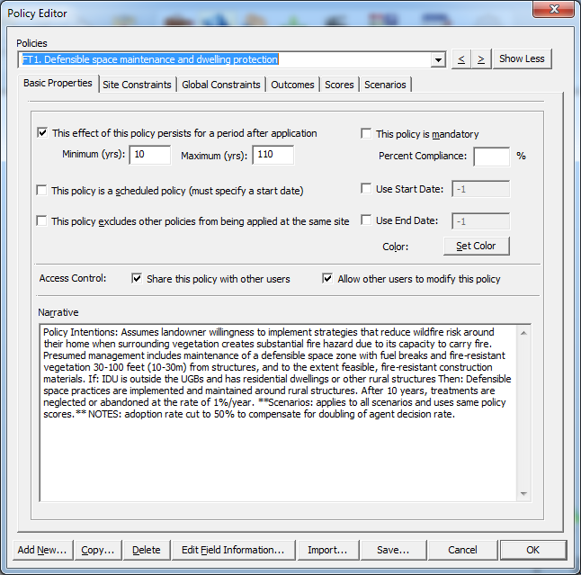
Basic Properties…

Slide 7
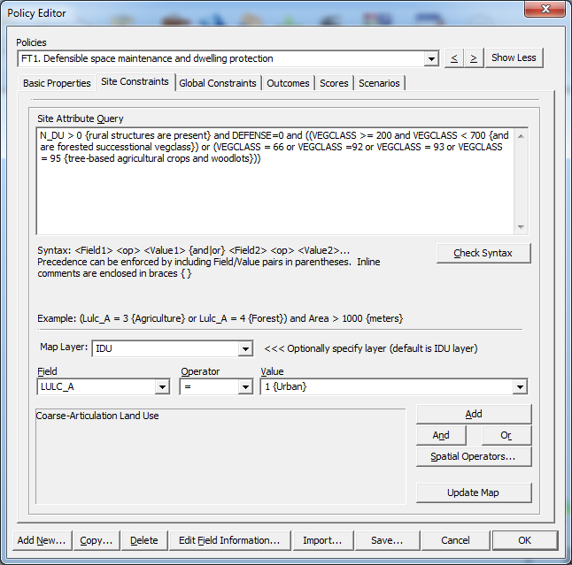
Site Constraints specify where policies can be applied
Basic Properties…
Spatial Query
Query Builder

Slide 8
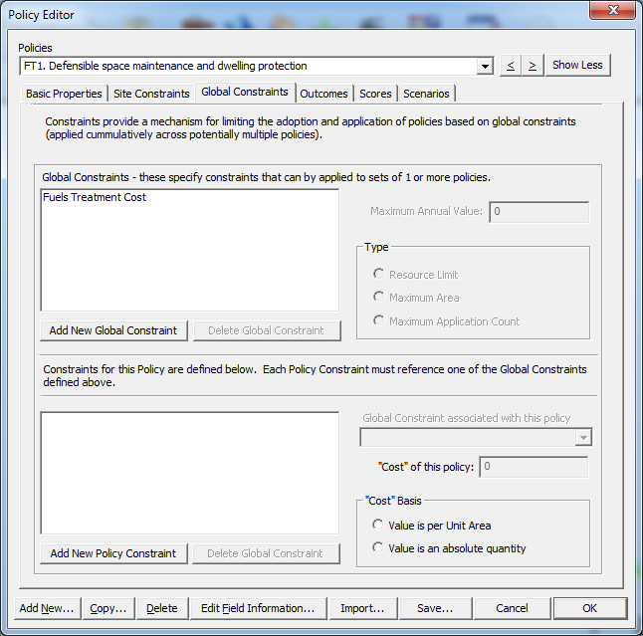
Resource Constraints specify maximum application rates, resource limits on policy use.
Site Constraints…
Basic Properties…
Resource constraints
Contributions from this policy

Slide 9
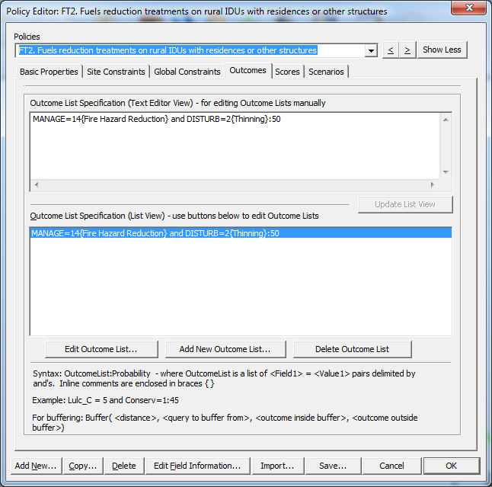
Outcomes specify what happens when a policy is adopted.
Basic Properties…
Site Constraints…
Global Constraints…
Outcome specification – Field::Value pairs (or spatial operators)

Slide 10
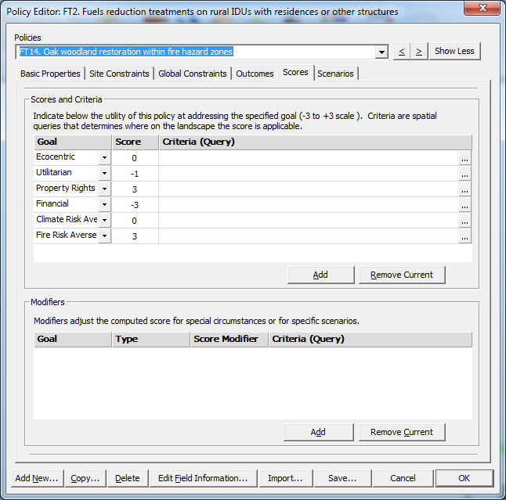
Scores specify policy intentions, scoring modifications when certain conditions are met
Basic Properties…
Site Constraints…
Global Constraints…
Outcomes…
Scores represent policy intentions.
Modifiers adjust scores up or down for special circumstances.

Slide 11
Actors in Envision
Actors are entities that make decisions about landscape change
Any number of actors can be defined ( 0-N)
Actors can be defined in terms of
A set of IDU attributes (Spatial Query)
Prescribed areas on the landscape
Randomly
Each IDU is controlled by at most one Actor
An Actor can choose at most one policy per decision
Actors make choices at some “Decision Frequency”

Slide 12
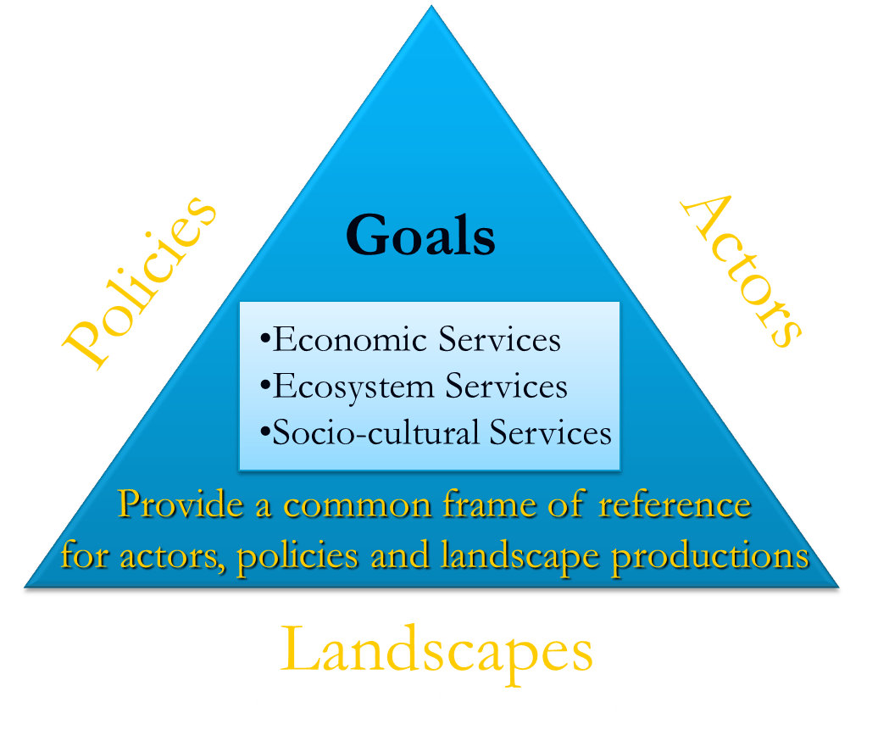
Actors in Envision (continued)
Actors have values that influence their decision-making behaviors. These values reflect landscape productions
Actors make choices about landscape management by selecting policies based on a weighted combination of:
Internal Values relative to Policy Intentions
Landscape Feedbacks/Emerging Scarcities (dynamically generated during a run)
A “Utility” function
Global Policy Preferences (defined by scenario)

Slide 13
ENVISION Actor Properties
Property | Meaning | Envision
Reactive | Responds to environment | Yes
Autonomous | Controls own actions | Yes
Social | Interact with other actors | Sort of
Goal-oriented | More than responsive to environment | Yes
Temporally continuous | Agent behavior continuous | Once/step
Communicative | Communicates with other agents | Sort Of
Mobile | Can transport self to other locations | Sort Of
Flexible | Actions not scripted | Yes
Learning | Changes based on experience | No (but coming soon?)
Character | Believable personality or emotions | No
Adapted from Benenson and Torrens (2004:156)

Slide 14
Altruism Score
Measures alignment between policy intentions and landscape production scarcities
Policy 1
Intention 1
Intention 2
…
Intention M
Actor
Global Policy Preference (θ₁)
Altruism Weight (α)
Policy Preference Weight (δ)
Policy 2
Self Interest Weight (β)
Utility Weight (γ)
Intention 1
Intention 2
…
Intention M
Value 1
Value 2
…
Value N
Global Policy Preference (θ₂)
Policy 3
Intention 1
Intention 2
…
Intention M
$${Altruism Score}_{i}= α∙dp_{i}$$
Global Policy Preference (θ₃)
Landscape Productions (Evaluative Models)
$$dp_{2}^{}$$
Intention/Production 3
$$dp_{1}^{}$$
Evaluate each policy:
$$dp_{3}^{}$$
Production 1
Production 2
Intention/Production 2
…
Production M
Intention/Production 1
”Intention” space
Multicriteria Policy Selection
Outcome(s)

Slide 15
Self Interest Score
Measures alignment between policy intentions and actor values
Policy 1
Intention 1
Intention 2
…
Intention M
Actor
Global Policy Preference (θ₁)
Altruism Weight (α)
Policy Preference Weight (δ)
Policy 2
Self Interest Weight (β)
Utility Weight (γ)
Intention 1
Intention 2
…
Intention M
Value 1
Value 2
…
Value N
Global Policy Preference (θ₂)
Policy 3
Intention 1
Intention 2
…
Intention M
$$ds_{2}^{}$$
$${Self Interest Score}_{i}= β∙ds_{i}$$
Global Policy Preference (θ₃)
$$ds_{3}^{}$$
$$ds_{1}^{}$$
Intention/Value 3
Evaluate each policy:
Intention/Value 2
Intention/Value 1
”Intention” space

Slide 16
Global Policy Preference
Measures overall, actor-independent policy preferences
Actor
Altruism Weight (α)
Policy Preference Weight (δ)
Self Interest Weight (β)
Utility Weight (γ)
Value 1
Value 2
…
Value N
Global Preference Weight $= δ∙θ$_{i}
Policy 1
Intention 1
Intention 2
…
Intention M
Global Policy Preference (θ₁)
Policy 2
Evaluate each policy:
Intention 1
Intention 2
…
Intention M
Global Policy Preference (θ₂)
Policy 3
Intention 1
Intention 2
…
Intention M
Global Policy Preference (θ₃)
Multicriteria Policy Selection
Outcome(s)

Slide 17
Combined Score
Multicriteria weighting based on altruism, actor value alignment, utility, and preference
Policy 1
Actor
Intention 1
Intention 2
…
Intention M
Policy 1
Altruism Weight (α)
Global Preference Weight (δ)
Global Policy Preference (θ₁)
$$dv_{2}^{}$$
Policy 2
Self Interest Weight (β)
Utility Weight (γ)
Intention/Value 3
$$dv_{3}^{}$$
Policy 3
…
Intention 1
Intention 2
…
Intention M
$$dv_{1}^{}$$
Value 1
Value 2
Value N
Policy 2
Intention/Value 2
Global Policy Preference (θ₂)
Intention/Value 1
Policy 3
Intention 1
Intention 2
…
Intention M
Global Policy Preference (θ₃)
$$P_{i}= α∙dp_{i}+β∙dv_{i}+γ∙{U_{l}+δ∙θ}_{i}$$
Altruism
Self-
Interest
Utility
Global
Preference
Landscape Productions
Policy 1
Utility Function (Ui)
Evaluate each policy:
Production 1
$$dp_{2}^{}$$
Intention/Production 3
$$dp_{3}^{}$$
Production 2
$$dp_{1}^{}$$
Policy 3
…
Production M
Policy 2
Intention/Production 2
Intention/Production 1
Multicriteria Policy Selection
Outcome(s)

Slide 18
Policy Selection Process
For each IDU, determine if it is time for a decision
Collect relevant Policies
Score relevant Policies (altruism, self interest, utility, global preference)
Select a policy (if any) and apply outcomes (if any)
Repeat for all IDUs

