Slide 1

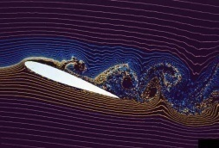

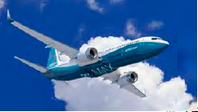
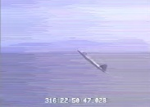
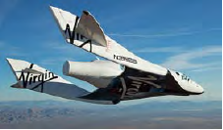
4th lecture
DYNAMIC STABILITY EQUATIONS

Slide 2




Slide 3
Dynamic Stability
The second type of stability which a stable system (so after Static Stability) must have is Dynamic Stability.
Dynamic stability refers to the response of the system over time.

Slide 4

Dynamic Flight Equations
Lift
Drag
Thrust
Weight

Slide 5
Definition | Symbols
translation, velocity and force applied in the direction parallel to the axis of the fuselage | x, U, X
translation, velocity and force applied in the direction perpendicular to the plane of symmetry of the aircraft | y, V, Y
translation, velocity and force applied in the direction perpendicular to both x and y | z, W, Z

Slide 6
angular velocity and moment in roll direction | p, L
angular velocity and moment in pitch direction | q, M
angular velocity and moment in yaw direction | r, N

Slide 8


– Sum of forces acting on the system (internal and external) are equal to its mass times its acceleration
– Sum of moments acting on the system (internal and external) are equal to its moment of inertia times its angular acceleration

Slide 9





Slide 10



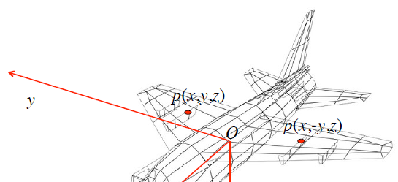
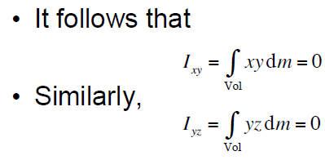
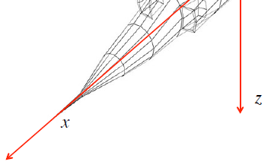

Slide 11








Slide 12
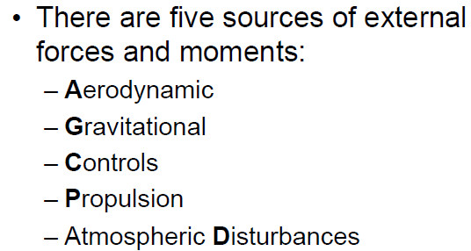

Slide 13
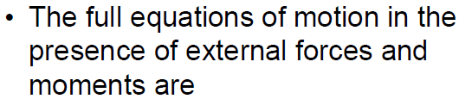



$$= X_{g}+X$$
$$= Y_{g}+Y$$
$$= Z_{g}+Z$$

Slide 14
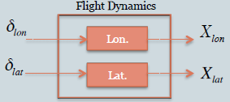
For a symmetric aircraft near a symmetric flight condition, the Flight Dynamics can be further decoupled in two independent parts

Slide 15
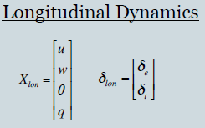
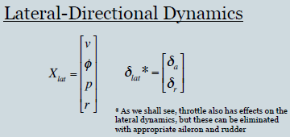

Slide 16

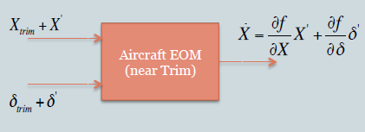

Slide 17



Slide 18
Can linearize about various steady state conditions of flight.
For steady state flight conditions must have
  So for equilibrium condition, forces balance on the aircraft

Slide 19
Impose additional constraints that depend on flight condition:
Also assume that
$$\dot{p}=\dot{q}=\dot{r}=\dot{u}=\dot{v}=\dot{w}=0$$
Steady wings level flight

Slide 25
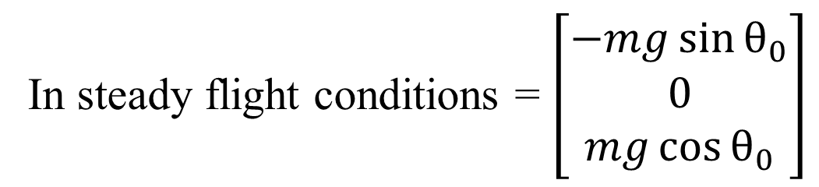
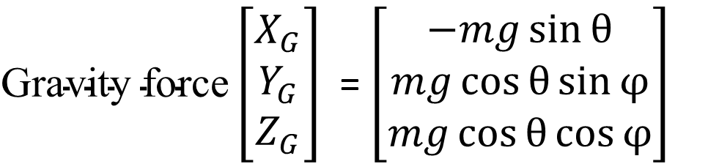
$\text{Gravity} \text{force}\left[\begin{matrix}X_{G} \\ Y_{G} \\ Z_{G}\end{matrix}\right]$= $\left[\begin{matrix}−mg\sin{θ} \\ mg\cos{θ\sin{φ}} \\ mg\cos{θ\cos{φ}}\end{matrix}\right]$
In steady flight conditions = $\left[\begin{matrix}−mg\sin{θ_{0}} \\ 0 \\ mg\cos{θ_{0}}\end{matrix}\right]$

Slide 26
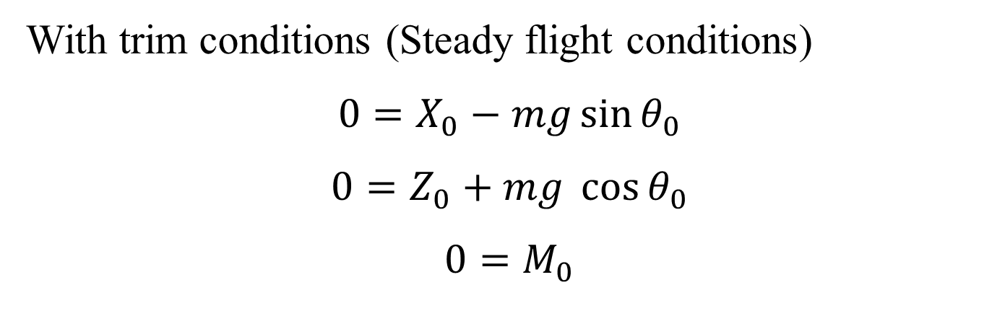

$$m (\dot{\left.U_{0}+u\right)}=X_{0}+∆X−mg\sin\left. (θ_{0}+θ)+m (rv−qw\right)$$
$$m \dot{w}=Z_{0}+∆Z+mgcos φ cos\left. \left(θ_{0}+θ\right)+m (q{\left(U\right.}_{0}+u)−pv\right)$$
$$I_{yy} \dot{q}=M_{0}+∆M+\left(I_{zz}−I_{xx}\right) p r$$
With trim conditions (Steady flight conditions)
$$0=X_{0}−mg\sin{θ_{0}}$$
$$0=Z_{0}+mg\cos{θ_{0}}$$
$$0=M_{0}$$

Slide 27
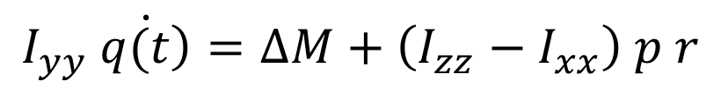
$$m \dot{u}=∆X− mg θ\cos{θ_{0}}{+m (rv−qw)}$$
$$m \dot{w}=∆Z− mg θ\sin{θ_{0}}\left.+ m (qU_{0}+q u\left(t\right)−pv\right)$$
$$I_{yy} \dot{\left.q(t\right)}=∆M+\left(I_{zz}−I_{xx}\right) p r$$

Slide 28
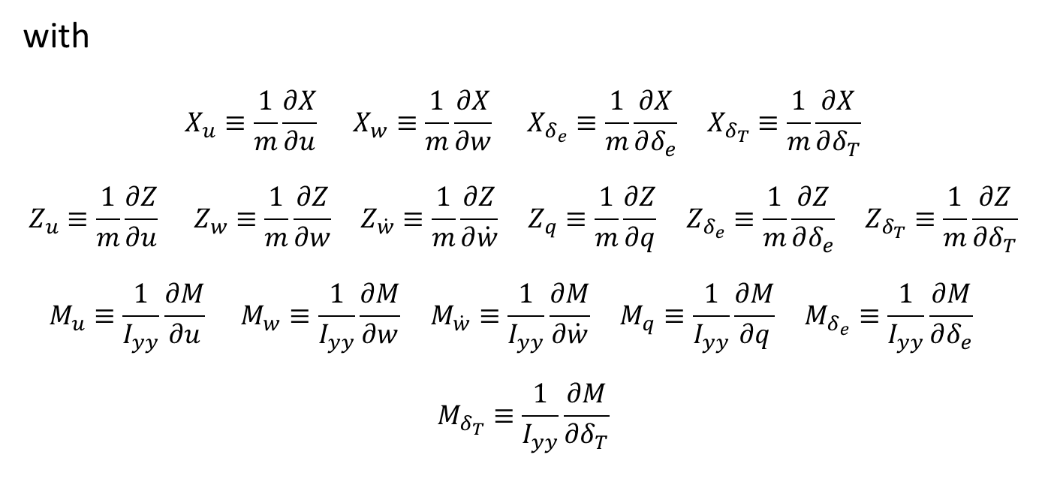
$$\dot{u}=X_{u}u+X_{w}w+X_{δ_{e}}δ_{e}+X_{δ_{T}}δ_{T}− g θ\cos{θ_{0}}{ }$$
$$\dot{w}=Z_{u}u+Z_{w}w+Z_{\dot{w}}\dot{w}+Z_{q}q+Z_{δ_{e}}δ_{e}+Z_{δ_{T}}δ_{T}− g θ\sin{θ_{0}}{+ qU_{0}}$$
$$\dot{q}=M_{u}u+M_{w}w+M_{\dot{w}}\dot{w}+M_{q}q+M_{δ_{e}}δ_{e}+M_{δ_{T}}δ_{T}$$
with
$$X_{u}≡\frac{1}{m}\frac{∂X}{∂u} X_{w}≡\frac{1}{m}\frac{∂X}{∂w} X_{δ_{e}}≡\frac{1}{m}\frac{∂X}{∂δ_{e}} X_{δ_{T}}≡\frac{1}{m}\frac{∂X}{∂δ_{T}}$$
$$Z_{u}≡\frac{1}{m}\frac{∂Z}{∂u} Z_{w}≡\frac{1}{m}\frac{∂Z}{∂w} Z_{\dot{w}}≡\frac{1}{m}\frac{∂Z}{∂\dot{w}} Z_{q}≡\frac{1}{m}\frac{∂Z}{∂q} Z_{δ_{e}}≡\frac{1}{m}\frac{∂Z}{∂δ_{e}} Z_{δ_{T}}≡\frac{1}{m}\frac{∂Z}{∂δ_{T}}$$
$$M_{u}≡\frac{1}{I_{yy}}\frac{∂M}{∂u} M_{w}≡\frac{1}{I_{yy}}\frac{∂M}{∂w} M_{\dot{w}}≡\frac{1}{I_{yy}}\frac{∂M}{∂\dot{w}} M_{q}≡\frac{1}{I_{yy}}\frac{∂M}{∂q} M_{δ_{e}}≡\frac{1}{I_{yy}}\frac{∂M}{∂δ_{e}}$$
$$M_{δ_{T}}≡\frac{1}{I_{yy}}\frac{∂M}{∂δ_{T}}$$

Slide 29
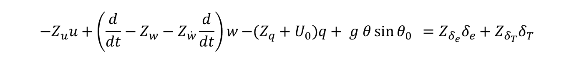
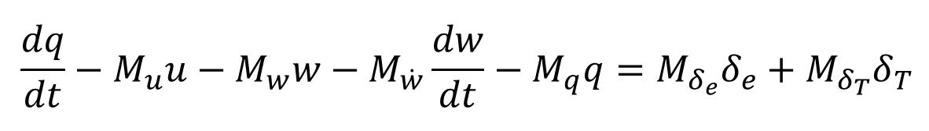
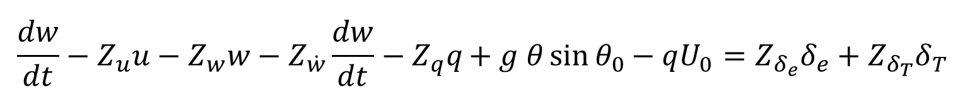
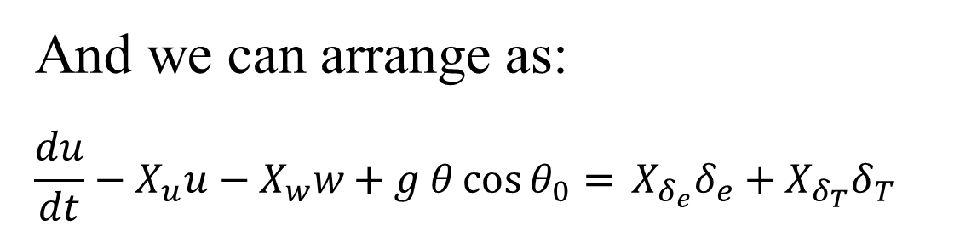
And we can arrange as:
$$\frac{du}{dt}−X_{u}u−X_{w}w+ g θ\cos{θ_{0}}{= }X_{δ_{e}}δ_{e}+X_{δ_{T}}δ_{T}$$
$$\frac{dw}{dt}−Z_{u}u−Z_{w}w−Z_{\dot{w}}\frac{dw}{dt}−Z_{q}q+ g θ\sin{θ_{0}}{− qU_{0}}=Z_{δ_{e}}δ_{e}+Z_{δ_{T}}δ_{T}$$
$$\frac{dq}{dt}−M_{u}u−M_{w}w−M_{\dot{w}}\frac{dw}{dt}−M_{q}q=M_{δ_{e}}δ_{e}+M_{δ_{T}}δ_{T}$$
And $(\frac{d}{dt}−X_{u})u−X_{w}w+ g θ\cos{θ_{0}}{= }X_{δ_{e}}δ_{e}+X_{δ_{T}}δ_{T}$
$$−Z_{u}u+\left(\frac{d}{dt}−Z_{w}−Z_{\dot{w}}\frac{d}{dt}\right)w−(Z_{q}+U_{0})q+ g θ\sin{θ_{0}}{ }=Z_{δ_{e}}δ_{e}+Z_{δ_{T}}δ_{T}$$
$$−M_{u}u−{(M}_{w}−M_{\dot{w}}\frac{d}{dt}) w+(\frac{d}{dt}−M_{q})q=M_{δ_{e}}δ_{e}+M_{δ_{T}}δ_{T}$$

Slide 30


    Longitudinal equations of motion

Slide 33
A the Longitudinal Aircraft Matrix

Slide 35
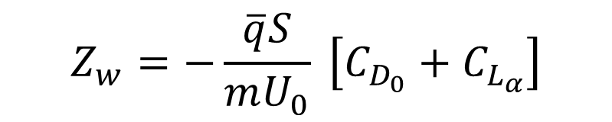
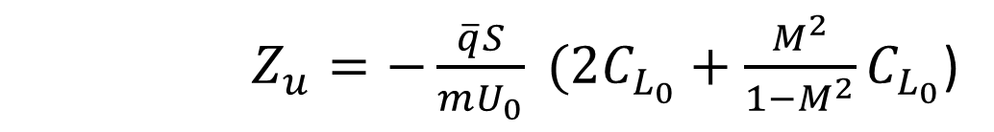
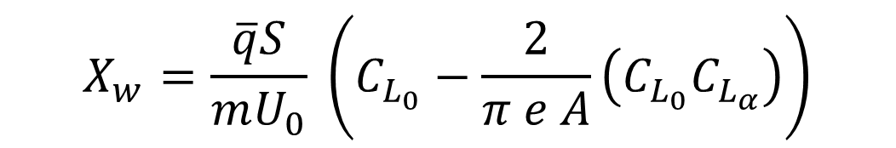
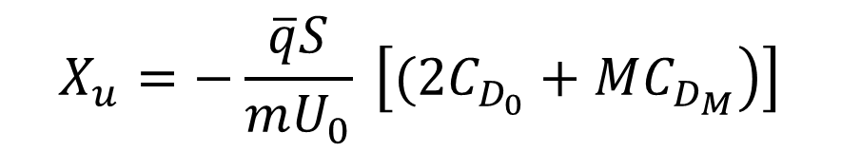
$$X_{u}=−\frac{\overline{q}S}{mU_{0}} \left[\left.(2C_{D_{0}}+MC_{D_{M}}\right)\right]$$
$$X_{w}=\frac{\overline{q}S}{mU_{0}} \left(C_{L_{0}}−\frac{2}{π e A}\left(C_{L_{0}}C_{L_{α}}\right)\right)$$
$Z_{u}=−\frac{\overline{q}S}{mU_{0}} (2C_{L_{0}}+\frac{M^{2}}{1−M^{2}}C_{L_{0}}$)
$$Z_{w}=−\frac{\overline{q}S}{mU_{0}} \left[C_{D_{0}}+C_{L_{α}}\right]$$

Slide 36
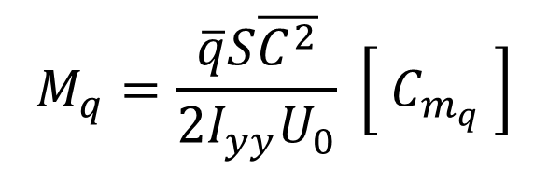
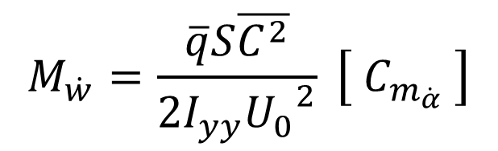
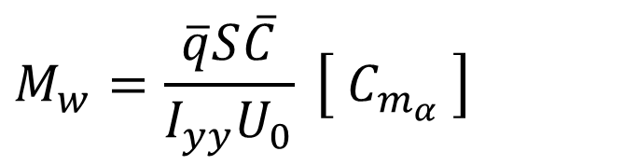
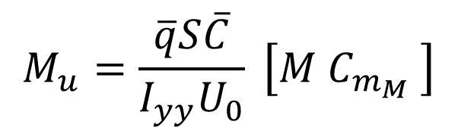
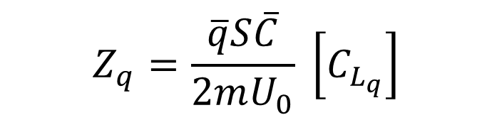
$$Z_{q}=\frac{\overline{q}S\overline{C}}{2mU_{0}} \left[C_{L_{q}}\right]$$
$$M_{u}=\frac{\overline{q}S\overline{C}}{I_{yy}U_{0}} \left[M C_{m_{M}} \right]$$
$$M_{w}=\frac{\overline{q}S\overline{C}}{I_{yy}U_{0}} \left[ C_{m_{α}} \right]$$
$$M_{\dot{w}}=\frac{\overline{q}S\overline{C^{2}}}{2I_{yy}{U_{0}}^{2}} \left[ C_{m_{\dot{α}}} \right]$$
$$M_{q}=\frac{\overline{q}S\overline{C^{2}}}{2I_{yy}U_{0}} \left[ C_{m_{q}} \right]$$

Slide 37
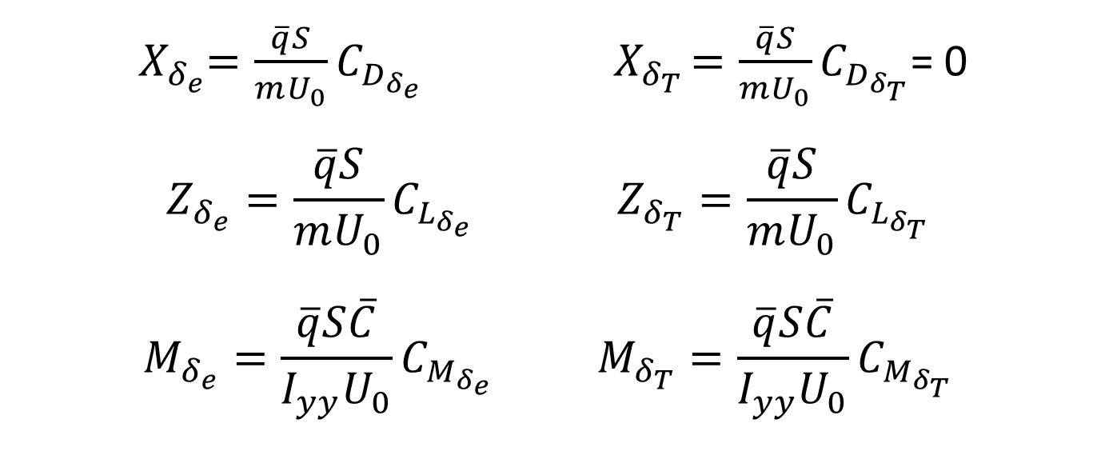
${ X}_{δ_{e}}=\frac{\overline{q}S}{mU_{0}}C_{D_{δ_{e}}}{ X}_{δ_{T}}=\frac{\overline{q}S}{mU_{0}}C_{D_{δ_{T}}}$= 0
$$Z_{δ_{e}}=\frac{\overline{q}S}{mU_{0}}C_{L_{δ_{e}}} Z_{δ_{T}}=\frac{\overline{q}S}{mU_{0}}C_{L_{δ_{T}}}$$
$$M_{δ_{e}}=\frac{\overline{q}S\overline{C}}{I_{yy}U_{0}}C_{M_{δ_{e}}} M_{δ_{T}}=\frac{\overline{q}S\overline{C}}{I_{yy}U_{0}}C_{M_{δ_{T}}}$$

Slide 38

From
=
0
The aircraft stability properties can be investigated by computing the eigenvalues of the system matrix A using:

Slide 39




Slide 40
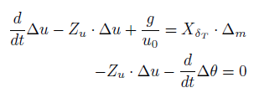

Slide 41


Slide 42
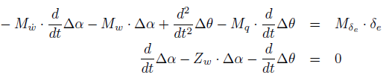


Slide 44

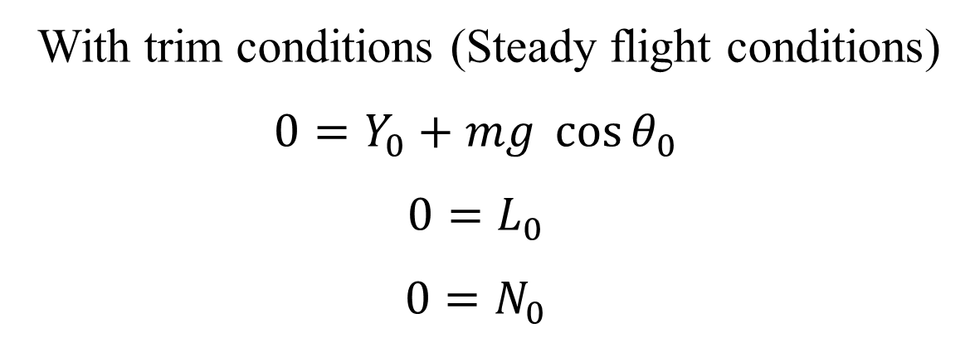
$$m \dot{v}=Y_{0}+∆Y+mgsin φ cos\left(θ_{0}+θ)+m (pw−r(U_{0}+u\right))$$
$$I_{xx} \dot{p}=L_{0}+∆L+\left(I_{yy}−I_{zz}\right) q r$$
$$I_{zz} \dot{r}=N_{0}+∆N+\left(I_{xx}−I_{yy}\right) p q$$
With trim conditions (Steady flight conditions)
$$0=Y_{0}+mg\cos{θ_{0}}$$
$$0=L_{0}$$
$$0=N_{0}$$

Slide 45


$$m \dot{v}=∆Y+mgφ cos{θ_{0}−m rU_{0}}$$
$$I_{xx} \dot{p}=∆L+\left(I_{yy}−I_{zz}\right) q r$$
$$I_{zz} \dot{r}=∆N+\left(I_{xx}−I_{yy}\right) p q$$

Slide 46


Slide 51
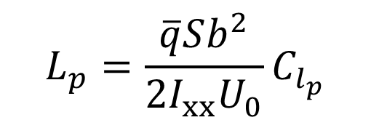
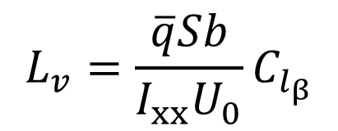
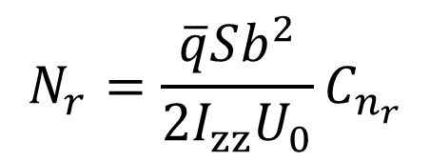
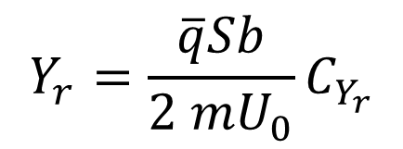
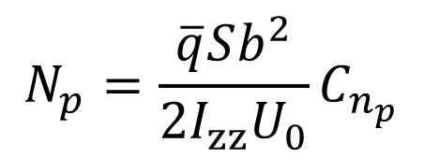
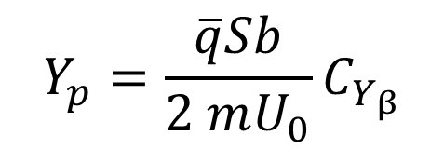
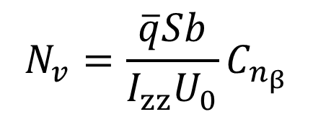
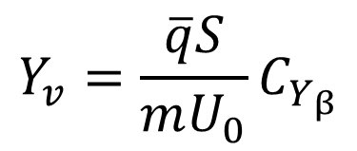
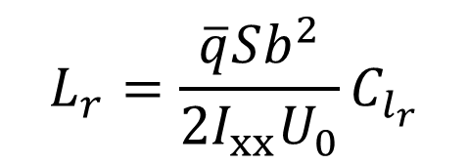
$$Y_{v}=\frac{\overline{q}S}{mU_{0}}C_{Y_{β}}$$
$$Y_{p}=\frac{\overline{q}Sb}{2 mU_{0}}C_{Y_{β}}$$
$$Y_{r}=\frac{\overline{q}Sb}{2 mU_{0}}C_{Y_{r}}$$
$$L_{p}=\frac{\overline{q}Sb^{2}}{{2I}_{xx}U_{0}}C_{l_{p}}$$
$$L_{r}=\frac{\overline{q}Sb^{2}}{{2I}_{xx}U_{0}}C_{l_{r}}$$
$$L_{v}=\frac{\overline{q}Sb}{I_{xx}U_{0}}C_{l_{β}}$$
$$N_{v}=\frac{\overline{q}Sb}{I_{zz}U_{0}}C_{n_{β}}$$
$$N_{p}=\frac{\overline{q}Sb^{2}}{{2I}_{zz}U_{0}}C_{n_{p}}$$
$$N_{r}=\frac{\overline{q}Sb^{2}}{{2I}_{zz}U_{0}}C_{n_{r}}$$

Slide 52
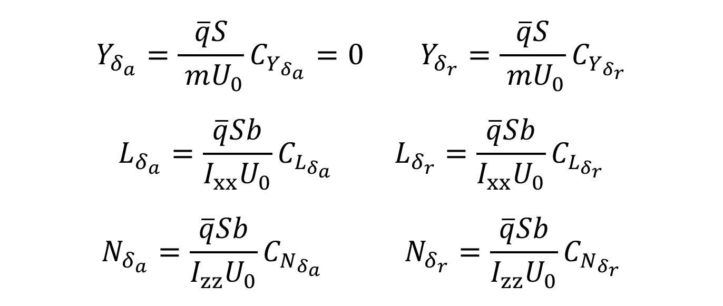
$$Y_{δ_{a}}=\frac{\overline{q}S}{ mU_{0}}{C_{Y_{δ_{a}}}=0 }_{}Y_{δ_{r}}=\frac{\overline{q}S}{ mU_{0}}C_{Y_{δ_{r}}}$$
$$L_{δ_{a}}=\frac{\overline{q}Sb}{I_{xx}U_{0}}C_{L_{δ_{a}}} L_{δ_{r}}=\frac{\overline{q}Sb}{I_{xx}U_{0}}C_{L_{δ_{r}}}$$
$$N_{δ_{a}}=\frac{\overline{q}Sb}{I_{zz}U_{0}}C_{N_{δ_{a}}} N_{δ_{r}}=\frac{\overline{q}Sb}{I_{zz}U_{0}}C_{N_{δ_{r}}}$$

Slide 53
From
=
0
The aircraft stability properties can be investigated by computing the eigenvalues of the system matrix A using:

Slide 54








Slide 55


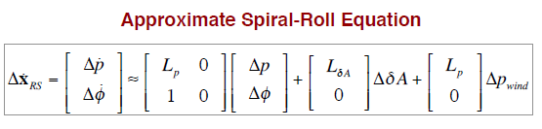


Slide 56




Slide 57

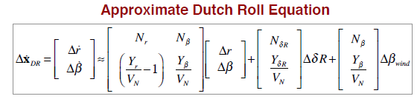


Slide 59

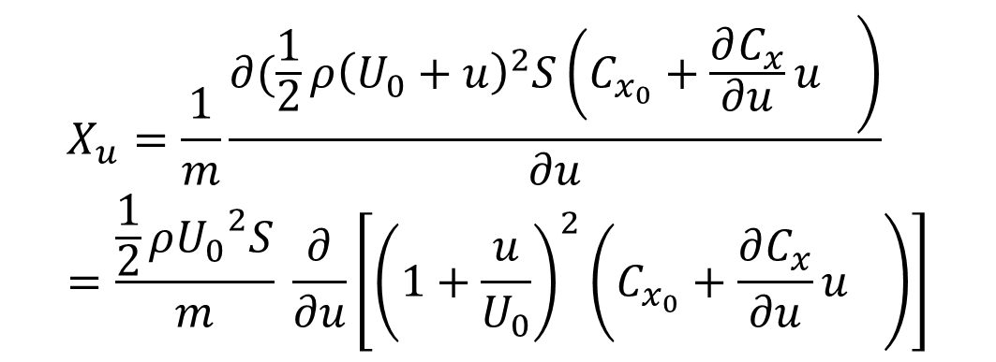
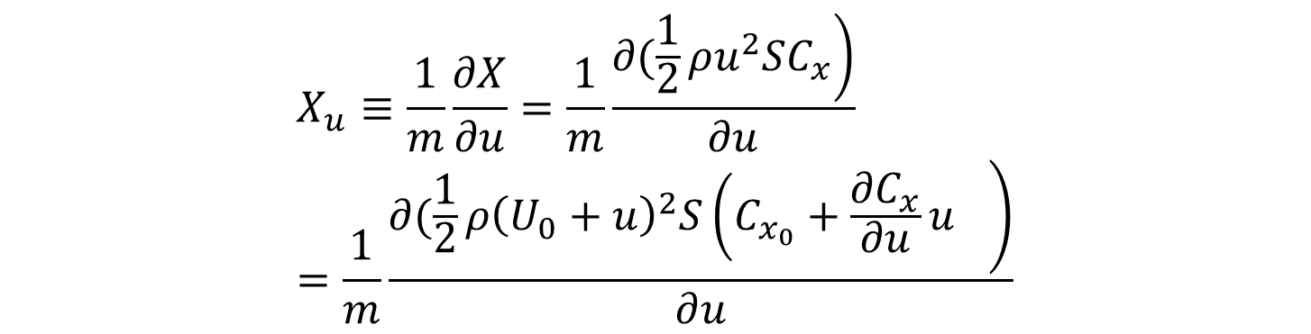
Appendix : $X_{u} Derivative calculation$
$$X_{u}≡\frac{1}{m}\frac{∂X}{∂u}=\frac{1}{m}\frac{\left.∂(\frac{1}{2}ρu^{2}SC_{x}\right)}{∂u}=\frac{1}{m}\frac{\left.∂(\frac{1}{2}ρ{\left(U_{0}+u\right)}^{2}S{\left(C_{x_{0}}+\frac{∂C_{x}}{∂u}u\right.}_{}\right)}{∂u}$$
$$X_{u}=\frac{1}{m}\frac{\left.∂(\frac{1}{2}ρ{\left(U_{0}+u\right)}^{2}S{\left(C_{x_{0}}+\frac{∂C_{x}}{∂u}u\right.}_{}\right)}{∂u}=\frac{\frac{1}{2}ρ{U_{0}}^{2}S}{m} \frac{∂}{∂u}\left[\left.{\left(1+\frac{u}{U_{0}}\right)}^{2}{\left(C_{x_{0}}+\frac{∂C_{x}}{∂u}u\right.}_{}\right)\right]$$

Slide 60
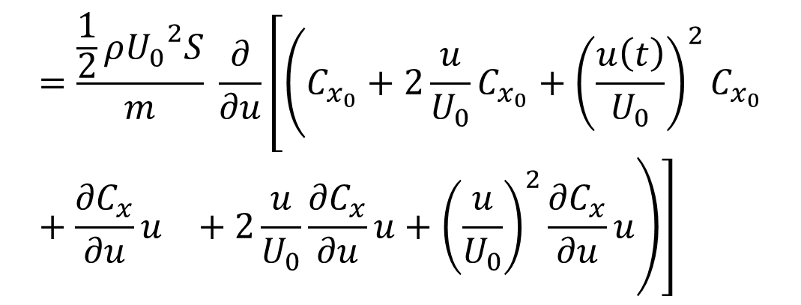

$$X_{u}=\frac{\frac{1}{2}ρ{U_{0}}^{2}S}{m} \frac{∂}{∂u}\left[\left.{\left(1+\frac{u}{U_{0}}\right)}^{2}{\left(C_{x_{0}}+\frac{∂C_{x}}{∂u}u\right.}_{}\right)\right]=\frac{\frac{1}{2}ρ{U_{0}}^{2}S}{m} \frac{∂}{∂u}\left[\left.{\left(1+2\frac{u}{U_{0}}+(\frac{u}{U_{0}}\right)}^{2}){\left(C_{x_{0}}+\frac{∂C_{x}}{∂u}u\right.}_{}\right)\right]$$
$$=\frac{\frac{1}{2}ρ{U_{0}}^{2}S}{m} \frac{∂}{∂u}\left[\left.{\left(C_{x_{0}}+2\frac{u}{U_{0}}C_{x_{0}}+{\left(\frac{u\left(t\right)}{U_{0}}\right)}^{2}C_{x_{0}}+\frac{∂C_{x}}{∂u}u\right.}_{}+2\frac{u}{U_{0}}\frac{∂C_{x}}{∂u}u+{\left(\frac{u}{U_{0}}\right)}^{2}\frac{∂C_{x}}{∂u}u\right)\right]$$

Slide 61



$$=\frac{\frac{1}{2}ρ{U_{0}}^{2}S}{m} \frac{∂}{∂u}\left[\left.{\left(C_{x_{0}}+2\frac{u}{U_{0}}C_{x_{0}}+{\left(\frac{u}{U_{0}}\right)}^{2}C_{x_{0}}+\frac{∂C_{x}}{∂u}u\right.}_{}+2\frac{u}{U_{0}}\frac{∂C_{x}}{∂u}u+{\left(\frac{u}{U_{0}}\right)}^{2}\frac{∂C_{x}}{∂u}u\right)\right]$$
$${ X}_{u}≈\frac{\frac{1}{2}ρ{U_{0}}^{2}S}{m} \frac{∂}{∂u}\left[\left.{\left(C_{x_{0}}+2\frac{u}{U_{0}}C_{x_{0}}+\frac{∂C_{x}}{∂u}u\right.}_{}\right)\right]$$
$${ X}_{u}=\frac{\frac{1}{2}ρ{U_{0}}^{2}S}{m} \left[\left.{\left(0+2\frac{C_{x_{0}}}{U_{0}}+\frac{∂C_{x}}{∂u}\right.}_{}\right)\right]$$

Slide 62





$${From C}_{x}=C_{T}−C_{D}\cos{α}+C_{L}\sin{α}≈C_{T}−C_{D}+C_{L}α$$
$${\frac{∂C_{x}}{∂u}}_{}={\frac{∂C_{T}}{∂u}}_{}−\frac{∂C_{D}}{∂u}{={\frac{∂C_{T}}{∂u}}_{}−C}_{D_{u}}=\frac{∂C_{T}}{∂u}−M\frac{∂C_{D}}{∂M}$$
$$\frac{∂C_{T}}{∂u}=\frac{1}{\frac{1}{2}ρ{U_{0}}^{2}S}\frac{∂T}{∂u}=\frac{1}{\frac{1}{2}ρ{U_{0}}^{2}S}\frac{\left.∂(\frac{1}{2}ρu^{2}SC_{T}\right)}{∂u}$$
$$≈ \frac{∂}{∂u}\left[\left.{\left(C_{T_{0}}+2\frac{u\left(t\right)}{U_{0}}C_{T_{0}}+\frac{∂C_{T}}{∂u}u\right.}_{}\right)\right]$$
$$\frac{∂C_{T}}{∂u}= −2C_{T_{0}}$$

Slide 63




Then ${\frac{∂C_{x}}{∂u}}_{}=2C_{T_{0}}−MC_{D_{M}}$
And $X_{u}=\frac{\overline{q}S}{mU_{0}} \left[{(2C_{x_{0}}−2C_{T_{0}}−MC_{D_{M}}}_{})\right]$
As in steady flight conditions
$$C_{x_{0}}=C_{T_{0}}−C_{D_{0}}+C_{L_{0}}\sin{θ_{0}}$$
So ${2C}_{x_{0}}−{2C}_{T_{0}}={−2 C}_{D_{0}}+2C_{L_{0}}\sin{θ_{0})≈{−2 C}_{D_{0}}}$
$${And X}_{u}=−\frac{\overline{q}S}{mU_{0}} \left[\left.{\left(2C_{D_{0}}+MC_{D_{M}}\right.}_{}\right)\right]$$

