Slide 1
Health coaching in practice:
Helping your clients achieve their health goals
Dr Danielle Crida MBChB, Dip Nutr
Nutritionist, Igennus Healthcare Nutrition

Slide 2
“It always seems impossible until it’s done” Nelson Mandela
Notes:
As healthcare practitioners,taking a full case history and giving expert advice is often the straightforward part of the job. Getting clients to implement your recommendations can be much more difficult. The reason is clear – information overload and hectic lifestyles make advice easy to access but challenging to put into practice. Too often clients get caught in the vicious circle of stress and health issues coupled with not making time for self-care and health-promoting practices. The best assessments, advice and supplements may be ineffective without consistent behaviour supporting nutrition, sleep, stress reduction and appropriate exercise, leading to unwell, unhappy clients and unfulfilled practitioners.
We all know where we want to be, it’s reaching it that’s difficult

Slide 3
Contents
Why assist clients with goal setting?
Why is change difficult?
Stages of change
Setting goals
Choosing focus areas
SMART action steps
Readiness for change
Barriers and Motivators
Finalising action steps
Tools
Follow up
Summary
Notes:
Close to my heart 2 reasons – working with patients, clients – frustrating when you are treating them but know really need to make lifestyle changes to optimise health
Spend years in situations where not prioritising self care. Know what have to do, don’t make time to do it. Or only focus on 1 or a few areas. Same tools use here, can use on yourself

Slide 4
Notes:
Many clients have goals but are unsure what steps to take to achieve them, or know what they need to do but just can’t bring themselves start implementing action steps or stick with the steps for long enough to appreciate the benefits
When we marry our roles of expert with that of health coach and ally, it’s more than just telling clients what to do, it’s about helping them decide which focus areas will help them achieve their health goals, co-creating SMART action steps, and assisting them with tools/tips to overcome barriers/increase motivation and helping them to reassess goals and adapt goals regularly.

Slide 5
Why move from expert to coach/ally to help clients achieve health goals ?
Improve client wellness
Empowering – greater chance of success
Takes emphasis off practitioner being responsible for clients’ health outcomes
Enhances consultation process
Fulfilment for practitioner
Follow-up appointments
Word-of-mouth referrals

Slide 7
Notes:
Seen by some as challenging and confrontational – creating fear & resistance
Can generate a sense of loss – one’s life may need to be re-examined, faced, reflected upon and adjusted
Not ready to make changes
Fear is not a good motivator
When someone tells you what to do you are less likely to want to do it
Lack of willpower – immediate gratification
stress/anxiety
Fearful of the impact of making the change
Stress promotes activities that provide temporary relief – eating high sugar, high salt, high fat foods
Sleep deprivation also – increases likelihood of poor choices – impacts decision making activities

Slide 8
Difficult, but worthwhile ...
Replacing 30 minutes of sedentary time with light physical activity reduced risk of death from all causes by 11%; from cardiovascular disease by 24%
Replacing 10 minutes of sedentary time per day with moderate to vigorous physical
activity resulted in a 38% reduction in deaths from cardiovascular disease
Dohrn,I et al (2017) Replacing sedentary time with physical activity: a 15-year follow-up of mortality in a national cohort. Clinical Epidemiology. 2018(10):179—186. https://doi.org/10.2147/CLEP.S151613
Notes:
(From Chris Kresser)Let’s face it—change is hard.
If it wasn’t, the chronic disease epidemic wouldn’t exist.
But the good news is that we can use smart strategies based on recent discoveries about how the brain works to make change easier.
One of these strategies, is “shrinking the change.”
This means breaking a big change—like starting an exercise program—into smaller, more doable chunks.
Shrinking the change increases our chances of success for several reasons:
It reduces our resistance to getting started
It builds momentum
It gives us a series of small wins, which increases confidence
And sometimes, even the small changes themselves can have a surprisingly big impact.

Slide 9
Notes:
Most people have an idea of their future self : Ideal of what they’d like to be.
But we identify with our present self – someone that likes instant gratification and lacks willpower.
Change talk : Imagine what you’d say to a friend who needs to make a change.
Now imagine that was your future self talking to you. Identify with your future self – make decisions that will move you from current self to future self.
(It has been suggested: Write a letter from your future self to your current self thanking you for the good decisions you’re making)

Slide 10
Notes:
Ppts told they were in a study about how watching TV while eating affects taste perception
Aim: See how guilt and shame affects willpower
1 group received compassionate message ‘Everyone indulges sometimes – don’t be too hard on yourself’, other did not. All given doughnut then told they could eat as much chocolate as they wanted – different types of chocolate.
Group given compassionate message ate less than control group
Control group had higher levels of guilt and shame and increased eating as result.
Brain switches to version of yourself that is more susceptible to immediate gratification/procrastination, will power switches off
Why ? We want to get rid of feeling such as guilt, shame, and research shows we will fall back to the very pattern that triggers these emotions in the first place.
Encouragement over criticism. Sometimes we fall off the wagon. It is not saying anything about who we are but rather about the process of change.
Research shows that individuals who are less critical, less guilty and blame oriented tend to be more forgiving and compassionate leading to higher levels of willpower and success outcomes.
Feeling desire to change while acknowledging there is a gap: self compassion can support this transition. Everyone struggles , it is a process and we are all human.
Letting go of the ideal and adjusting expectations.
Disinhibition – overeating among restrained eaters
Practise self compassion vs. negative self-evaluation after behaviour-breaking
Falling off wagon vs. stopping the wagon

Slide 11
Notes:
Motivation – the internal driving force by which humans move towards a goal – Motivation drives behaviour and behaviour is what we need to change to improve health. Difference between changing behaviour and maintaining behavioural change.
3 components to motivation: Activation (involves decision to initiate a behaviour, such as booking a session with an NLC), persistence – continued effort towards a goal despite obstacles (e.g. walking in bad weather), intensity (commitment and vigour goes into pursuing a goal e.g. an unfit person walking 1 mile 5 times per week vs. someone already fit running 30 mins once per week)
Motivation wanting to lose weight (look better, improve self esteem), improve energy (be able to exercise, play with kids, feel better), wanting a diet supporting cardiovascular health (sent by dr, avoid going on medication, reducing health symptoms))

Slide 12
Extrinsic motivators
“I should”
Being ‘pushed forwards’
Often short-lived
Fear-based
Reward-based
Love-based
Financial
Recognition
Intrinsic Motivators
“I want to”
Being ‘pulled forwards’
Changing behaviour because it makes you feel good
Engenders feelings of joy and stimulation
Reward comes from action itself
Reason for change: self-love, self-compassion
Key to long-term successful change
Notes:
Motivators can be internal or external
Extrinsic/external:
Performing an action or in order to receive an external reward or outcome.
This can be positive such as receiving financial reward or recognition or it can be
from a more negative place e.g. feeling the need to lose weight to be more loveable
Fear based motivation – The desire to change behaviour to avoid a negative outcome e.g. going on a
low fat diet to prevent a heart attack
Based on ‘I should’ rather than ‘I want to’
Reward based motivation – Changing behaviour to achieve a reward e.g. You (or your spouse) buying you
a new wardrobe after you lose 10 lbs
The lure of the reward will certainly motivate for a while but what happens when this has been achieved?
Love Based Motivation – An example might be giving up cigarettes because your kids worry about you
This can be love of self or love of others
Internal/Intrinsic:
It brings intrinsic joy
The vision of a ‘well life’ will pull you forward towards your goal
Intrinsic motivation – Changing a behaviour and
maintaining that change because that behaviour makes you feel good e.g. the endorphin hit after
exercise or being aware of the energy that you feel when you eat well
You enjoy how the behaviour makes you feel, regardless of health benefits
Engenders feelings of joy, fun and stimulation
Helping clients to understand their own intrinsic motivators is the key to longterm successful change
Performing an action or behaviour because you enjoy the activity.
The reward comes from the action itself
We can’t motivate someone to change, however we can help them understand
their own motivation and especially to discover what is a positive motivator for
them
Are they being pushed forward or running from a fear based motivation?
Or running towards a healthy and well life?
Helping your clients understand their own motivations
Help your client discover positive motivations that pull
them towards healthy behaviour, loved based
Create a vision of themselves as healthy - big picture
Change the reasons for change - to self-love, self-worth, self-compassion

Slide 13
Stages of Change
Pre-contemplation
Contemplation
Preparation
Action
Maintenance & Relapse
Notes:
Stages of behaviour change J O Prochaska and C C DiClemente Stages of Change Model
As individuals move through various stages of change, new thought patterns emerge and a deeper awareness bringing new insights that support behavioural change and increase motivation and self efficacy.
Changing one behaviour increases odds of taking action on a second behaviour, known as ‘coaction’
Convincing/persuading/manipulating tactics not as effective as focussing on coachee’s own agenda and supporting it with active listening, powerful questioning, empathy, unconditional positive regard and meeting coachee where they are in stages of change framework.
Tapping into an individual’s stengths, positive motivators and supports key to building self confidence, optimism, self-accountability.
Patient non-compliance and motivation often focus on pt failure.
Understanding client readiness to make change, appreciating barriers to change and helping clients anticipate relapse can improve client satisfaction and lower physician frustration during the change process.

Slide 14
Pre-contemplation
Contemplation
Preparation
Action
Maintenance
& relapse
Not considering changing
In denial
Given up due to past failures
Dealing with grief, loss of control, shame
Hopeless , indifferent or defensive
Convincing/persuading tactics met with resistance
Goal : THINK about changing a behaviour
Maintain a positive relationship, personalise risk factors, pose thoughtful questions, instil hope
Talk about feelings and fears
Encourage connection with others and support
Questions: “How will you know it’s time to quit/change” “What would have to happen for you to know that this is a problem ?”
Notes:
PRECONTEMPLATION STAGE eg person had heart attack but downplaying importance of it, pretending it didn’t happen, pre-diabetic made no dietary or exercise changes, COPD still smoking.
During the precontemplation stage, patients do not even consider changing. Smokers who are “in denial” may not see that the advice applies to them personally. Patients with high cholesterol levels may feel “immune” to the health problems that strike others. Obese patients may have tried unsuccessfully so many times to lose weight that they have simply given up. May not believe their behaviour is a problem. Resigned to behaviour because of previous failed efforts. Believes consequences are not serious. Argumentative, hopeless, in denial. Natural tendency to try convince them, usually engenders resistance
Goal: Think about changing a behaviour. Resistance = sign that practitioner has moved too far ahead of patient in change process – shift back to empathy and thought-provoking questions.
Physician can engage clients in the contemplation process by developing and maintaining a positive relationship, personalizing risk factors and posing questions that provoke thoughts about patient risk factors and the perceived “bottom line.” Reflect with empathy, instill hope and gently point out discrepancies between goals and statements. “How will you know that it's time to quit?” allows patients to be their “own expert” and can help them begin a thought process that extends beyond the examination room. “What would have to happen for you to know that this is a problem?”
“What warning signs would let you know that this is a problem?”
“Have you tried to change in the past?”
“Astounding non-compliance” changing(event,(like(the(onset(or(worsening(of(a(health(challenge(they(feel(a(loss(of(control(
that(may(threaten(their(safety,(they(experience(grief(at(the(loss(of(health,(ability,(or(dreams,(
and(often(need(to(redefine(their(identity. Loss of dreams, how you thought your life would be. (Stages of grieving: Denial – Anger-Bargaining-Depression-Acceptance). May be framing illness as a personal failing. Embarresment/shame that no longer fully healthy.
Make them feel like they have an ally, someone who has their best interests at heart.Person needs understanding, empathy and support, not lots of pressure to make changes immediately. Improve self esteem. Regain sense of power & control in life. – realaise they can affect the course of their illness by lifestyle changes they make.
Meet with compassion not judgement, acknowledge and explore their experience, ask what it was like receiving diagnosis, reflect their feelings, talk about any fears, encourage them to connect to others and ask for support

Slide 15
Pre-contemplation
Contemplation
Preparation
Action
Maintenance
& relapse
Ambivalent about change
Giving up enjoyed behaviour causes sense of loss despite perceived gain
Assessing pros and cons of change
“Yes, but...” statements
Give empathy, praise, encouragement
Questions: “What difficult things have you accomplished in the past?” “Why do you want change at this time?” “What are your reasons for not changing?”
Notes:
CONTEMPLATION STAGE
During the contemplation stage, patients are ambivalent about changing. Giving up an enjoyed behavior causes them to feel a sense of loss despite the perceived gain. During this stage, patients assess barriers (e.g., time, expense, hassle, fear, “I know I need to, doc, but ...”) as well as the benefits of change. Struggle with ambivalence – weighing pros and cons of current behaviour and benefits and barriers to change. It is not unusual for pts to spend years in the contemplation stage, which physicians can easily recognize by their “yes, but” statements. Empathy, validation, praise and encouragement are necessary during all stages but especially when patients struggle with ambivalence and doubt their ability to accomplish the change. Physicians may find statements such as the following to be useful: “Yes, it is difficult. What difficult things have you accomplished in the past?” or “I've seen you handle some tough stuff, I know you'll be able to conquer this.” A successful approach calls for physicians to ask patients about possible strategies to overcome barriers and then arrive at a commitment to
Goal: patient will examine benefits and barriers to change.
“Why do you want to change at this time?”
“What were the reasons for not changing?”
“What would keep you from changing at this

Slide 16
Pre-contemplation
Contemplation
Preparation
Action
Maintenance
& Relapse
Planning to make a change in next month
May experiment with small changes
Encourage addressing barriers
Cutting preparation short lowers chance of success
Be generous with praise and admiration
Notes:
PREPARATION STAGE
During the preparation stage, patients prepare to make a specific change. They may experiment with small changes as their determination to change increases. For example, sampling low-fat foods may be an experimentation with or a move toward greater dietary modification. Switching to a different brand of cigarettes or decreasing their drinking signals that they have decided a change is needed. When patients experiment with changing a behavior (preparation stage) such as cutting down on smoking or starting to exercise, they are shifting into more decisive action. Physicians should encourage them to address the barriers to full-fledged action. While continuing to explore patient ambivalence, strategies should shift from motivational to behavioral skills. During the action and maintenance stages, physicians should continue to ask about successes and difficulties—and be generous with praise and admiration.
Planning to make changes within the next month. Important first step is to make their intention public. People who cut preparation stage short lower chances of success.

Slide 17
Pre-contemplation
Contemplation
Preparation
Action
Maintenance
& relapse
Where we all want to see our clients !
Most obviously busy period, requiring time and energy
If prior stages rushed, action often short-lived
Praise any action taken
Notes:
ACTION STAGE
The action stage is the one that most physicians are eager to see their patients reach. Many failed New Year's resolutions
provide evidence that if the prior stages have been glossed over, action itself is often not enough. Any action taken by patients should be praised because it demonstrates the desire for lifestyle change.
Remove all treats from cupboard, pour last beer down drain, throw cigarettes away. Most obviously busy period, requiring most time and energy.

Slide 18
Pre-contemplation
Contemplation
Preparation
Action
Maintenance
& relapse
Most people cycle though stages of change several times before change becomes truly established
Anticipate and learn from relapses
Focus on successes
Notes:
MAINTENANCE AND RELAPSE PREVENTION
Maintenance and relapse prevention involve incorporating the new behavior “over the long haul.” Discouragement over occasional “slips” may halt the change process and result in the patient giving up. However, most patients find themselves “recycling” through the stages of change several times before the change becomes truly established.
Relapses bound to happen – good to learn from them eg smoker relapses learn best avoid smoke-filled environments
Clients learn to order from menu rather than go to all you can eat buffet
Focusing on the successful part of the plan (“You did it for six days; what made that work?”) shifts the focus from failure, promotes problem solving and offers encouragement. The goal here is to support patients and re-engage their efforts in the change process. They should be left with a sense of realistic goals to prevent discouragement, and their positive steps toward behavior change should be acknowledged.

Slide 19
Readiness to change ruler
Not ready to change Ready to change
Questions:
“Why not further to left?” - to elicit motivational statements
“What would it take to move more to right ?” – to elicit barriers
1 2 3 4 5 6 7 8 9 10
Notes:
Ways to overcome barriers and things that can be done before next visit.

Slide 20
Notes:
Why ?
What would change in your life for the better ?
How rate current health scale of 1-10 ? Why not a 1 ?
Tell me 3 things that would positively change in your life if your health was 10/10
Now lets look at 3 reasons why you might not want to change your diet/lifestyle ?
List 3 reasons why you want to change your diet and lifestyle
What would need to change in your life in order to attain that goal ?
How would your life look in 6/12 months time if you achieved your goal.
How would your life look in x years if you made no change ?
What would have to change to improve that to ?
Listen for vision, value, purpose and committment
Listen for the big 5 – 1. Focus – Goal feasibility; 2. Mindset/Attitude 3. Skills & Capabilities 4. Habilts, practises and patterns 5. Energy – follow the energy
Use of Powerful questions – evoke possibility, don’t presume an answer, get client to positive mindset, promote deep thinking

Slide 21
Goal(s)
Focus area
Action step
Action step
Focus area
Action step
Action step

Slide 22
Focus areas
Nutrition examples
Non-nutrition examples
Decrease sugar
Decrease refined carbs
Decrease processed food
Eat more nuts, seeds, legumes
Eat more veg & fruit
Choose more plant over animal protein
Decrease caffeine
Sleep – improving amount or quality
Exercise – increasing or starting a new type
Stress reduction – starting meditation, yoga
Increasing pleasurable activities
Community/relationships
Stop smoking
Choosing focus areas
Client: “Do you have any ideas, or anything that has worked for you before, that you think might help towards your goal?” OR “Has your healthcare provider recommended that you make certain changes ?”
Suggestions from you
+/- Wellness wheel
Notes:
(If you’re a nutritionist may have food diary, questionairres to help with this etc)
Non nutrition – wellness wheel can help
What areas of your diet and lifestyle do you need to focus on to achieve it ?
Get client to suggest ideas first then add your own based on your expertise

Slide 23
Notes:
WHEEL OF LIFE INSTRUCTIONS
The 8 sections in the Wheel of Life represent balance. **
• Use the center of the wheel as 0 and the outer edge
as 10, rank your level of satisfaction with each
area out of 10 by drawing a straight or curved line to
create a new outer edge (see example)
• The new perimeter of the circle represents your
‘Wheel of Life’.
Example
environment – home, place of work
Fun, leisure, recreation, enjoyment – what makes you light up and what is sucking away your joy and happiness - Pleasure
Self development/learning/spiritual
Significant other/romance/partner
Friends and family
Career/occupational
Finances
Health (emotional/physical/fitness/nutrition/wellbeing
Community – volunteering, joining a class, spend time with friends, find a ‘tribe’, meetups
Relationships can be one – romantic partners and family. OK to move away from toxic relationships/
There’s more to llife than health and there’s more to health than food (Chris Kresser)
Health – The abillity to live your dream (Moshe Feldenkreis)
See the blind spots – significant areas of our lives where we lack awareness and insight – weak link in chain – strong chains spent significant money and time on

Slide 24
Notes:
WHEEL OF LIFE INSTRUCTIONS
The 8 sections in the Wheel of Life represent balance. **
• Use the center of the wheel as 0 and the outer edge
as 10, rank your level of satisfaction with each
area out of 10 by drawing a straight or curved line to
create a new outer edge (see example)
• The new perimeter of the circle represents your
‘Wheel of Life’.
Example
environment – home, place of work
Fun, leisure, recreation, enjoyment – what makes you light up and what is sucking away your joy and happiness - Pleasure
Self development/learning/spiritual
Significant other/romance/partner
Friends and family
Career/occupational
Finances
Health (emotional/physical/fitness/nutrition/wellbeing
Community – volunteering, joining a class, spend time with friends, find a ‘tribe’, meetups
Relationships can be one – romantic partners and family. OK to move away from toxic relationships/
There’s more to llife than health and there’s more to health than food (Chris Kresser)
Health – The abillity to live your dream (Moshe Feldenkreis)
See the blind spots – significant areas of our lives where we lack awareness and insight – weak link in chain – strong chains spent significant money and time on

Slide 25
Example: Pam
42yrs old
Mother of 2 teenagers
Health goals: Lose weight & increase energy
Focus areas:
Nutrition: Decrease refined carbohydrates; increase veg & fruit; decrease alcohol
Non-nutrition: Improve sleep; start regular exercise; start a stress-relief activity

Slide 26
Smart Action Steps
S
Specific
M
T
Time-bound
A
Measurable
Realistic
R
Achievable
Notes:
Let client come up with them, assist as neccesary
Specific – much greater chance of cheiving a specific than a general goal eg exercise more vs walk for 20 mins 3 days per wekk
Measureable – something able to be tracked so clients can measure progress made, feel good factor of having accomplished a goal
Acheivable/attainable, taking into account any barriers
Realistic – client must be both willing and able to work towards the action
Time-bound – all actions should be grounded in a time frame – how many times per week, for how long etc
Smart vs not smart: Increase vegetable intake vs eat 3 different vegetables at dinner, 5 days per week
Action: Reduce amount of coffee you drink vs. Replace afternoon coffee with warm water or herbal tea 3 days per week.

Slide 27
Pam: Brainstorming SMART Action Steps
Decrease refined carbohydrates
Eat oats (rather than cereal/toast) for breakfast 3 times per week
Swap lunchtime sandwich for a homemade salad with legumes 3 times per week
Increase veg & fruit
Eat 3 portions of veg/salad with dinner 5 times per week
Have a piece of fruit for an afternoon snack 5 times per week
Decrease alcohol
Drink no more than 2 drinks per day
Have 4 alcohol-free days per week
Improve sleep
Turn off mobile phone by 9pm 6 nights per week
Switch off light by 10pm 4 nights per week
Start regular exercise
Walk for 30 minutes 4 times per week
Do Parkrun 3 times per month
Start a stress-relief activity
Use a meditation app e.g. Headspace
Join a yoga class once per week

Slide 28
Readiness to change 1 - 5
Decrease refined carbohydrates
5 Eat oats (rather than cereal/toast) for breakfast 3 times per week
3 Swap lunchtime sandwich for a homemade salad with beans 3 times per week
Increase veg & fruit
3 Eat 3 portions of veg/salad with dinner 5 times per week
5 Have a piece of fruit for an afternoon snack 5 times per week
Decrease alcohol
2 Drink no more than 2 drinks per day
5 Have 4 alcohol-free days per week
Improve sleep
2 Turn off mobile phone by 9pm 6 nights per week
5 Switch off light by 10pm 4 nights per week
Start regular exercise
5 Walk for 30 minutes 4 times per week
1 Do Parkrun 3 times per month
Start a stress-relief activity
5 Use a meditation app e.g. Headspace for 10 minutes, 4 times per week
2 Join a yoga class once per week
Notes:
Simple readiness for change tool, how ready are you to make this change on a scale of 1 to 5. Do they have the confidence, support, resources to make them work. Who
Work brainstormed action steps down to 3-5 nutrition and 3-5 non nutriti steps with highest readiness to change score to move forward with initially
Establish if the changes feel manageable or if they need to be reduced/modified in any way to feel more manageable.
Give tips for making them easier to manage eg. bedtime hacks – brush teeth/skincare routine straight after dinner so it’s not a duty to do them later when tired – can lead to procrastination; prepare a healthy breakfast/lunch at night rather than relying on doing it in the morning, plan your weeks meals, goals on a Sunday for the week. Exercise hack – wear exercise clothes when you get up in the morning so you don’t have to change. Do online shopping if you get tempted at supermarket.
Less is more. - nothing succeeds like success. Shrink the change (Chris Kresser)

Slide 29
Finalising action steps
Decrease refined carbohydrates
5 Eat oats (rather than cereal/toast) for breakfast 3 times per week
3 Swap lunchtime sandwich for a homemade salad with beans 3 times per week
Increase veg & fruit
3 Eat 3 portions of veg/salad with dinner 5 times per week
5 Have a piece of fruit for an afternoon snack 5 times per week
Decrease alcohol
2 Drink no more than 2 drinks per day
5 Have 4 alcohol-free days per week
Improve sleep
2 Turn off mobile phone by 9pm 6 nights per week
5 Switch off light by 10pm 4 nights per week
Start regular exercise
5 Walk for 30 minutes 4 times per week
1 Do Parkrun 3 times per month
Start a stress-relief activity
5 Use a meditation app e.g. Headspace for 10 minutes, 4 times per week
2 Join a yoga class once per week
Start small. 3-5 nutrition and non-nutrition action steps.
Notes:
3-5 nutritional and non nutritional
Start small ! More confidence is built when succeeding with small goals.
Balance btwn action steps which are acheivable but are significant enough to make a tangible difference
Praise: You’ve chosen really great goals/focus areas/action steps and I’m feeling really positive about the impact that acheiving these will have on your life

Slide 30
Exploring barriers and motivators
Physical health
Emotional health
Improvement in relationships
Accountability to others
Improved self esteem
Time
Energy
Finances
Lack of support
Lack of skills
Motivators
Barriers
Notes:
Motivators: Internal drivers that makes a person move towards a goal OR external. Can start with external motivators which become internal motivation when once sees that one enjoys the health-promoting behaviour or the positive changes it brings, once self confidence and self esteem increases.
Accountability
Barriers: Anything that prevents you from making changes or failing at changes you decided to make
Eg Time, energy, lack of cooking skills, disliking ‘healthy’ food, lack of money
Identify support/resources/ways of overcoming barriers
Tips to overcome – ‘hacks’

Slide 31
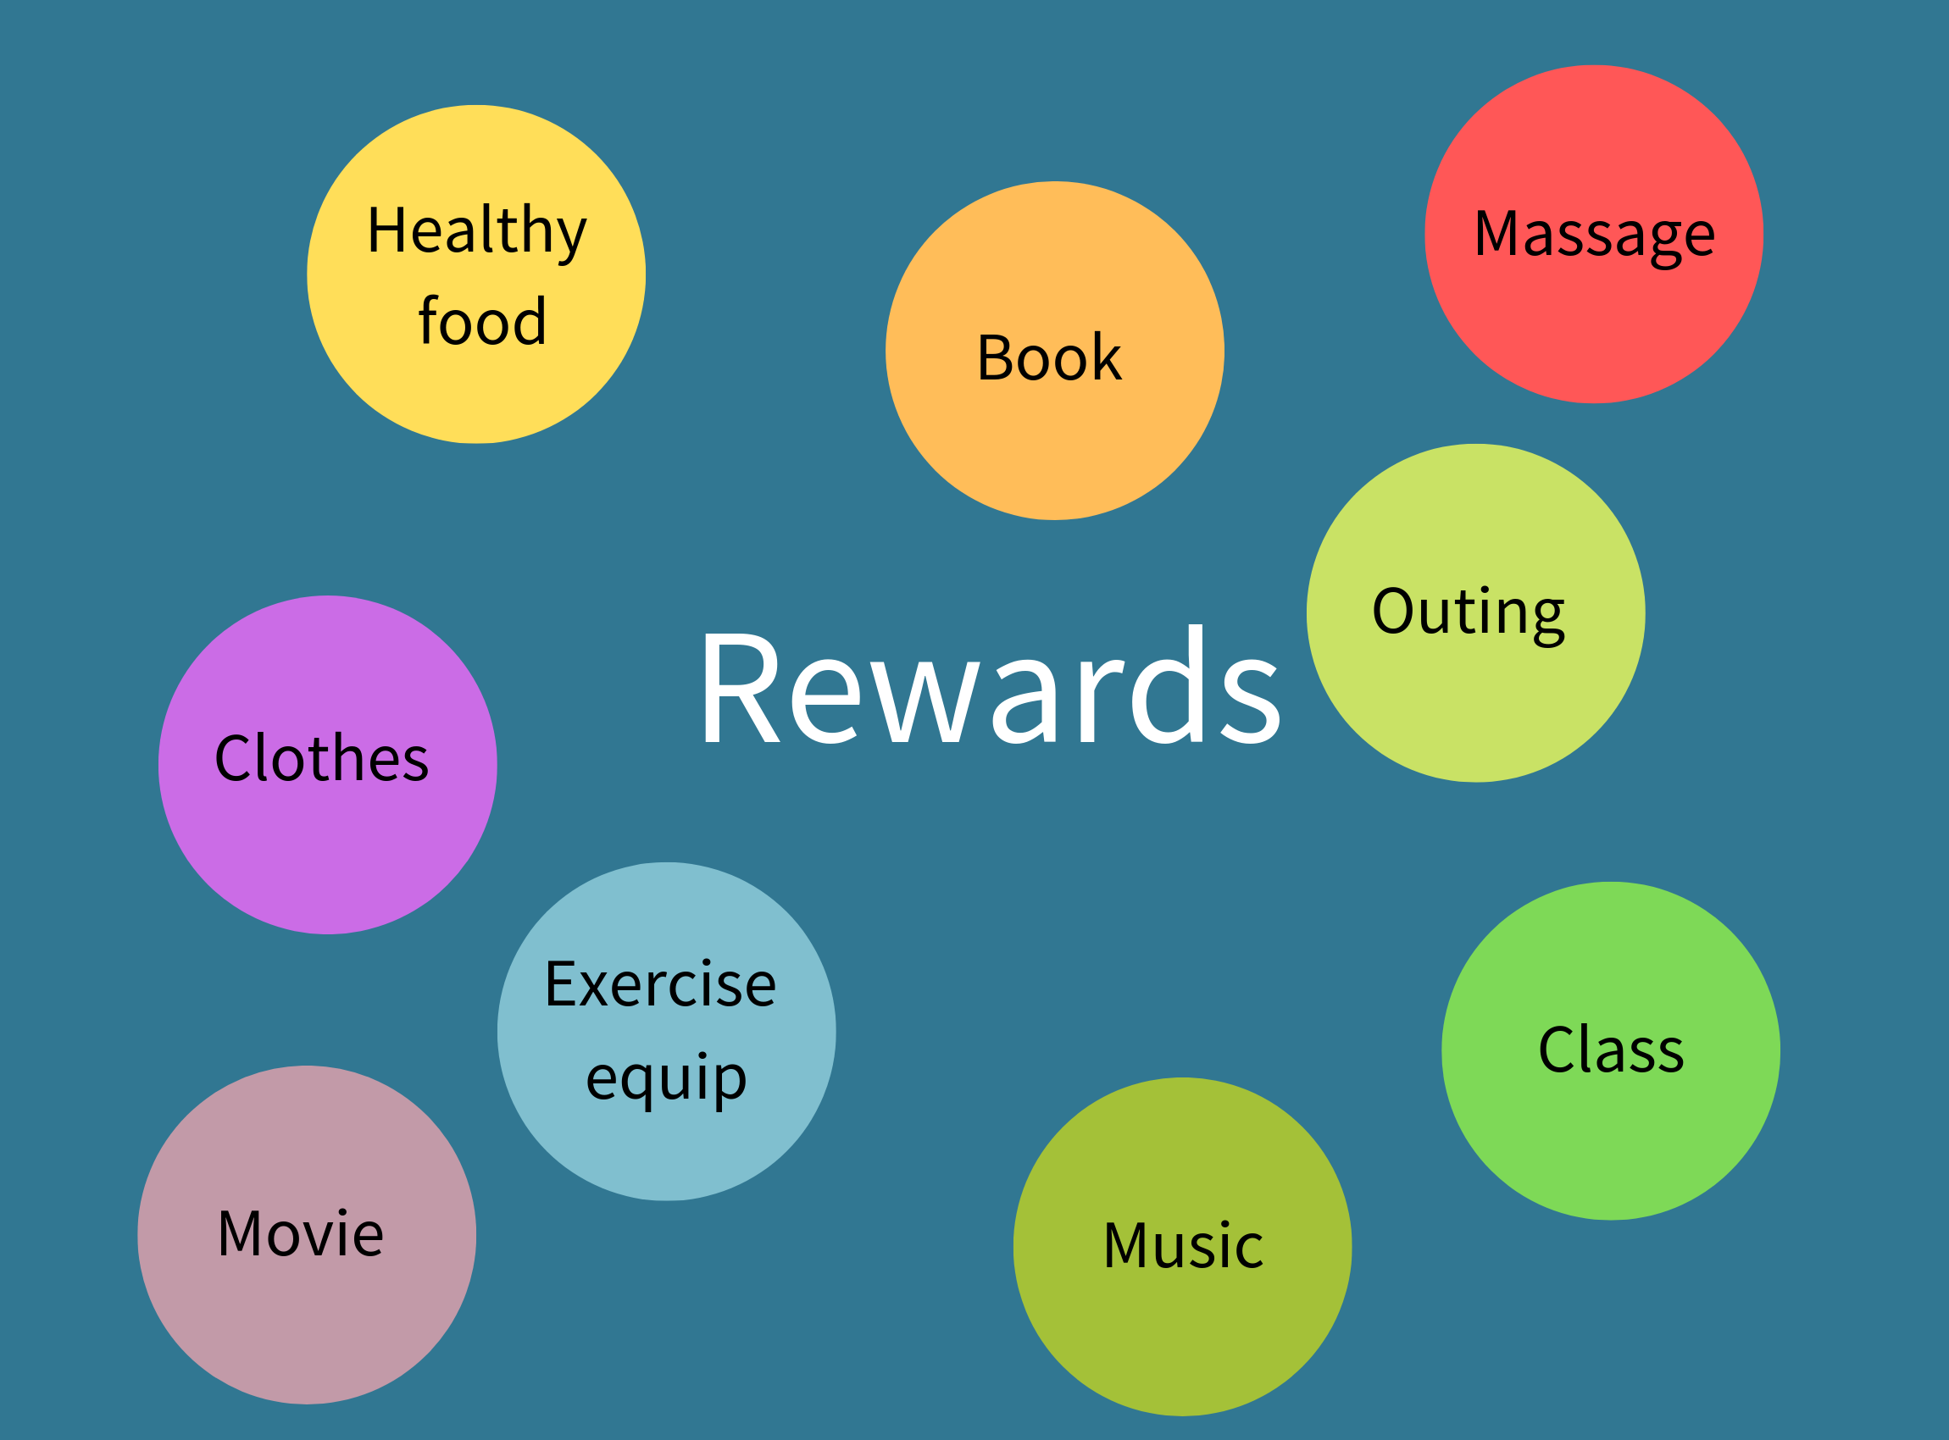

Slide 32
Tracking sheet
 | Mon | Tues | Wed | Thurs | Fri | Sat | Sun
Light out by 10pm, 4 nights/wk | x | x |  | x |  |  | x
Achieved
Walk 30 mins, 4x/wk | x |  | x |  |  | x | x
Achieved
Meditation app 10 mins, 4x per week |  | x | x |  | x |  | x
Achieved
Notes:
Summary of action steps, days of week agreed to, and record of whether client acheived steps or not.

Slide 33
Tracking sheet
 | Mon | Tues | Wed | Thurs | Fri | Sat | Sun
Light out by 10pm, 4 nights/wk | x | x |  | x |  |  | x
Achieved | x | x |  | x |  |  | x
Walk 30 mins, 4x/wk | x |  | x |  |  | x | x
Achieved |  |  |  | x | x | x | x
Meditation app 10 mins, 4x per week |  | x | x |  | x |  | x
Achieved |  |  | x
Notes:
Summary of action steps, days of week agreed to, and record of whether client acheived steps or not.

Slide 34
Additional extras
Supplement recommendations
Referrals
Tools
Notes:
Within scope of practise or refer to reputable company eg Igennus
Referrals (Red flags, other healthcare/sports practitioners)(MyONLINE Clinic)
Tools - Ticksheet – a star chart for grown ups !
Recommendations summary
Info sheets
Recipes

Slide 35
Follow-up
Why ?
How often ?
How ?
Moving the goalposts –
adjusting focus areas &
action steps
Notes:
Track acheivements, fine-tune and build on action steps.
Praise for acheivements : I’ve learned that people will forget what you said, people will forget what you did, but people will neevr forget how you mae them feel – Maya Angelou
Re-assessing and adapting health goals

Slide 36
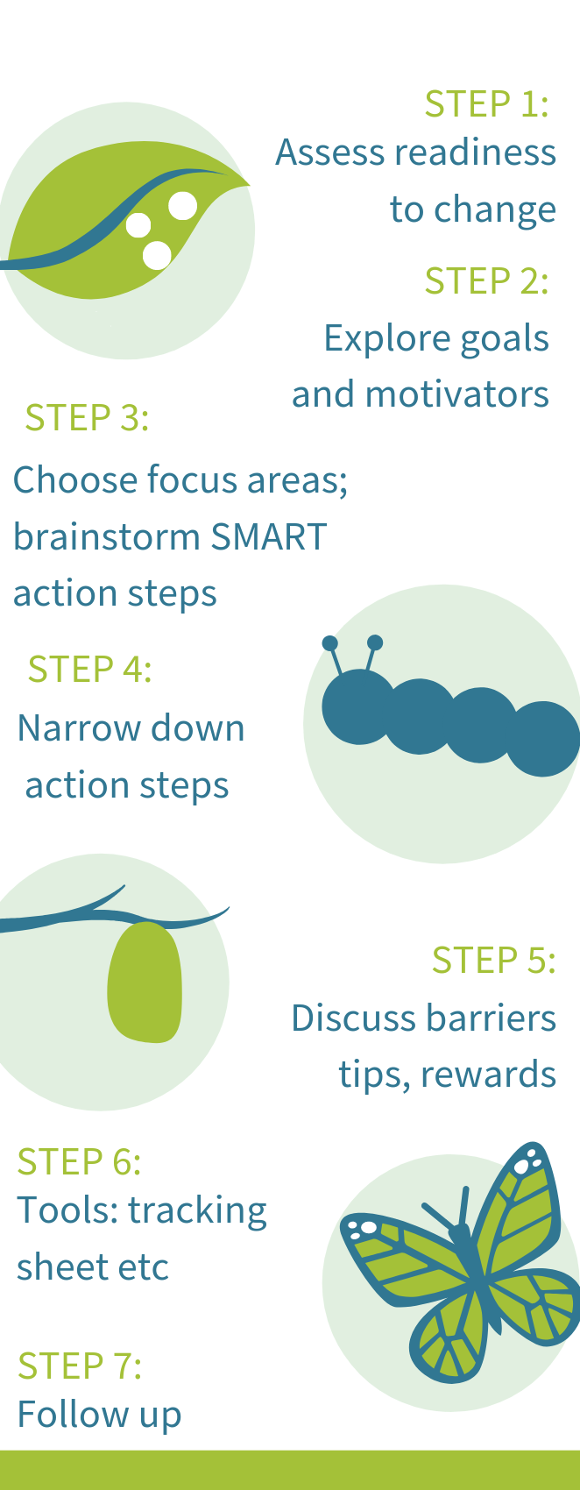
Putting it
all together

Slide 37
References
Adams & Leary (2007). Promoting self-compassionate attitudes towards eating among restrictive and guilty eaters. Journal of Social and Clinical Psychology, Vol. 26, No. 10, 2007, pp. 1120-1144
Arloski, M. Astonishing Non compliance - Understanding Readiness for Change in the Health Challenged Client. Available from: https://www.realbalance.com/images/astonishing_nc-best.pdf
Dohrn,I et al (2017) Replacing sedentary time with physical activity: a 15-year follow-up of mortality in a national cohort. Clinical Epidemiology. 2018(10):179—186. https://doi.org/10.2147/CLEP.S151613
IHS (2017) NLC Unit 14: Coaching Skills. Dublin: Institute of Health Sciences
Zimmerman, G., Olsen, M. & Bosworth, D. (2000) A ‘Stages of Change’ Approach to Helping Patients Change Behavior. Am Fam Physician. 2000 Mar 1;61(5):1409- 1416.

Slide 38
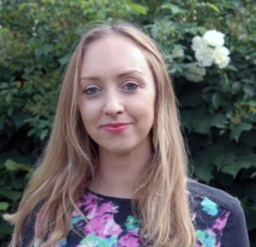
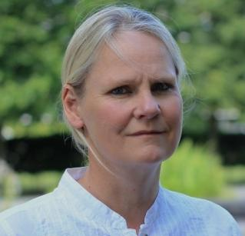
Contact
Commercial | Technical | Nutrition advice
Mina Nazemi Commercial Director minan@igennus.com | Dr Nina Bailey Head of R&D ninab@igennus.com | Danielle Crida Nutritionist danielle@igennus.com
Notes:
DONE

