Slide 1
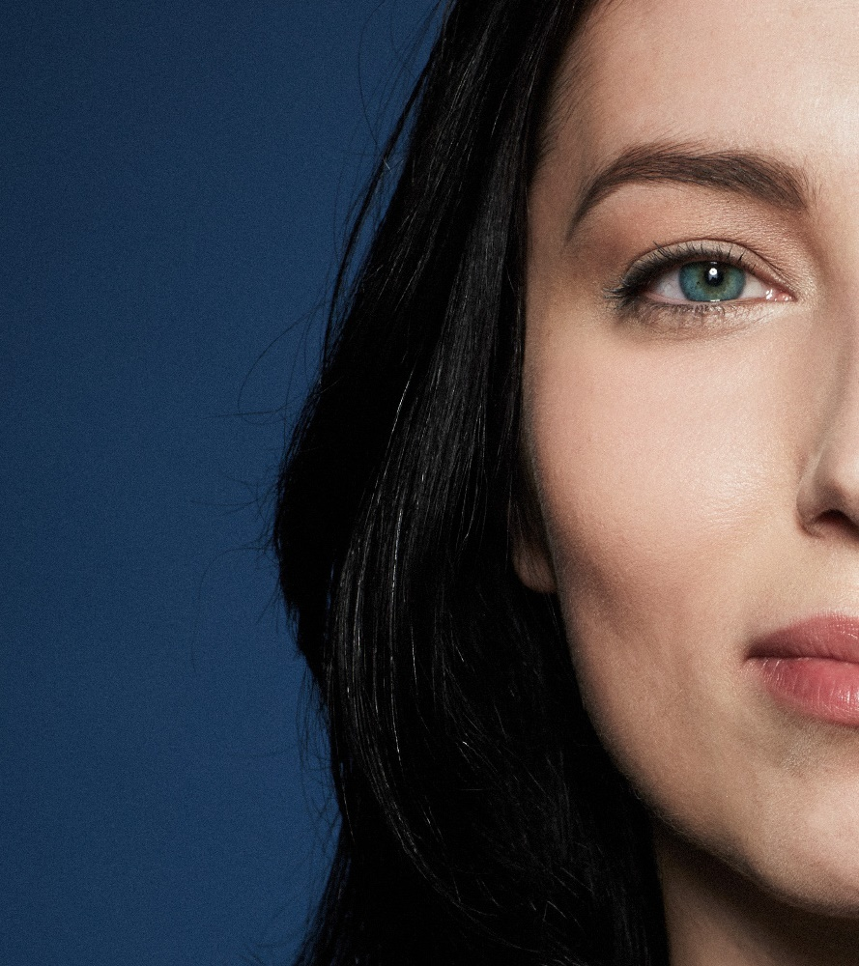
IT Workspace
Summary Workshop
Stockholm
January 23rd 24th 2019
John Doe
Notes:
1

