Slide 1

Collaboration
Luci Xu 03/01/2018

Slide 2

State of the Industry

Slide 3
Evolution of Communications Technology
Modern Video
Communications
Telephone
Conferencing
Hardware Video
Conferencing
Web
Meetings
Cloud Video Conferencing
Interoperable Systems & Meetings
Persistent Chat

Slide 4
Trends Driving Change
Virtual Teams
Rise of Huddle Rooms
Video Quality and Reliability Matters
85% of knowledge workers work on virtual teams
41% never meet in person
The ratio of people to meeting space used to be 75 to 1; now it’s 10 to 1 and in the future it will be 5 to 1
82% of network traffic in 2021 will be video

Slide 5

Transform Your Business with Zoom
Increase Teamwork
with different offices and remote employees
Place video conferencing for everyone in every room
Provide a consistent experience across rooms desktop and mobile
What can a transformed workplace do for your organization?

Slide 6
Zoom Company Overview

Slide 7

Leadership
    Eric S. Yuan
    Founded Zoom in 2011 with experienced engineering team*
    Built the most widely-used video meeting tech
*Zoom engineers have over 1000 years of combined experience working on real-time collaboration software.
Growth
20 Billion+ Annual Meeting Minutes
40%+ of the Fortune 50
90%+ of the Top US Universities
150% YoY User Growth
Cash-flow positive
Funding
About Zoom
145.5M
Sequoia
Emergence Capital
Enterprise Video Communications
Qualcomm Ventures
Horizons Ventures
Notes:
Top US Universities from 2017 US News and World Report

Slide 8

Why We Made Zoom
Eric’s Story
CEO / FOUNDER
    Founding engineer at WebEx, VP of engineering at Cisco WebEx
    Approached Cisco leadership regarding the obvious flaws of WebEx, but Cisco was unwilling to listen
    Left Cisco to create Zoom, WebEx’s best engineers quickly followed
    The Problem: Legacy systems are expensive, complex, and don’t play well with others.
    Eric’s Solution: Build an enterprise-grade, affordable, useable all-in-one platform that works consistently across mobile, desktop, and conference rooms.
Notes:
Specific flaws of Cisco’s collaboration strategy that Eric saw: WebEx built on antiquated data collaboration architecture with poor user experience, Cisco Social Networking built on on-premise architecture, Cisco Jabber shouldn’t be a separate product, etc.

Slide 9

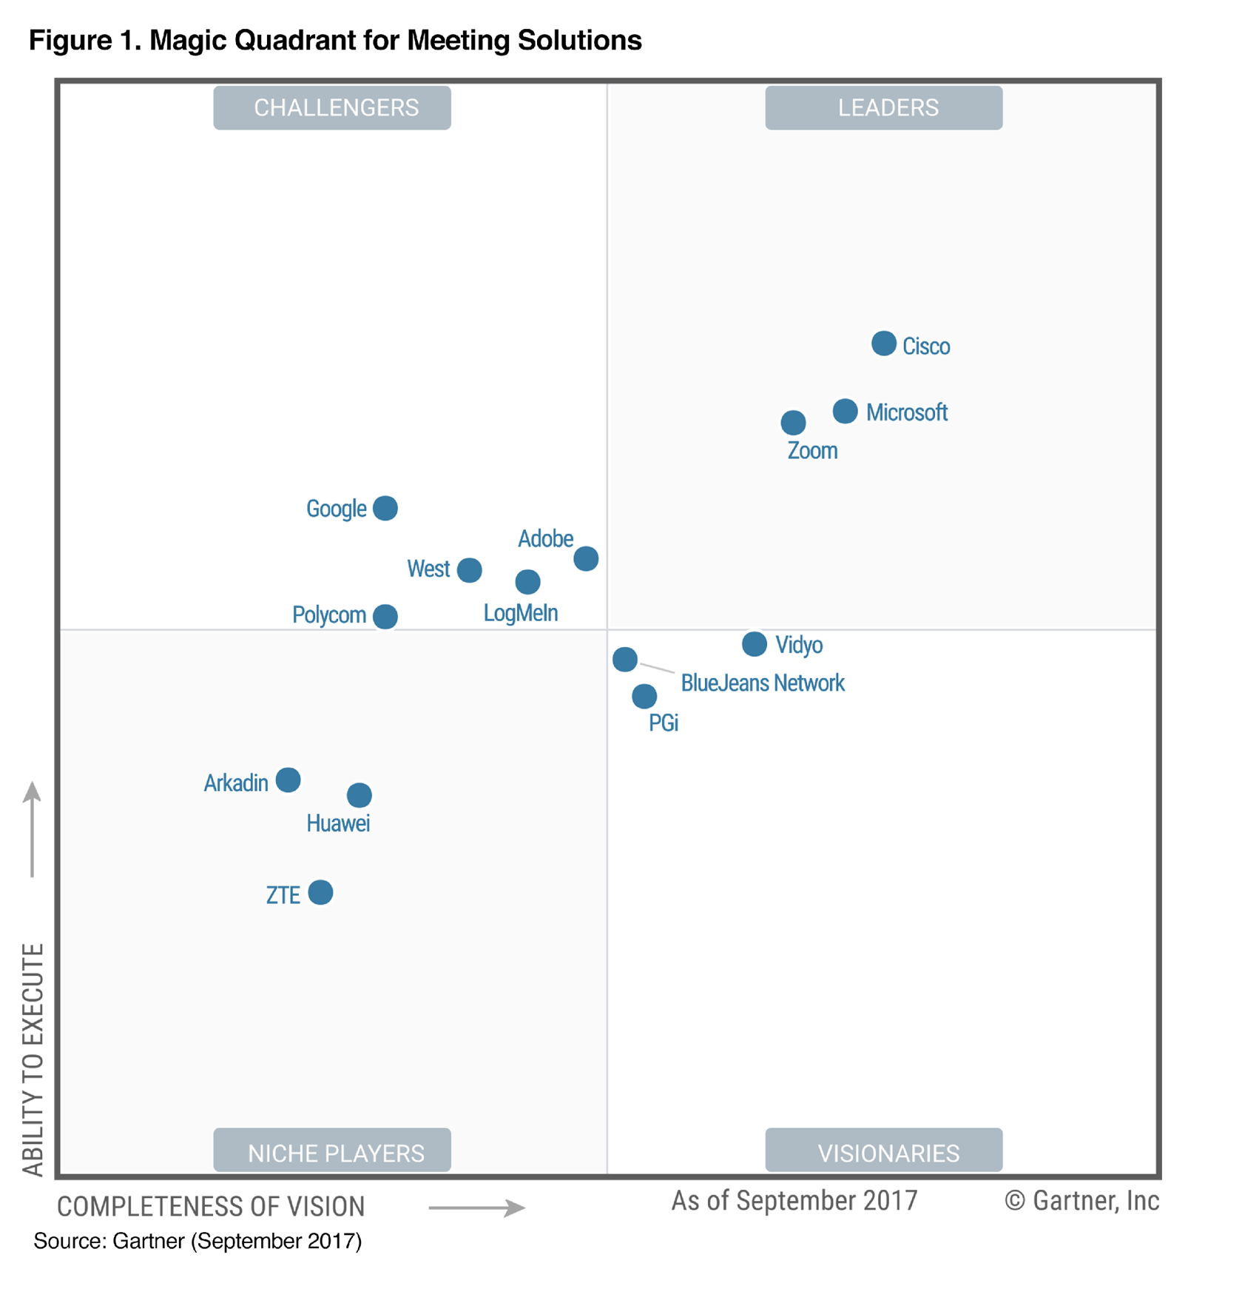
Leader Placement
Gartner Magic Quadrant for Meeting Solutions 2017
Leaders:
Achieved significant market share
Respond to customer needs
Robust, scalable products
Large installed base
Strong financial performance & distribution
Notes:
CAUTION: Note when competing against Microsoft and Cisco, use carefully. Shows us to be close to them, but might be interpreted that we’re not as good as them. Note that Y axis is market share/revenues, so that is why Cisco is so far ahead on that.

Slide 10

Top Rated By Customers

Slide 11


















































In Good Company
Confidential
Notes:
Alternate logos surrounding the slide to choose from.

Slide 12

Zoom Solution Overview

Slide 13
Meetings
Chat
Online Meeting, Training
& Technical Support
Cross-Platform Messaging & File Sharing
Zoom
Communications
Platform
Zoom for
Developers
Video
Webinar
One Consistent
Enterprise Experience
Empower Your Apps with Video & Screen Sharing
Marketing Events
& Town Hall
Meetings
H.323/SIP Connector
Zoom Rooms
Bring H.323/SIP Video Systems to the Cloud
Build Collaboration-Enabled
Conference Rooms

Slide 14


Meetings
HD video and high quality audio
Mobile, desktop, conference rooms
Up to 500 video participants
One-click start or join
Local and cloud recording with transcripts
Multi-screen sharing, co-annotation, remote control
Mobile features: Mobile screen sharing, mobile scheduling, Siri integration
Play video with audio
Dual camera, dual monitor

Slide 15


Audio Conferencing
Join by unlimited VoIP and toll-based options
Web interface to manage participants
Toll-free numbers in 60+ countries
Pay-as-you-go or monthly
Call out & Call-me when meeting starts
Dedicated dial-in numbers – no pins or meeting IDs

Slide 16

Chat
Send text, image, and audio files across desktop, laptop, tablet, and mobile
See if someone is busy, on desktop or mobile
Instantly start a meeting
Content library for easy sharing
Create groups for easy collaboration

Slide 17

Video Webinar
Broaden Your Reach
Easy Management
Engagement Tools
Key Integrations
Up to 100 panelists with video, voice, and screen sharing
Up to 10,000 attendees
Facebook Live and YouTube integrations
Scheduling and registration options
Reporting
Host controls
Polling
Chat
Q/A
Promote attendee to panelist
Salesforce
Marketo
Eloqua
Zapier and more

Slide 18


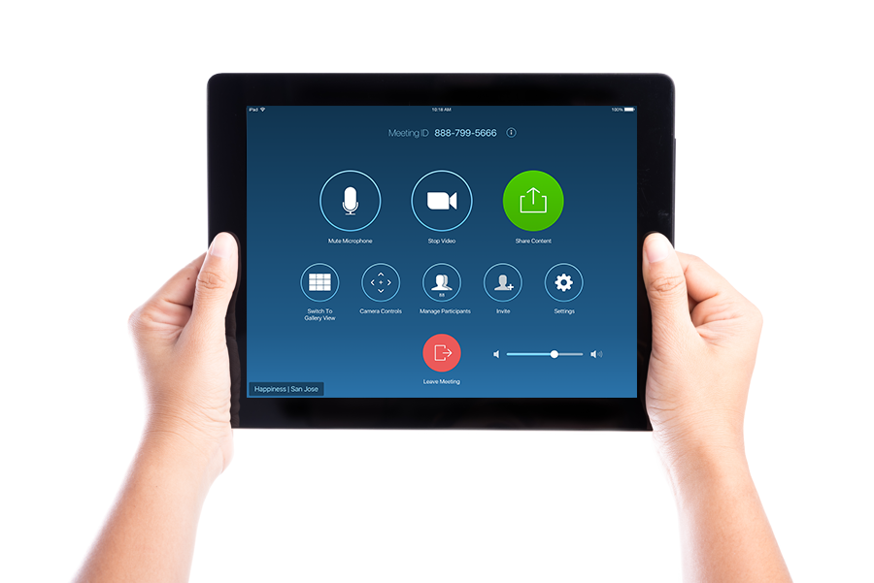
Zoom Rooms
Software-Based Conference Room Solution
HD Video and Audio
High quality video, audio, and web conferencing in any sized room with off-the-shelf hardware
Wireless Sharing
Present content wirelessly from your laptop or mobile device, Intelligent Proximity to start sharing with one click
One Touch to Meet or Reserve Room
Start an instant meeting or integrate with your calendaring system
Enterprise Remote Management
Dashboard and alerts for scalable management
Group by location or room type for IT assignment

Slide 19

Zoom Rooms
Are Perfect For…
Board and Conference Rooms
Executive Offices/Focus Rooms
Fast deployment with off-the-shelf hardware. Up to three screens show content, active speaker, and participants.
Easy, intuitive controls. Start a meeting in seconds with calendar integration and one-touch to start.
Huddle Rooms
Training Rooms
Small teams can convene for impromptu or scheduled meetings. Supports touch screens for powerful collaboration. Affordable to outfit all your rooms.
Wireless screen sharing for presentations. Include remote employees in staff training and all hands. Cloud recordings for those who can’t attend.

Slide 20
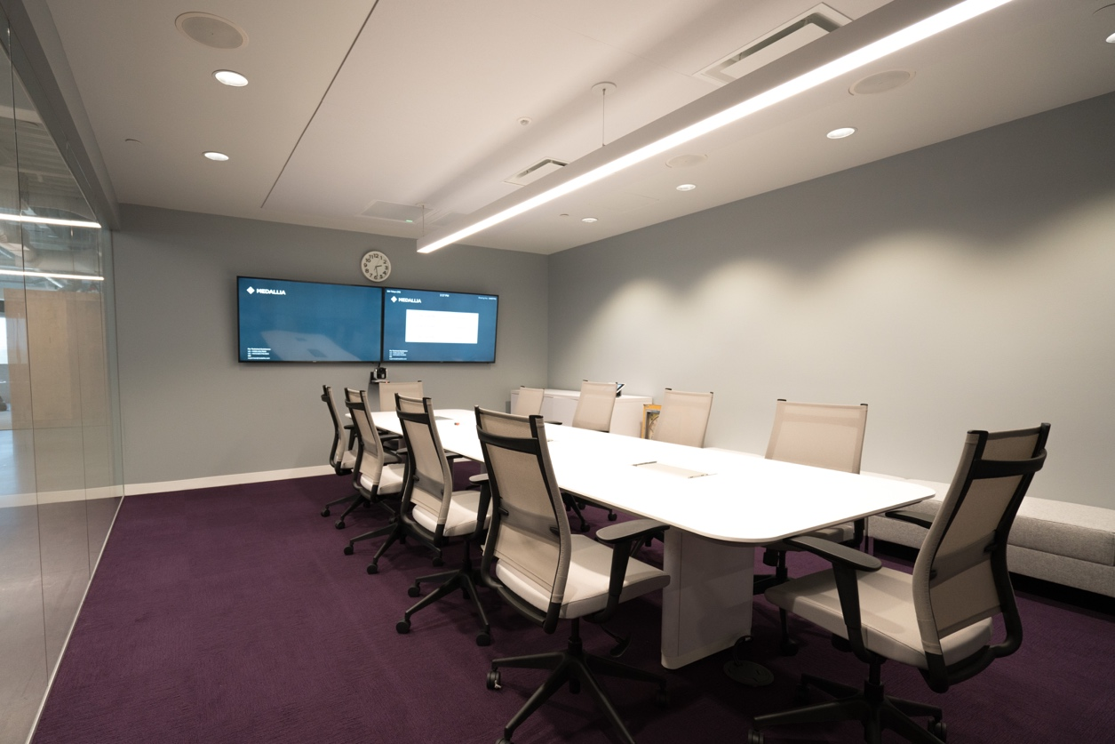



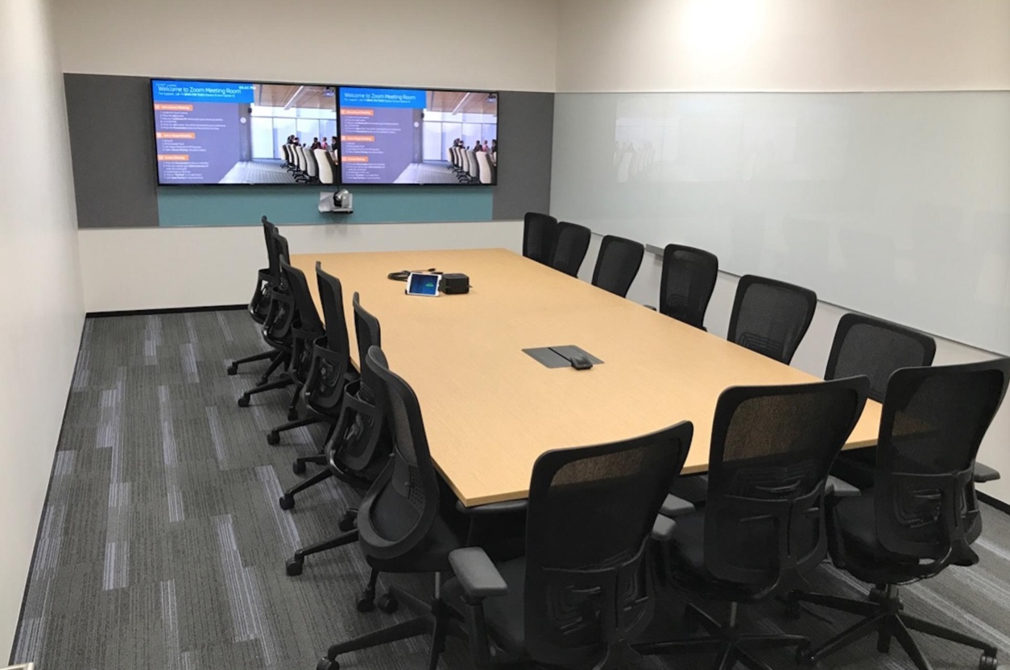
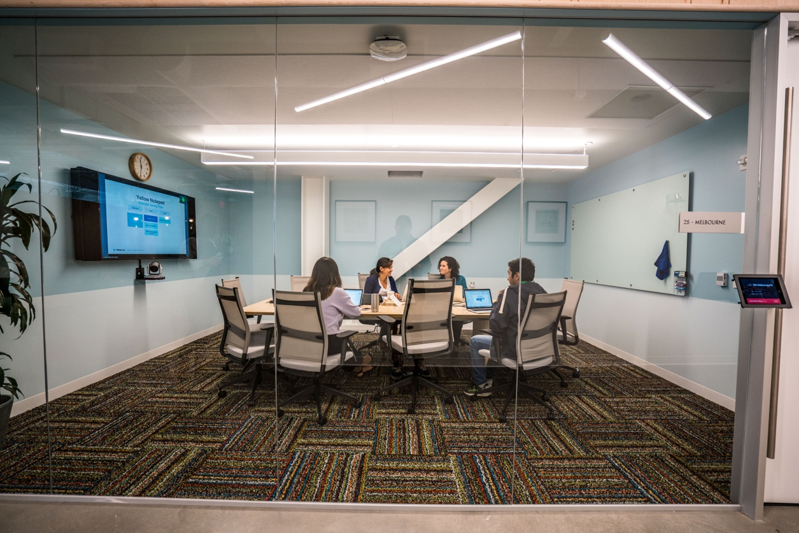
Zoom Rooms
Customer Rooms

Slide 21

Zoom Rooms
Scheduling Display
Room-based, wall-mounted
Displays upcoming meetings and room availability
Allows employees to instantly book a room
For any meeting or collaboration space
Notes:
Buy one Zoom Room, outfit your entire campus

Slide 22

Zoom Rooms
Digital Signage
Sample Use Cases:
Upcoming events bulletin board
Sales goals success tracking
Support call stats / wait times
Lobby signage & wayfinding
Broadcast All Hands from Zoom
Branding
Display current events, photos, local news and weather
Inform staff and students about upcoming events, assemblies and awards ceremonies
Deliver emergency alerts and public safety information

Slide 23
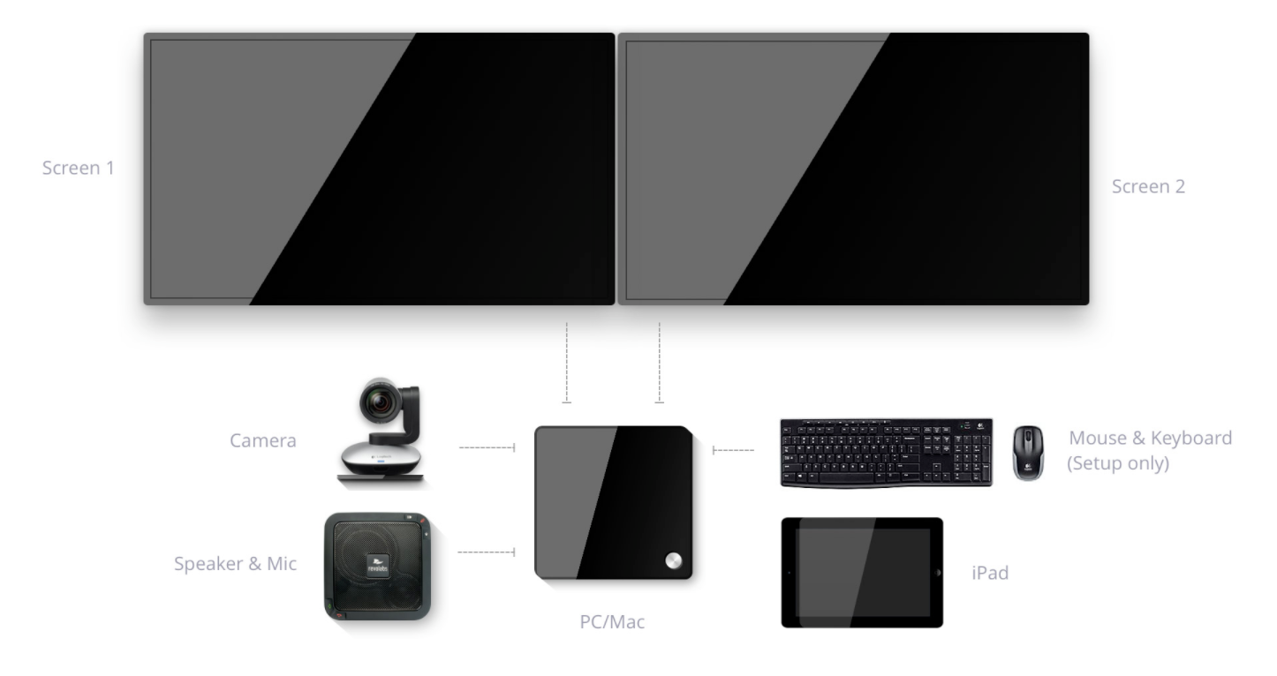
Flexible Hardware Options for Any Room
Supports up to 3 screens with split view, gallery, or active speaker options, or an interactive touchscreen display
Connect up to 3 cameras; supports PTZ with preset focus and controls

Slide 24

H.323/SIP Connector
Leverage investments in Polycom, Lifesize, Cisco Tandberg, Huawei, AVer
Meet with other conference rooms, desktops, or mobile devices in the Zoom cloud
Connect multiple endpoints
Invite participants using Skype for Business
One-tap start and join for Polycom and Cisco

Slide 25


Zoom for Developers
Apps
Enhance Mobile, Desktop, and Web Apps with Zoom
Mobile apps: Add video, audio & screen sharing to mobile apps via Zoom iOS & Android SDKs
    Desktop apps: Add video, audio & screen sharing to desktop apps via Zoom Windows & Mac SDKs
    Web apps: Schedule & organize Zoom meetings inside of web app, launch Zoom app inside of web app
Notes:
Add image – video on mobile

Slide 26



Security
Secure socket layer (SSL) encryption
AES 256 bit encryption
Role-based user security
Watermark screenshots
Firewall compatible
Password-protected meeting option
Supports single sign-on (SSO) with SAML or Oauth
SSAE 16 SOC2 compliant data centers
Enables HIPAA compliance (signed BAA)
Fedramp in progress (moderate level)
Notes:
https://d24cgw3uvb9a9h.cloudfront.net/static/44383/doc/Zoom-Security-White-Paper.pdf

Slide 27

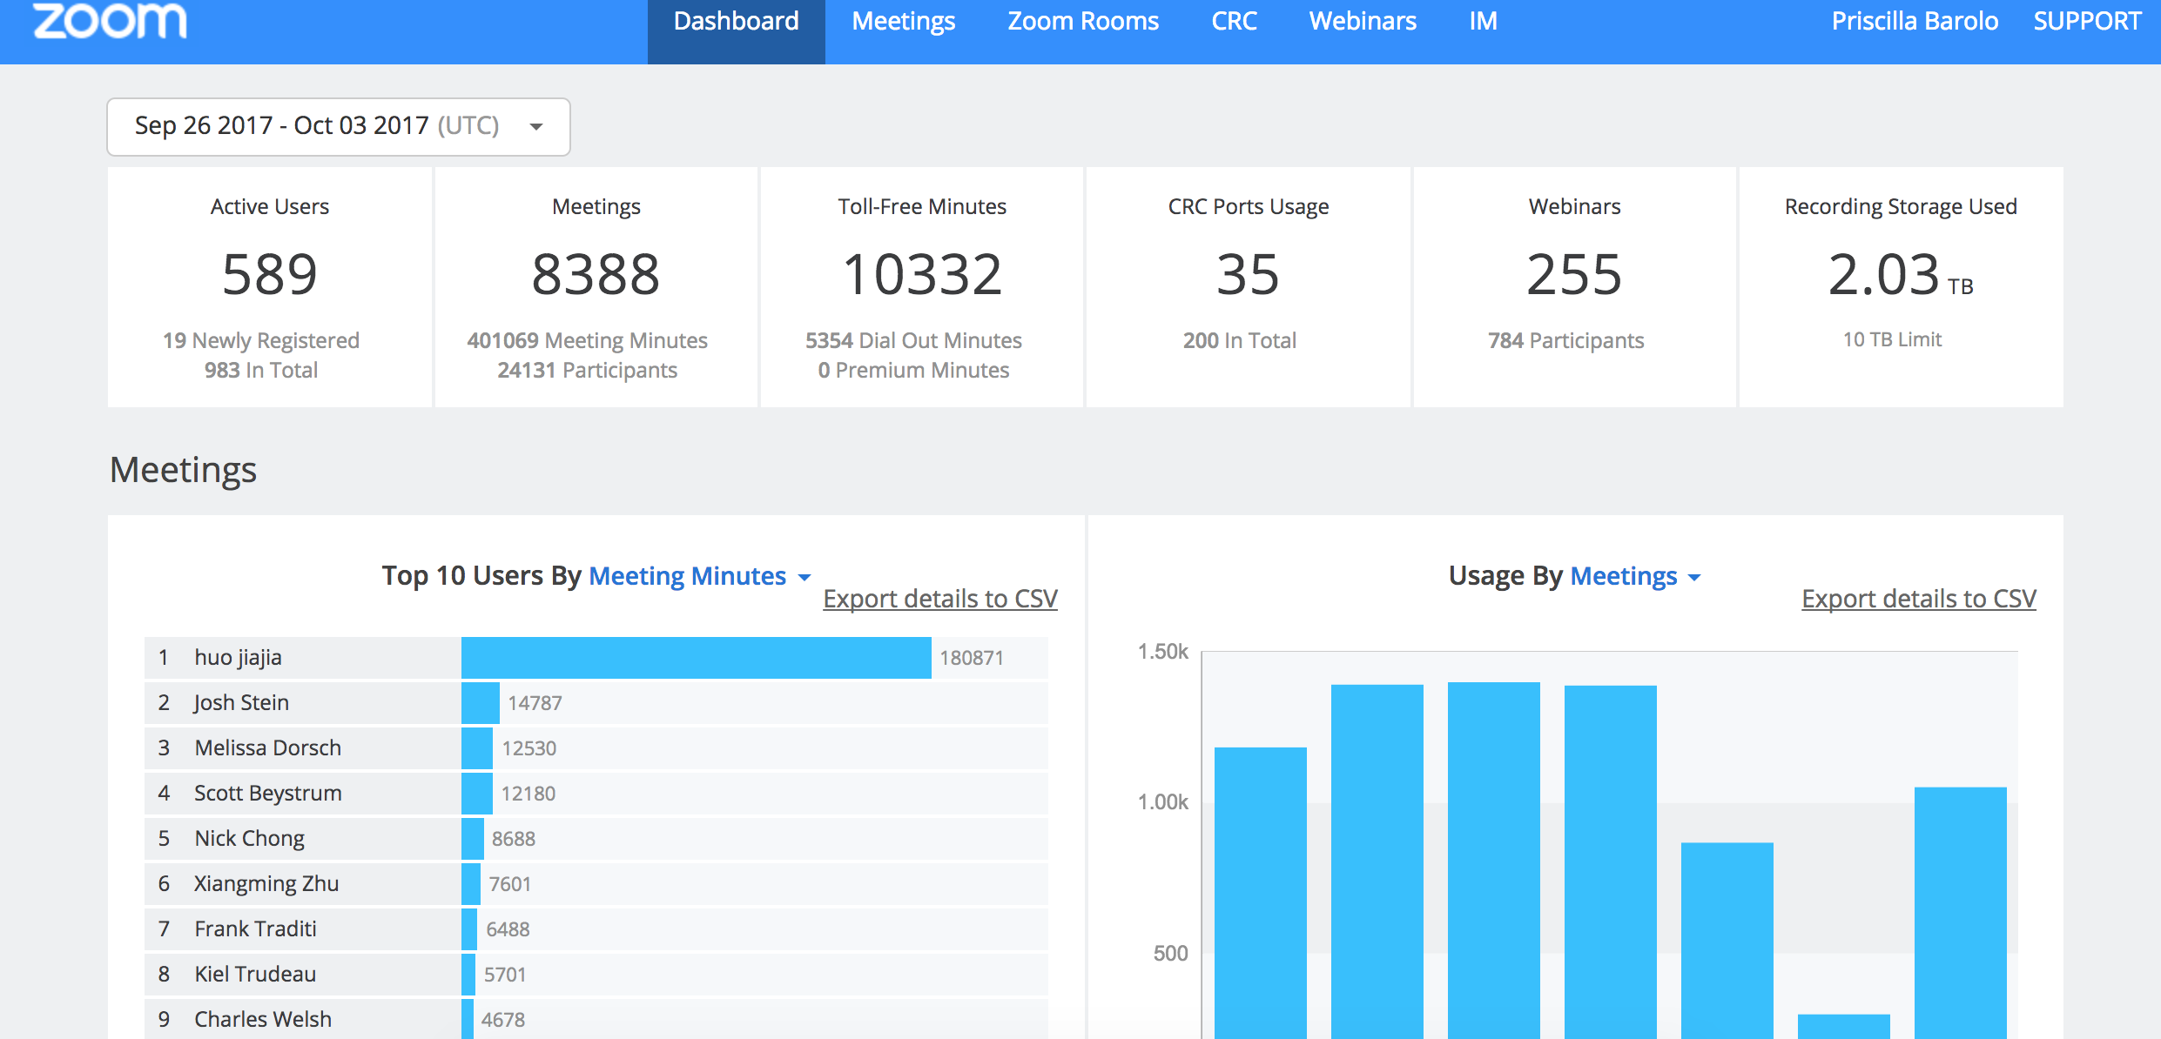
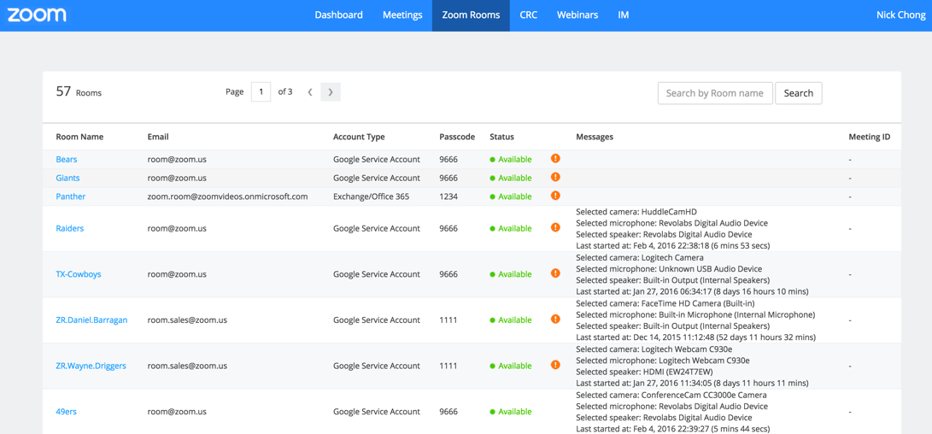
Enterprise Management for Scale
Reporting and Analytics
Administrative Management
Real-time dashboard and historical reports
Zoom usage, users, and devices
Webinar registration, attendance, and Q/A
Dashboard of all Zoom Rooms by location
Alerts for hardware issues and more
Tiered Settings

Slide 28

Architected for
Reliability & Scale
Proprietary compression technology operates with up to 45% packet loss
Meeting services availability of 99.99% uptime
Active/Active architecture for the meeting service with full redundancy - virtually no risk of interrupted service

Slide 29
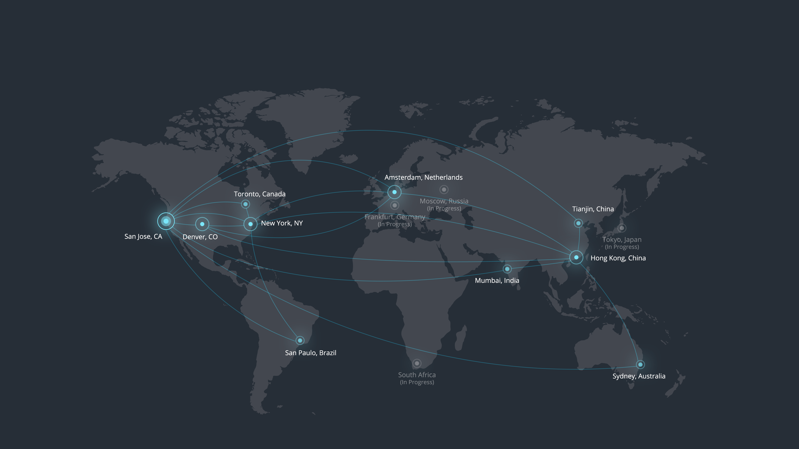
Data Centers for Global Reliability

Slide 30
Ensuring Adoption & Success
Dedicated enterprise team: Account Executive, Sales Engineer, Customer Success Manager, Support Manager
Planning
Professional
Services
Onboarding
Adoption
Pro-Active Engagement
Ongoing
Support
Kick-off call
Account set-up
Planning multi-phased approach
Zoom Rooms consulting & deployment
Webinar and
event support
Phased admin / user training
Weekly milestone reviews
Fast deployment: Group management, SSO, active directory
Establish monthly /
bi-monthly reviews
Identify initial adoption challenges
Daily live training open to all
Adoption/ROI analysis
Send/Track NPS
Dashboard with daily & historical data
Quarterly review with CSM
Global 24/7/365 support
Chat/Email/Phone
support.zoom.us

Slide 31

Zoom Customers

Slide 32

Customer Stories
Pain Point
Seeking to replace WebEx, which they found to be unreliable
“Zoom worked beautifully for our weekly IT meetings. It was awesome seeing faces rather than just hearing voices.”
Needs
Reliability and video quality
Deployment
15,000 employee accounts (1000 Capacity), 75 Zoom Rooms, 5 H.323/SIP Connectors, 1 Webinar 5000, Audio Conferencing, 150 GB Cloud Storage within 3 months
TRENT TANAKA
AV Manager
Tesla Motors

Slide 33
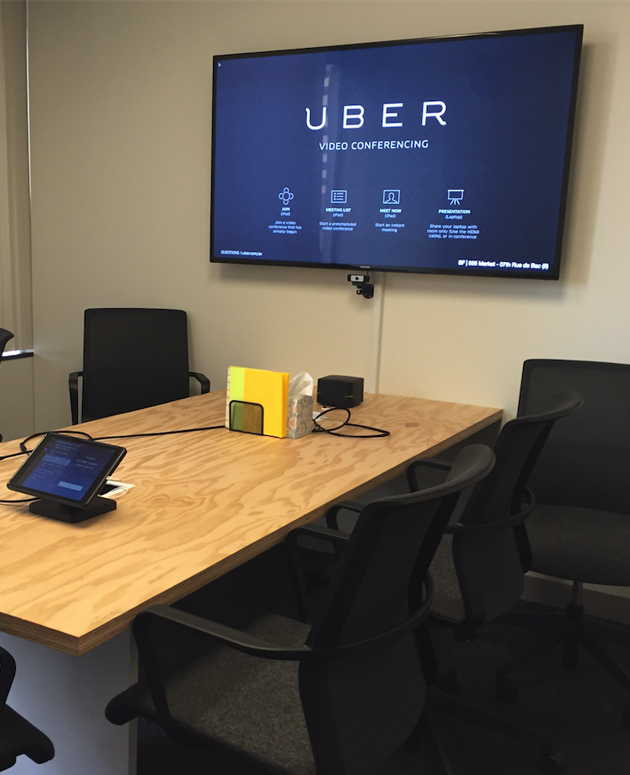
Customer Stories
Needs
High-quality video conferencing
Affordable solution that can scale with the company
Needed to connect global offices and community managers
Deployment
Deployed over 1,600 Zoom Rooms

Slide 34

Customer Stories
22 Campuses
Largest system of higher education in the country with broad educational and administrative use cases
Process
1-year RFP process, tested multiple services. Zoom proved to meet needs the best
Pain Points/Needs
Needed to standardize meeting tools across all campuses for greater collaboration and provide a communications tool for remote students and guest lecturers. Current services had issues with reliability, compatibility, and cost. Needed a reliable, easy, high quality standard
Deployment
About 500,000 licenses for all faculty and students. Deployment included all Zoom services including Zoom Rooms, Webinar, and H.323/SIP Connectors
MARK CRASE
Assistant Vice Chancellor and CIO
The California State University
“We knew we needed a platform that could enable our students, faculty, and staff to share knowledge and work together. After a rigorous evaluation process, Zoom was the clear choice.”

Slide 35




Recent Analyst and Industry Awards
Recent Analyst and Industry Awards
  Leader
  2016 & 2017
Forbes Cloud 100
2016 & 2017
  Trust Radius Top Web Conferencing Software
  2016 & 2017
  Frost & Sullivan
  Global Video Conferencing Company of the Year
  2017
  TMC Communications Solution Product of the Year
  2017

Slide 36
Zoom in China

Slide 37
Zoom China Business
Selling through partners
Server will be run and maintained by partners
Annual commitment
FY2018, Zoom China will target on those G500 companies
Zoom teams will fully support our partners to promote zoom
Total users: 19,774,579
Month | New Users | Active Users | Total Meetings | Total Participants | Total Meeting Minutes
2018-01 | 1,407,230 | 3,522,194 | 13,853,961 | 62,767,932 | 2,316,799,155
2018-02 | 1,018,878 | 3,547,644 | 10,918,774 | 49,331,737 | 1,846,772,766
Notes:
https://d24cgw3uvb9a9h.cloudfront.net/static/44383/doc/Zoom-Security-White-Paper.pdf

Slide 38






Zoom China Customers
Notes:
https://d24cgw3uvb9a9h.cloudfront.net/static/44383/doc/Zoom-Security-White-Paper.pdf

Slide 39
Thank You

