Slide 1
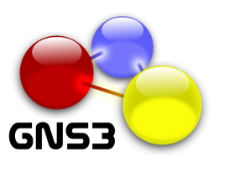
GNS3 – Graphical Network Simulator
Alexey Eromenko (co-developer of GNS3)
02.12.2014

Slide 2
General overview
GNS3, Graphical Network Simulator, allows anyone to build a virtual network on his home PC.
It was built for education, to teach students Cisco networks, but later became a multi-vendor solution
In addition, it can be used for testing of network-related software
<number>
Notes:
<number>

Slide 3
Supported platforms
Available certifications for students
Cisco (CCNA/CCNP)
Juniper (JNCIA)
Microsoft (MSCE)
Linux (RHCT) certifications.
GNS3 is an Open-Source Software, available for Free
Supported host OS, runs on:
Windows
Linux
MAC OS
<number>
Notes:
<number>

Slide 4
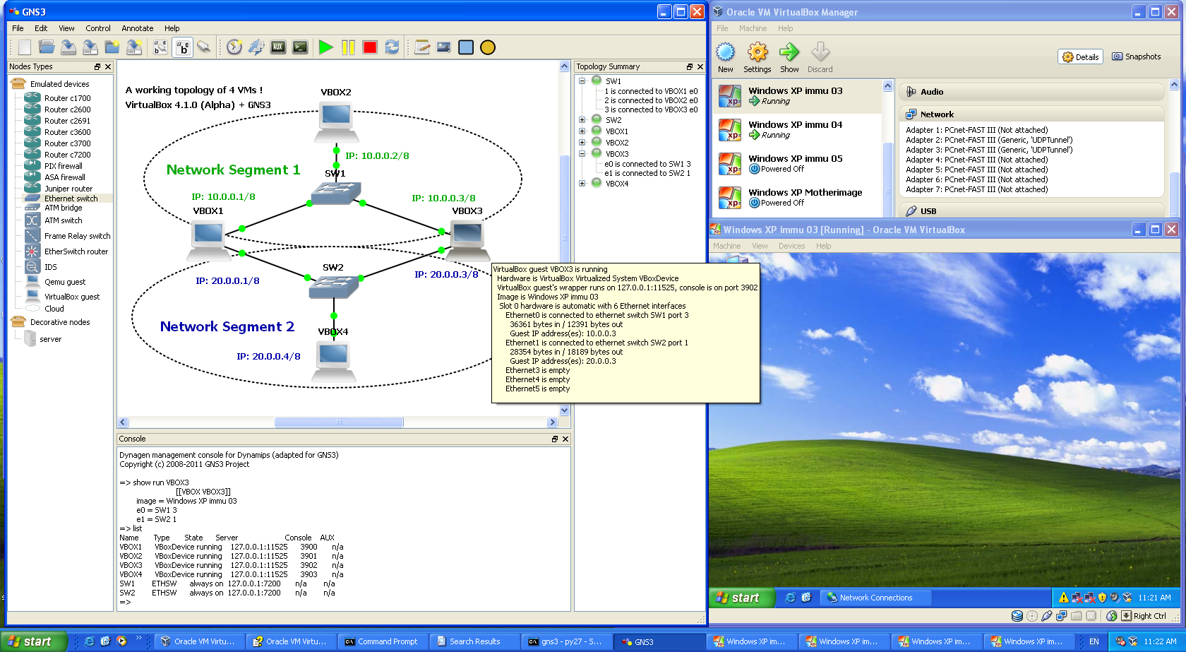
Simple diagram
<number>
Notes:
<number>

Slide 5
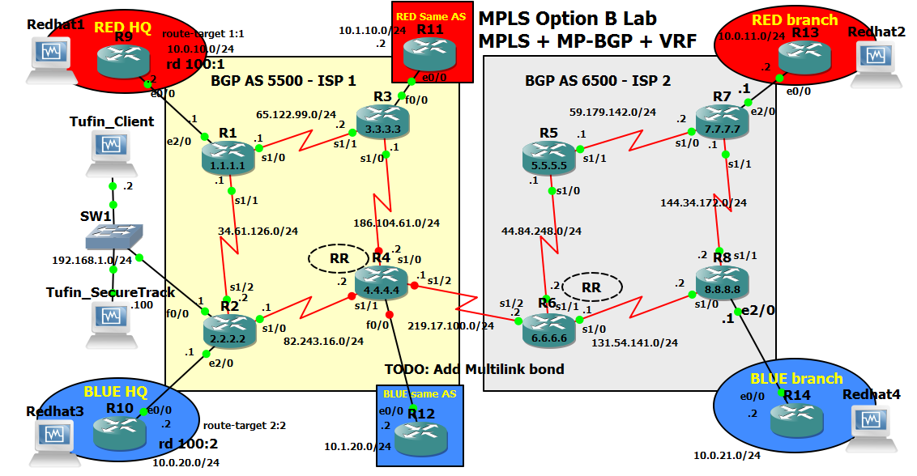
More complex: MPLS Lab with GNS3
<number>
Notes:
<number>

Slide 6
Architecture
GNS3 -- Graphical Network Simulator (GUI layer, python-Qt4)
Dynagen – Dynamic Network Topology Layer + virtual network cables (python) Technically “cables” are really UDP tunnels between engines.
 | Qemu wrapper (python) | Vbox wrapper (python)
1) Dynamips Engine (C) Cisco Routers | 2) Qemu Engine: (C) Special-purpose VMs: ASA/PIX/IDS/JunOS | 3) VirtualBox Engine: (C++) Desktop VMs (Windows/Linux/Android)
Simple devices: -Ethernet Switch -Frame-relay Switch -ATM switch … |  | Server VMs: (Windows Server/Linux/UNIX)
Cloud (host network) Allows connect to physical network |  | Special-purpose VMs: Juniper Router Cisco Nexus NX-OS Check Point
<number>
Notes:
<number>

Slide 7
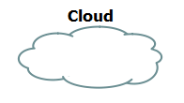
Additional features
Distributed architecture
allows to build huge topologies on server farms or multiple PCs
Wireshark integration
Live traffic capture & analysis
Connect to the real network via cloud
<number>
Notes:
<number>

Slide 8
Advantages of GNS3 over ESX / Vmware vSphere
Graphical topology – ability to construct complex networks with complex connections between them
Wireshark live traffic capture
Ability to integrate with virtual Cisco Routers
Open-source software (which allows to fix things and add features)
GNS3 can connect to real physical networks
<number>
Notes:
<number>

Slide 9
Installing GNS3
You can download it for free from sourceforge.net, search for “GNS3”, section Files->GNS3->0.8.6 [it’s preferable from downloading from GNS3 site]
Windows installer is “next->next”, and installs all the components. “GNS3-0.8.6-all-in-one.exe”
Linux installer is very OS specific, available for SUSE Linux and for Debian and Ubuntu Linux platforms from the distro main repository. There is no installer for Red Hat-based Linux, so installation there is manual, and separate for each component.
<number>
Notes:
<number>

Slide 10
System requirements
It can run on desktop (or laptop):
If you have low RAM (under 8 GB), you may be forced to use older guest virtual machines, such as Cisco IOS 3600 v12.0 images instead of v15.1 c7200 images, and older operating systems (Linux from 2003) and Windows 2000/XP.
More CPU cores is very helpful.
More RAM allows to build bigger topologies.
Quad core CPU with 16 GB of RAM is today’s standard for high-end computing.
Some virtual machines (Cisco Nexus) take huge amounts of RAM… 2 GB each!
Newer Cisco IOS v15 takes 512 MB of RAM vs 32 MB RAM for older Cisco IOS.
Make sure you configure “idle-PC” for Cisco IOS Routers. (later on that…)
<number>
Notes:
<number>

Slide 11
System requirements
It can run on big iron servers:
You can run GNS3 on 128 vCPUs with 1 TB of RAM to build huge topologies on Linux hosts.
Alternatively, you can daisy-chain multiple hosts (desktops or small servers) to build huge topologies.
I don’t recommend to run GNS3 on ESX servers, as VMware network bridge filters some packets at layer 2, and it may require additional configuration.
<number>
Notes:
<number>

Slide 12
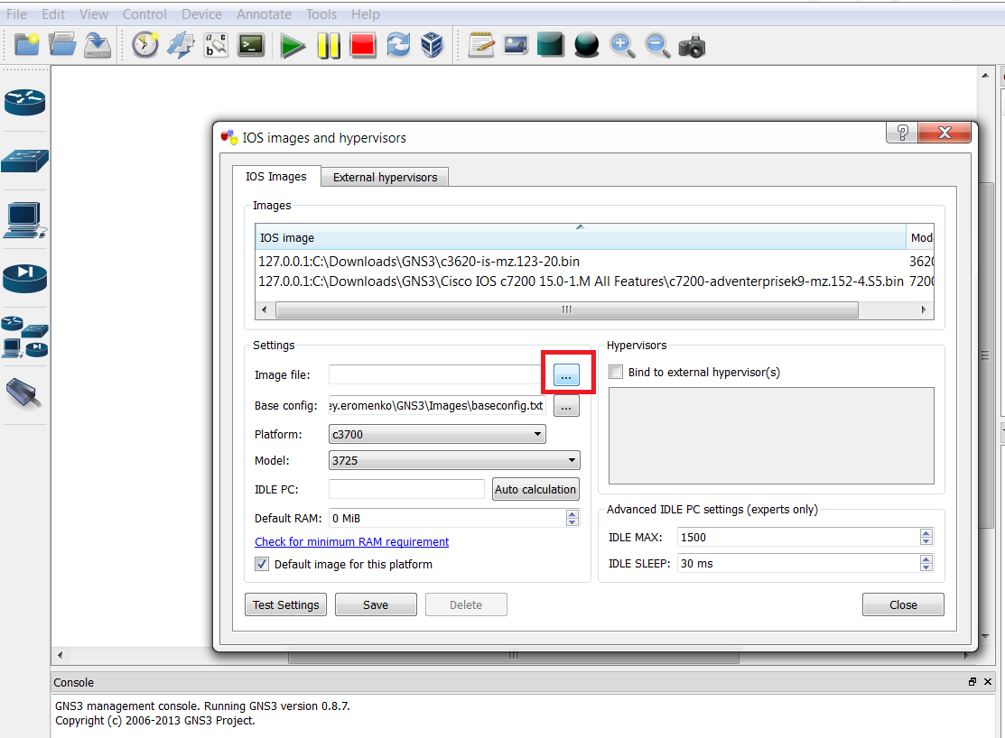
Adding a simple Cisco IOS router
In GNS3 main windows go to “Edit->IOS images and hypervisors”
In “IOS images” tab click on “…” button and choose Cisco IOS image.
[Optionally] After that you can calculate “idle-PC” value, which lowers CPU usage and allows to save power.
<number>
Notes:
<number>

Slide 13
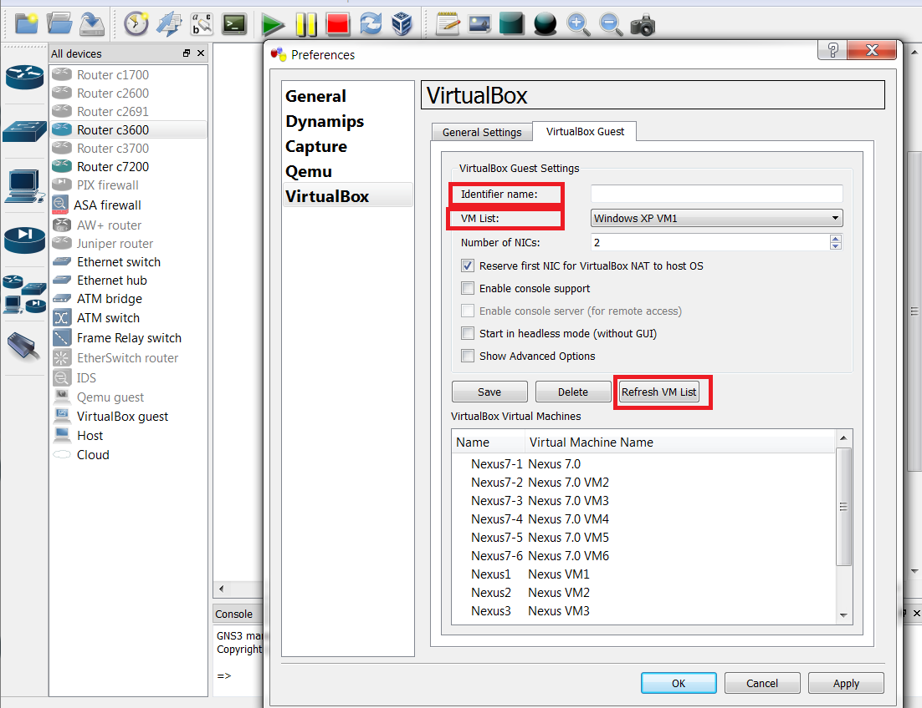
Adding a VirtualBox machine
If you want Windows/Linux/Tufin OS
In GNS3 main windows go to “Edit->preferences”
Go to “VirtualBox->VirtualBox guest” tab.
Click “Refresh VM list”, then choose your VM from VM List drop-down and input identifier name (usually similar to VM name) and click “Save”&“OK”.
<number>
Notes:
<number>

Slide 14
Simple topology -- adding devices
Adding devices to topology
How to build a simple network having two pcs on different networks connected by the router added before
Just drag-n-drop devices from “All devices” window to the “topology”.
In some cases, you will have to configure devices (esp. IOS routers) with the proper network cards or modules.
Then choose “cable” icon, and connect those devices.
When finished drawing topology, click “START”
<number>
Notes:
<number>

Slide 15
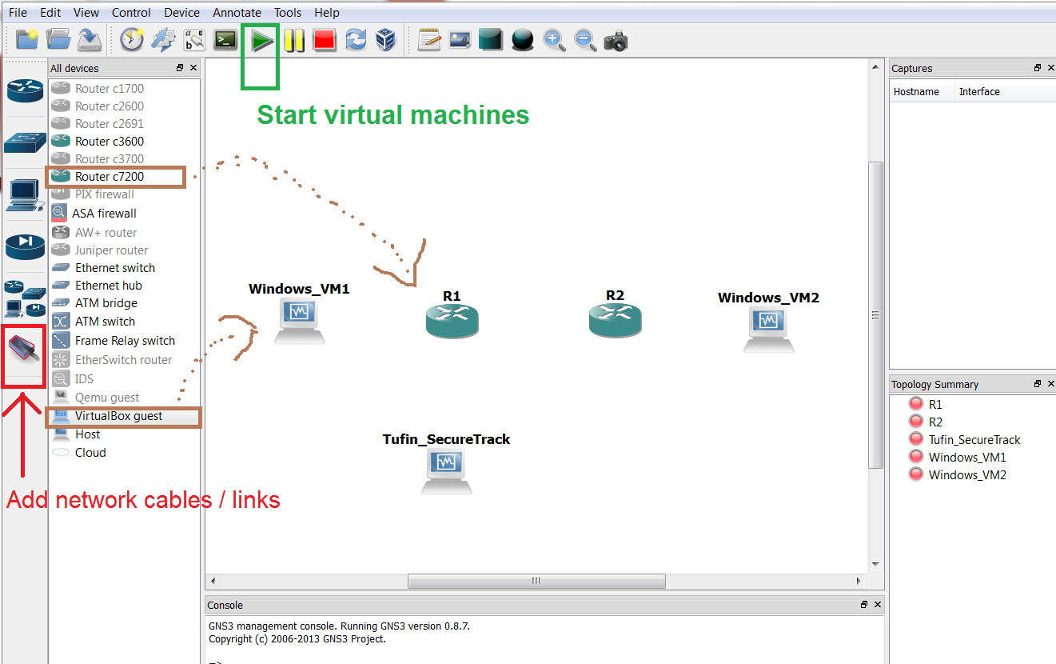
Adding devices and cables
<number>

Slide 16
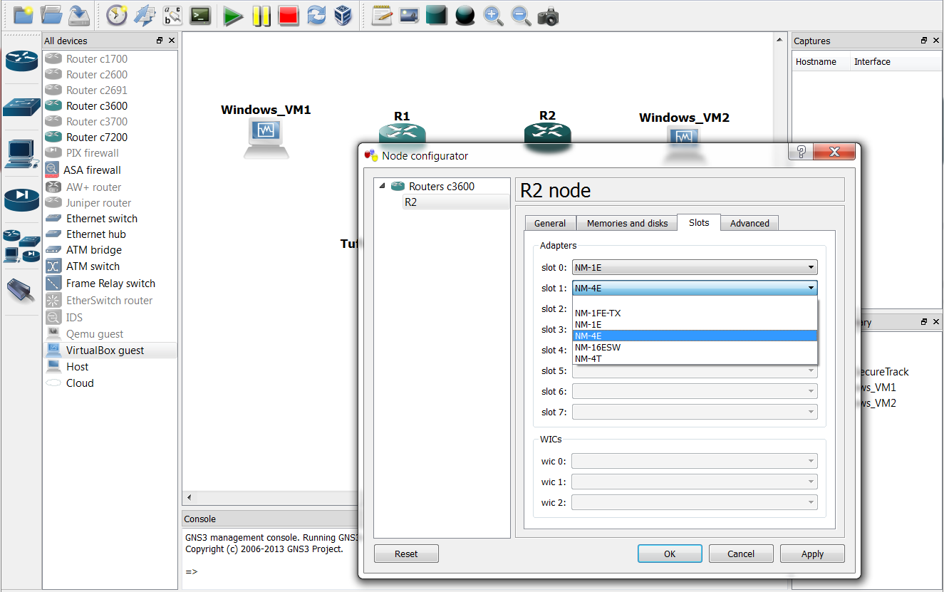
Configuring Cisco IOS router slots & modules
In some cases, you will have to configure devices (esp. IOS routers) with the proper network cards and slot modules.
Modules ending with *E are Ethernet, ending with *T are serial links.
Right click on Router->”Configure”
<number>

Slide 17
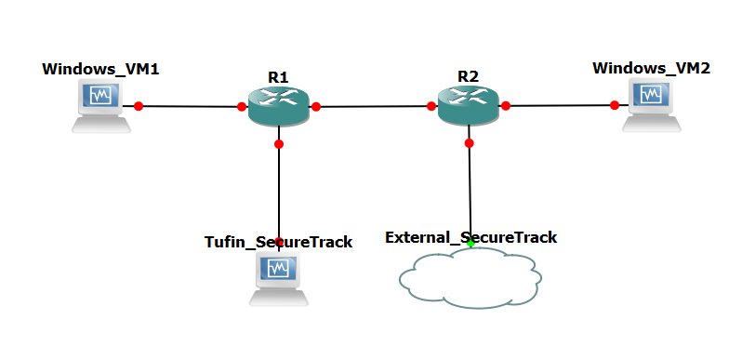
Add Tufin OS / SecureTrack machine
Tufin SecureTrack (ST) machines:
Can be in-topology ST [adding virtual box machine] or
External ST machine connected via cloud
In-topology ST gives more freedom over IP address range. (no need to ask system administrator or boss about free IP addresses)
External ST gives ability to connect many SecureTracks to the same virtual devices, and useful if you want to share your virtual lab with other developers and QA.
External ST requires more planning for IP addresses and routing.
To use “cloud” you must be “root” or “Administrator” user.
<number>
Notes:
<number>

Slide 18
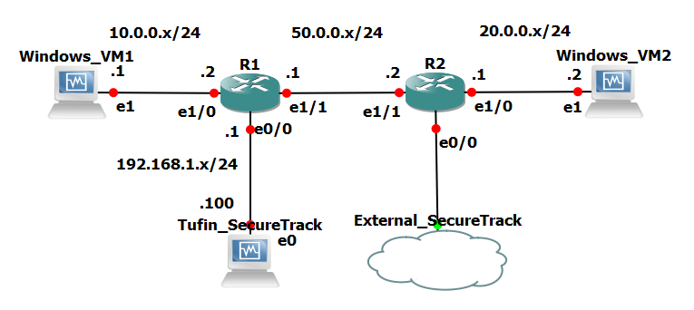
Decorating topology, adding information
This allows you to add interfaces and IP addresses
Click on “Show/Hide interface labels” on GNS3 toolbar.
(Or for VRF or ZONE or area)
<number>
Notes:
<number>

Slide 19
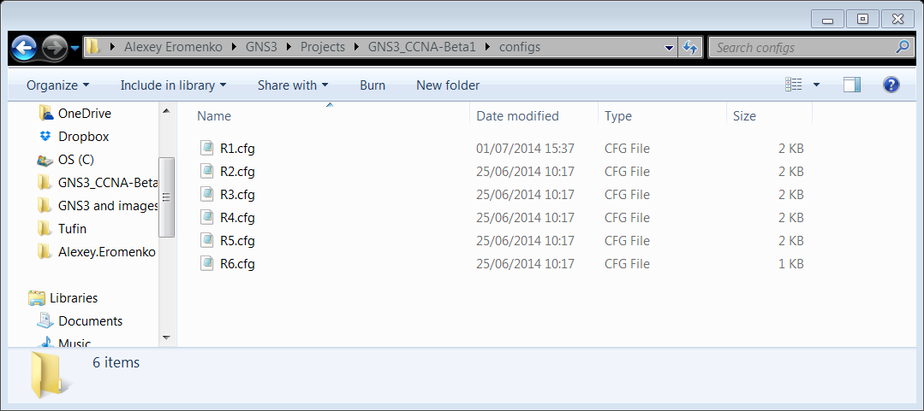
Automation / API
GNS3 has unofficial and limited API.
Each engine can be connected to via telnet. (start/stop/restart VMs via CLI from remote)
Dynagen can be configured from command-line (Google for “Dynagen Tutorial”)
Dynagen provides INI-formatted plain text for topology saves, specifies devices and links (cables) between them.
Dynamips saves Cisco IOS config files as plain text on your host OS, so you can edit them before starting GNS3.
Sadly this isn’t true for other devices (ASA/PIX/Juniper/…). Those are binary, so you cannot those edit without starting GNS3.
<number>
Notes:
<number>

Slide 20
Questions?

