Slide 1
Content Management Systems and Drupal
Information Systems 337
Prof. Harry Plantinga

Slide 2
Term Project
Project ideas all finalized?
Checkpoint 1

Slide 3
Domain Names
To set up a website, you’ll need a domain name, like EasternAvenueCRC.org
How to get one?

Slide 4
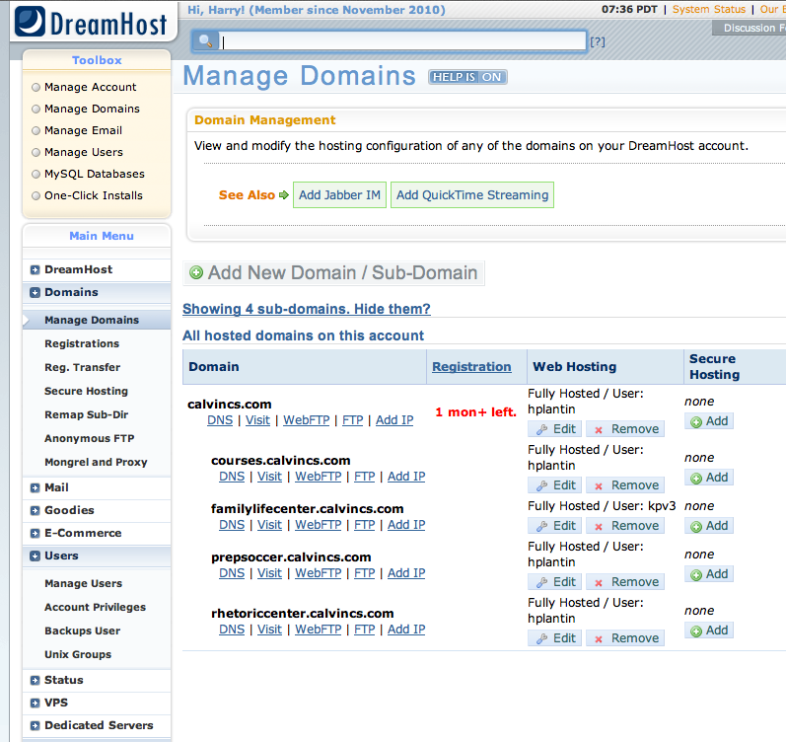

Slide 5
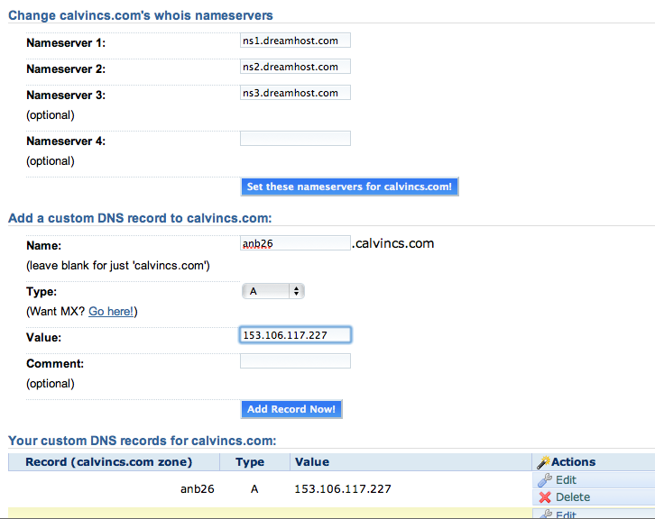

Slide 6
Domain Names
Dreamhost account: calvincs.com
Dreamhost’s DNS servers configured to return your IP address for abc12.calvincs.com
Eventually we’ll create project-dev.calvincs.com DNS entries (you’ll have two drupal websites)
Later you’ll publish to an ISP, using your choice of domain name
Notes:
why can't I see the .htaccess file?
what goes in the .htaccess file?
where do you put modules, themes, etc?
did your mission, slogan display? configuring your theme.

Slide 7
How to set up a website?
Static pages, or what?
What server?
Domain name service?
Hosting?
Managed?

Slide 8
Content Management Systems
What is a CMS?
Store all content in a database
Site-wide theme
On-line management and content creation
Out-of-box capabilities (e.g. blogging, forum, calendar, wiki, shopping cart, tagging, …)
Typical architecture: LAMP
Hundreds of options, open source or commercial
Calvin uses .cms (open source, hosted, Java-based)
Microsoft has SharePoint
Notes:
SharePoint is like a content management system, but broader capabilities.

Slide 9
Drupal
Open-source CMS
Or, “Content Management Framework” because it is geared more toward configurability and customizability
Uses PHP; Apache, MySQL most common
Collaborative at the core
Comparisions
Easy single-purpose tools such as phpbb or WordPress are a little more popular – but little flexibility
Joomla: popular, polished looking, possibly easier
Drupal: more flexible/configurable, better designed, SEO?
Notes:
Flexibility (customizability and generality) comes at a cost: it may mean it’s harder to figure out how to do certain things – you have to understand more abstract tools.
Mambo and Joomla split from a common base in 2005. Not as sophisticated/cleanly written/flexible as Drupal?
Drupal advantages:
better SEO
taxonomy is flexible, powerful
static site, e.g. tutorials, one reviewer suggests Joomla.

Slide 10
Who Uses Drupal?
Many thousands of websites including Sony BMG, Al Jazeera, Popular Science, Amnesty International, Oxfam, Electronic Frontier Foundation, NCAA, FCC, AT&T, Whitehouse, United Nations, UK government, FedEx, MTV,…
2014: 30,000 add-ons, 31,000 developers, 1 million members of community
Countless more helping with testing, documentation, design, user support, translations, etc.

Slide 11
Is Drupal Right for You?
Creating a simple blog?
Consider WordPress or hosted solution (e.g. blogger.com)
But you'll be limited in features, flexibility
Only need a Wiki?
Consider MediaWiki or a hosted solution (e.g. wikia.com)
Just looking for a discussion forum?
Try SimpleMachines or phpBB or hosted solution (e.g. forumer.com)
Notes:
E.g. googlemapsmania.blogspot.com

Slide 12
Want even more control?
Popular web frameworks
HTML, CSS, JS
Bootstrap: for responsive, mobile-first projects (twitter)
JavaScript
AngularJS: easy MVC-organized projects (Google)
PHP:
Laravel: easy to learn, active community, popular
Python
Django: “for perfectionists with deadlines”
ASP.net

Slide 13
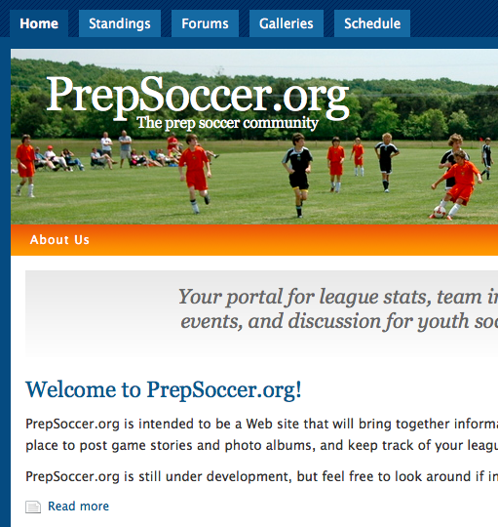
Drupal Overview
Themes
Modules
Menus
Blocks
Content types
Roles

Slide 14
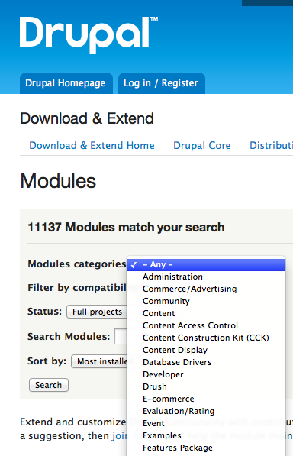
Modules
Modules available for
E-commerce
Forums
Groups
Photo galleries
Event management
Search
Games
Ratings
Etc. etc.

Slide 15
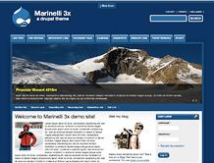
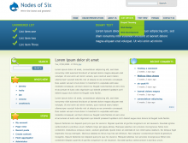
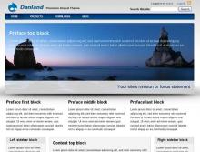
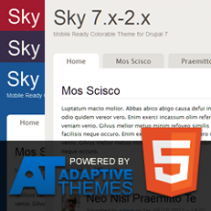
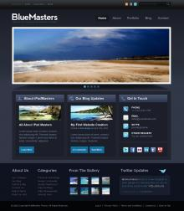
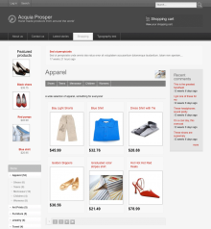
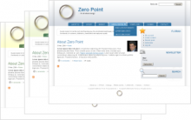
Customizable Themes

Slide 16
A Church website
How to upload/store/display sermons?

Slide 17
Content Types
Create your own content types such as blog posts, calendar events, ballgames, photos, church bulletins
Define a custom set of data fields
Create a custom look for display
Define who may add, edit them

Slide 18
Social Publishing and Collaboration
Built-in support for
Group blogging
Comments
Forums
Customizable user profiles
Almost anything else you can think of is a module away (ratings, groups, moderation tools…)

Slide 19
SEO Built In
Out-of-the-box support for
Human readable URLs
Standards compliance
Proper use of h1, meta, etc
Proper content ordering

Slide 20
How does Drupal work?
URL request is sent to apache server
Index.php is run to handles request
Loads many PHP modules
From active theme, determines what blocks are displayed
Calls modules to generate output for each block (requested content (nodes) may be fetched from database)
Output is sent through theme engine for customization according to selected theme
Resulting page sent back to user

Slide 21
Drupal File Organization
Drupal file layout
index.php, install.php, update.php
modules
themes
sites
default/settings.php
sites/all/themes
sites/all/modules
How does drupal get "started" when you access a server, e.g. prepsoccer.org?
What directory should all of this stuff go in?
Notes:
Look in the apache config directory, /etc/apache2, in the sites_configured subdir.
Mention virtual hosts.
FIles in /srv/www.
We're going to

Slide 22
Lab 5—Installing Drupal
In Lab 5 you'll be installing and configuring PHP, MySQL, and Drupal
Most remaining labs – continue to configure your Drupal website.
A few things you'll need to know…
Notes:
Aside –
Do you like labs?
Should they be totally step-by-step?
I should really just tell you "set up a website" and answer questions… learn more but cover less. Maybe I'll do some of that.

Slide 23
MySQL
Open-source, free Database server
Most popular database server, especially for websites
Your website will connect to MySQL, store all its data there
You'll need to issue some commands
Create databases
Create logins with appropriate privileges
We’ll do these things with PHPMyAdmin

Slide 24
Installing Drupal
Installation steps:
Install apache, php, mysql
Create a database and user for Drupal to use
Configure apache to default to index.php
Configure apache to use .htaccess files
Install latest Drupal source in web server home
Make a world-writable site.php file for your site
Run install.php
Change site.php back to world-readable
Download and install themes, modules, etc.

Slide 25
Installing Drupal
How to download and install files in Linux?
apt-get, etc
Download, unpack, install manually
wget, tar, mv
How to see or move files like ".htaccess"?
Who should own the files of your website? Why?
How to change the owner of a file?
Notes:
User www-data

Slide 26
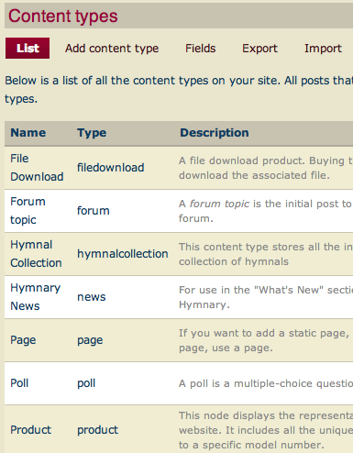
Content (Nodes)
All content in Drupal is a node
There are various types of nodes: blog posts, comments, pictures, ballgames, . . . (Content types)
Content types can have custom templates for display
Notes:
Node: generic bit of content. Has ID, title, creation date, author, body, and maybe other properties
Taxonomy: can define your own vocabularies. Can use as e.g.
content classification system
product catalog
tagging
Path: part of the URL
- default: ?q=node/7, e.g. /node/19528
-with clean URLs; /whatever/you/want
-pathauto: generate from title of the document. (See, e.g. engadget.com)

Slide 27
Entities
Drupal “entities”: another level of abstraction
Nodes
Users
Comments
Files
Entity fields
Default: Title, Body
Can define additional ones

Slide 28
Paths
Suppose you create a seventh node.
Path: node/7
Default URL: mysite.com?q=node/7
With clean URLs: mysite.com/node/7 or mysite.com/hymnals/presbyterian_hymnal_1981
Other paths you might see
taxonomy/term/6
user/login
user/3
admin/

Slide 29
Selecting a Theme
How to select a theme?
Layout you want (columns, menus, slogan, etc)
Menu structure you want
Version compatible
Fixed vs. liquid
Responsive
Install
Configure
Make it default (only?)

Slide 30
Installing a Theme
How?
/var/www/html/sites/all/themes

Slide 31
Virtual Hosts
Can configure multiple domain names to refer to the same IP address
Web requests arrive with hostname in header
Your server can run different sites for different hostnames (/etc/apache2/sites-enabled)
Configure drupal for multiple sites (/var/www/html/sites)
Can optionally share filesystem, database
We'll run two per student on the system lab servers:
yourlogin.calvincs.com
yourlogin-dev.calvincs.com

Slide 32
More Tidbits (Lab 6)
Hostname, /etc/hostname
Mail service, postfix
PHP memory requirements
Cron, crontab
See /etc/crontab, cron.hourly, cron.daily, etc
Edit with sudo crontab –e
Add something like this:
7 * * * * /usr/bin/wget http://yoursite.com/cron.php

Slide 33
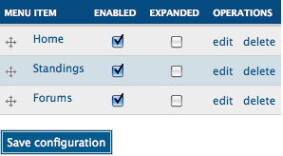
Menus
Primary
e.g. Home, Standings, Forum, Store
Typically top of the page
My be hierarchical
Secondary
e.g. About, Contact us, Log out, Terms of Service, Privacy Policy [not in Drupal 7, but you can create one]
Navigation
All of the tasks you can do
May not be displayed for unauthenticated users
Configuration
Set location, visibility in theme (or blocks)

Slide 34
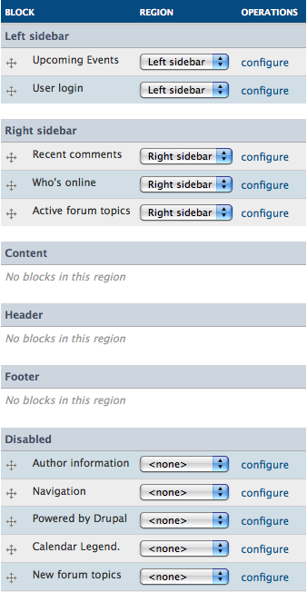
Blocks
Modules present their information as 'blocks'
You configure what blocks go where, on which pages
This is the primary means of configuring the functionality of your website

Slide 35
Users
Creating logins
User Settings
Registration options
Text of emails that Drupal sends
Signature, picture support
Profiles
Each user has a profile page
Use the Profile module to customize contents

Slide 36
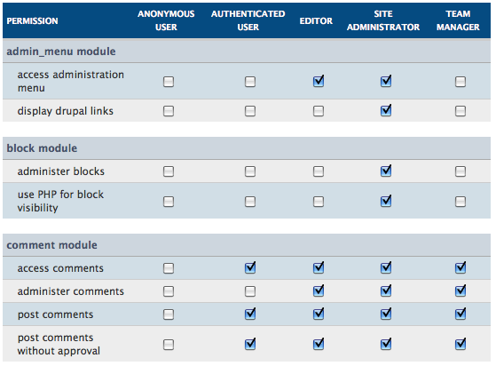
Roles
For PrepSoccer.org:
administrator (can do everything)
team manager (can update scores and schedule, add games, post photos, stories and comments)
authenticated user (can post photos, stories, and comments)
unauthenticated user (can read anything and change nothing)
In Drupal
Configure with User Management -> Roles, Permissions
Notes:
demo: config roles

Slide 37
What if site is down?
Debugging is a key skill…
How to debug your site?
What part is malfunctioning?
Is server running and connected to the Internet?
Is webserver running?
Is database server running?
Web server logs are your friends
/var/log/apache2

Slide 38
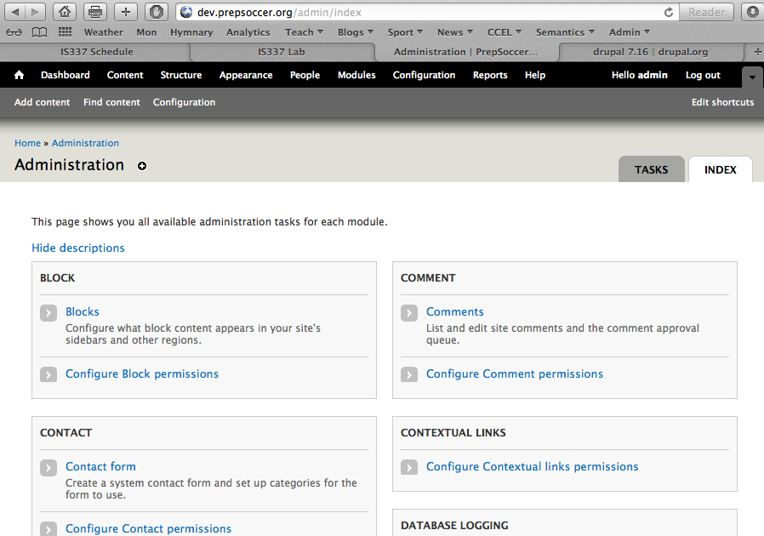
Administration
Notes:
You’re familiar with the toolbar for administration at the top of the page
There’s another whole page dedicated to administration, which has the full list of administrative pages
organized by the module to which they belong:
/admin/index

Slide 39
Modules
What do you use modules for?
How to find, select?
How, where to install?
Configuration
Effects on performance, usability

Slide 40
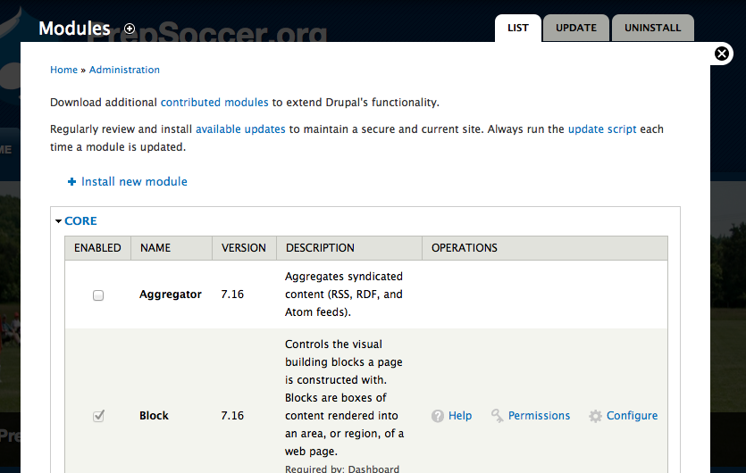
Modules
Notes:
You’ve worked with modules a bit. Can enable/disable, configure

Slide 41
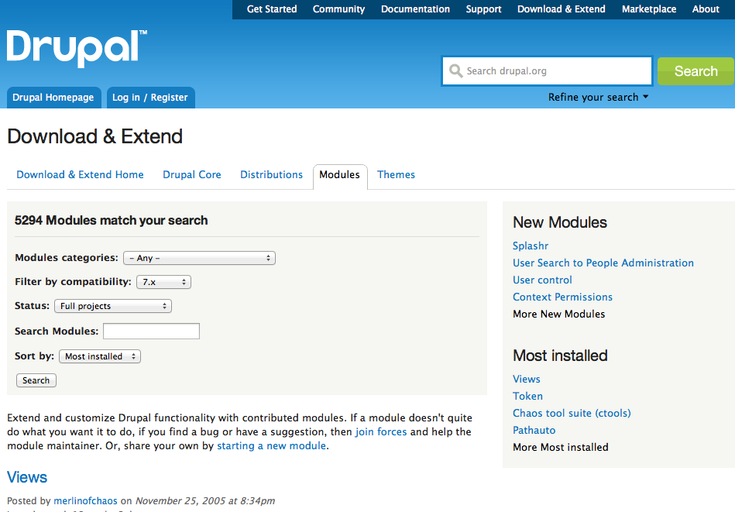
Finding Modules
Notes:
How to find and select modules?
Search at the drupal site for what you want.
Be sure to filter by compatibility: 7.x.

Slide 42
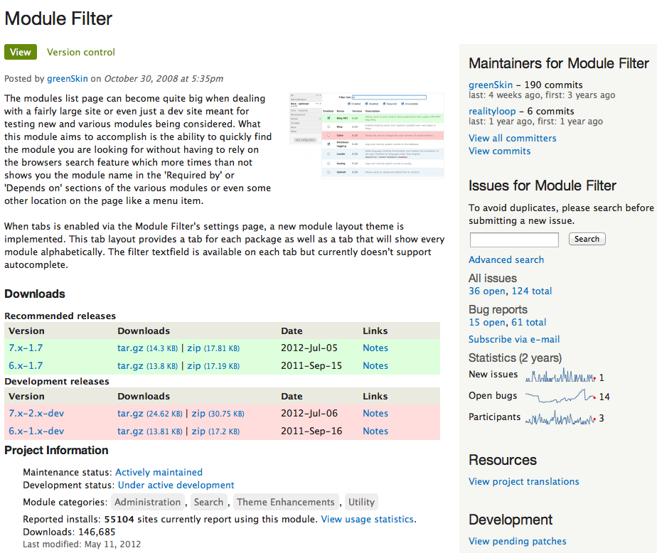
Selecting a Module
Notes:
When you have selected a module, check it out.
Is it used a lot? When was it last updated? Is it maintained? Are there open bug reports

Slide 43
Manual Installation
Download and unpack in sites/all/modules cd /var/www/sites/all/modules wget http://ftp.drupal.org/files/projects/module_filter-7.x-1.7.zip unzip module_filter-7.x-1.7.zip
If necessary, run the update script
Notes:
Manual installation is pretty quick and easy, though it requires a few unix commands.

Slide 44
Configure
Enable module
Configure module
Notes:
Manual installation is pretty quick and easy, though it requires a few unix commands.

Slide 45
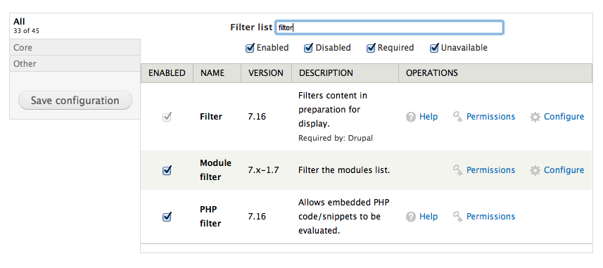
Enjoy

Slide 46
Content Types
Create a content type for every type of 'thing' on your website (blog post, story, newsletter, photograph, calendar entry, bulletin, team, game result, …)
Add and configure custom content types
Add custom ways for displaying content types
To add content, use Create Content -> …

Slide 47
Adding Content Types
Default content types
Page: Intended for static content such as “About Us”
Story: Intended for content that will be frequently posted, such as news articles
You can add content types in various ways
Add a module, e.g. Blog, that adds a content type
Create your own custom content types

Slide 48
When should I use Story vs. Blog?
Blog module adds
“blog” content type
overview of all blog posts at /blog
overview of each blogger’s posts at /blog/3
links at the bottom of each blog post to the author’s other blog posts
filtered RSS feed for blogger’s posts
a private “my blog” link in the navigation menu for each user who has permission to create blog posts
Notes:
“blog” is not really appropriate for our application because stories are connected to teams, not to people.

Slide 49
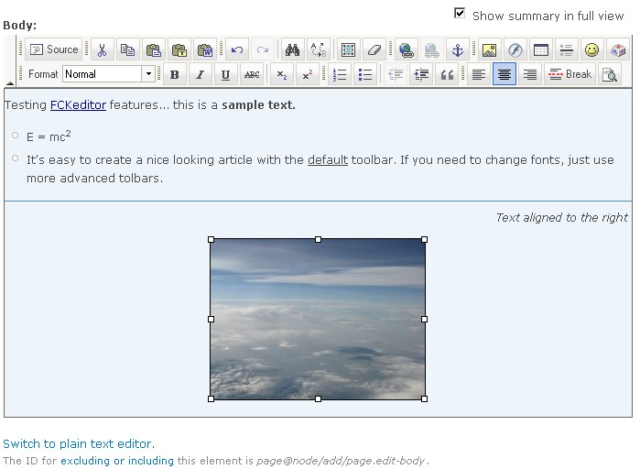
Stories
We want users who don’t know HTML to be able to add game stories, event updates, etc
Install FCKeditor
We want to be able to include images in the game stories
Install IMCE

Slide 50
Comments
Users (with permission) can add comments to pages
Spam vs. Ham?
Mollom
Auto-delete spam identified by stats of millions of other blots’ content
Also blocks spam in contact form, nodes, user registration forms, etc.
Displays captcha in questionable cases
Can also delete low-quality, abusive content (flames)

Slide 51
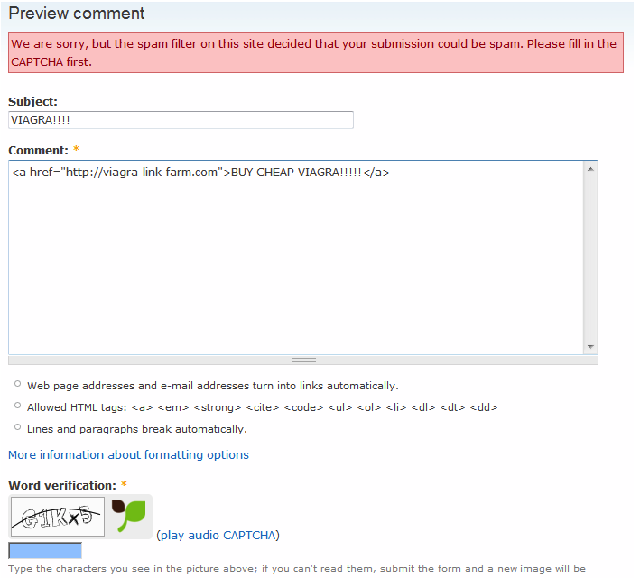

Slide 52
