Slide 1
Hypertext Transfer Protocol
Information Systems 337
Prof. Harry Plantinga
Notes:
How does HTTP work? Steps?

Slide 2
HTTP
Try this:
telnet calvin.edu 80
get / HTTP/1.0
Basic protocol:
Server waits for connection requests on a port (default 80)
Client connects to server
Client sends request (GET, HEAD, PUT, etc.) with header
Server sends response header and document
Server closes connection
Watch with firebug!

Slide 3
HTTP Methods
Available HTTP request methods:
GET -- get a file
HEAD -- identical to GET, but returns header only
POST -- used to send to the server, e.g. post a message
PUT -- upload a file at specified URI
DELETE --- delete a file
OPTIONS -- request for info about available communication options

Slide 4
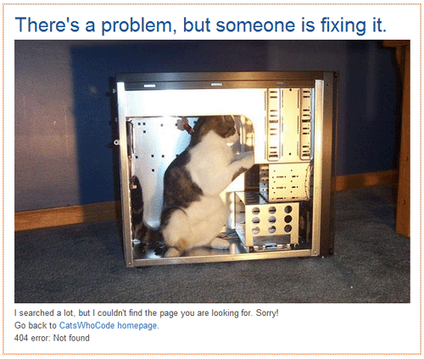
Response Status Codes
Common status codes:
200 OK
206 Partial Content (request specified Range: header)
301 Moved Permanently (fetch Location: header)
302 Moved Temporarily
304 Not Modified
403 Forbidden
404 Not Found
500 Server Error
Notes:
What's a 404? 404 not found? Have you heard anyone say antying like that?

Slide 5
Interesting Headers
Authorization: used to request restricted documents
Range: get part of a document
Referer [sic]:
User-Agent:
Content-Encoding:
Etag:
Last-Modified:
Location:
Refresh:
Notes:
Refresh: eg <meta http-equiv="refresh" content="5; url=http://example.com/"> [but back button may not work correctly]
Etag = entity tag. If it's the same, you can use the cached version. E.g. a hash of a file. Server may send back a 304 Not Modified on the next request (including etag) if file is unmodified.

Slide 6
HTTP Proxies
A server could receive a request to another server, fetch it, and return it
GET http://www.somehost.com/path/file.html HTTP/1.0
Called a "proxy"
Example uses:
firewall
cache
Bess
getting around Bess

Slide 7
Location
Maintain URLs so links don't break
301 Moved Permanently
Try http://www.ccel.org/t/theo_ger
See julian:/srv/ccel.org/htdocs/.htaccess
Mod_rewrite: keep those old URLs working
How could you write a Web page that causes another Web page to load?
<meta http-equiv="refresh" content="0;url=hplantin/">

Slide 8
Forms
<form name="input" action="name.php" method="get"> Userame: <input type="text" name="user" /> <input type="submit" value="Submit" /> </form>
What does action mean?
Send this form's data along with a request for another page
What does method mean?
Use HTTP get (or post)

Slide 9
Forms Methods
GET
Send forms parameters in URL, e.g. GET http://example.com/form.php?user=hplantin&pwd=123
POST
Send forms parameters with a POST method.
Not visible in URL. E.g
POST /example.com/form.php HTTP/1.0
[client headers here]
user=hplantin&pwd=123

Slide 10
Cookies
What are cookies used for?
How cookies work:
Server sends a Set-Cookie header in its response
Client is expected to store the cookie on disk, along with the URL that assigned it
In subsequent requests to that URL, client sends along the cookie with the Cookie header
Cookies and Flash, HTML5 – new evilness!

Slide 11
Cookie Example
Client request:
POST /www.whosis.com/order.pl HTTP/1.0
[client headers here]
Type=new&firstname=Harry&lastname=Plant
Server Response
HTTP/1.0 200 OK
[server headers here]
Set-Cookie: acct=01234567
Cookie file
www.whosis.com/order.pl acct=01234567
Next client request
GET /www.whosis.com/order.pl
[client headers here]
Cookie: acct=01234567

