Slide 1
Classic Seminars
Course
Advanced Project Risk Management
For project managers
Training material copyright by Classic Seminars (2017)

Slide 2
Agenda (Section 2)
Thinking about risk
Beyond PMBOK®
Management
Beyond PMBOK®
Tool example
5Aug17
1992 / 2006

Slide 3
Exercise: ability to manage risk
In groups
Discuss what you consider to be the most important abilities a project manager should have to manage risks
How can these abilities be developed?
Summarise your conclusions, be ready to discuss
Agree time allocation
Debriefing

Slide 4
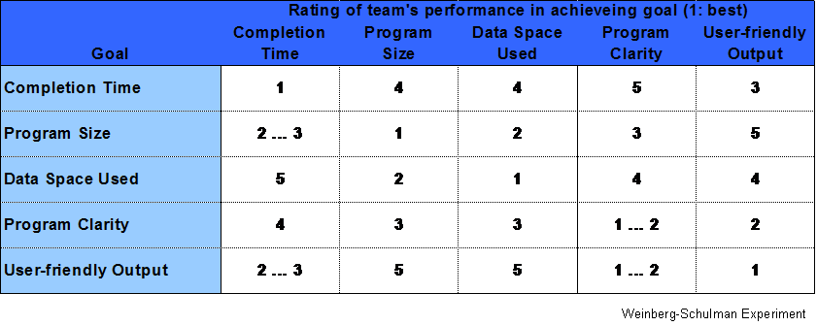
Our ability to meet multiple objectives

Slide 5
Taleb’s black swan
Mediocristan vs. Extremistan
The impact of outliers
Average weight
Average income
Deterministic vs. randomness
The role of quantitative techniques
Physical vs. social sphere
Identifying black swans
Events are a surprise
Events have major impact
Events can be rationalised by hindsight, as if they could have been predicted
The role of sentiment
Is it
Deterministic
Socially-bound

Slide 6
Agenda (Day 2)
Thinking about risk
Beyond PMBOK®
Management
Beyond PMBOK®
Tool example

Slide 7
Example: probability scheme
Probability Chance Rank
Very high: occurrence is almost certain >= 1 in 2 10
1 in 3 9
High: repeated occurrences possible 1 in 8 8
1 in 20 7
Moderate: occasional occurrences 1 in 80 6
1 in 400 5
1 in 2,000 4
Low: relatively few occurrences 1 in 15,000 3
1 in 150,000 2
Remote: occurrence is unlikely <= 1 in 1,500,000 1

Slide 8
Example: impact scheme
Effect Criteria Rank
Hazardous, no warning Project severely impacted, possible cancellation, no warning 10
Hazardous, with warning Project severely impacted, possible cancellation, with warning 9
Very high Major impact on project schedule, budget or performance; 8
may cause severe delays, overruns, or degradation of performance
High Project schedule, budget, or performance impacted significantly 7
job can be completed, but customer will be very dissatisfied
Moderate Project schedule, budget, or performance impacted some, 6
customer will be dissatisfied
Low Project schedule, budget, or performance impacted slightly 5
customer will be mildly dissatisfied
Very Low Some impact to project, customer will be aware of impact 4
Minor Small impact to project, average customer will be aware of impact 3
Very Minor Impact so small that it would be noticed only by a very 2
discriminating customer
None No effect 1
?

Slide 9
Classification examples
Level
Deliverable Potentially Impacted
Milestone Potentially Impacted
Project Level Impact
Programme Level Impact
Enterprise Objectives Impacted
Enterprise Strategy Impacted
Effect
Cosmetic
Bad Data
Bad Output
Bad Performance
Loss of Data
Work Efficiency Affected
Loss of Function
Loss of System
Loss of Service
Passive Security Breach
Active Security Breach
Malicious Security Breach

Slide 10
Classification examples
Severity
No Functionality Impaired
Cosmetic problem
Possibility of misunderstanding
Incorrect Results may be Produced
Simple Workaround Possible
Difficult Workaround Possible
Individual Level Function Impaired
Work Group Level Function Impaired
Division Level Function Impaired
Enterprise Level Function Impaired
Significant Cost of Failure
Strategy Impaired
Customer Service Level Impacted
Contravention of Law
Going Concern Affected
Human Misery Results
Loss of Life
Failure category
Will not fail - cosmetic issue
Will fail under unusual circumstances only
Will fail, but workaround possible
Will fail, difficult workaround possible
Will Fail, now workaround possible
Target
Operation at Risk
Quality at Risk
Functionality at Risk
Schedule at Risk
Cost at Risk

Slide 11
Case: homeland security principles
Effective risk management
Unity of effort
Enterprise-wide
Synchronisation
Integration
Transparency
Communication
Adaptability
Dynamic
Responsive
Practicality
Not all risks can be eliminated
Customisation
Tailoring
Cultural awareness
Balance

Slide 12
Agenda (Day 2)
Thinking about risk
Beyond PMBOK®
Management
Beyond PMBOK®
Tool example

Slide 13
Futrell, Robert T; et al. Quality Software Project Management. Software Quality Institute. 2002.
Charette, Robert. Application Strategies for Risk Management. McGraw-Hill. 1990.
Lewis, James. The Project Manager’s Desk Reference. McGraw-Hill. 2000.
Murch, Richard. Project Management. Prentice Hall. 2001.
Phillips, Dwayne. The Software Project Managers Handbook. IEEE Computer Society. 1998.
Hallows, Jolyon. Information Systems Project Management. Amacom. 1998.
Kerzner, Harold. Project Management. John Wiley. 2003
Krolak, Dale. Software Engineering Risk Management. IEEE Computer Society. 1996.
Boehm, Barry. Software Risk Management. IEEE Computer Society. 1989.
Wideman, Max. Project and Program Risk Management. PMI. 1992.
De Marco, Tom. Lister, Tim. Waltzing the Bears. Dorset House. 2003.
Jones, Capers. Assessment and Control of Software Risks. Yourdon Press. 1994.
A Guide to the Project Management Body of Knowledge. PMI. 2000.
Hohman, Luke. The Journey of the Software Professional. Prentice-Hall. 1997.
Brassard, Michael. Ritter, Diane. Memory Jogger II. Goal/QPC. 1994.
Brassard, Michael. Ritter, Diane. The Creativity Tools Memory Jogger II. Goal/QPC. 1998.
www.keirsey.com
Montgomery, Stephen. People Patterns. Prometheus Nemesis. 2002.
Keirsey, David. Please Understand Me II. Prometheus Nemesis. 1998

